Slide 1
Agenda
Welcome from the Skyline team!
PRM Targeted Proteomics Using Full-Scan MS2
Introduction with Brendan MacLean
PRM Introduced by Bruno Domon – PRM Researcher
Tutorial with Brendan MacLean
  Workflow overview
  Data processing tutorial
Audience Q&A – submit questions to Google Form:
http://tinyurl.com/QA4Skyline (also in chat window)

Slide 2
Parallel Reaction Monitoring Synonyms
MRM-HR™
Targeted MS/MS (MacLean, ASMS 2011) - tMSMS
Psuedo-SRM (Sherrod, JPR 2012)
PRM (Peterson, MCP 2012)
More mass spectrometry synonyms
http://tinyurl.com/ms-synonyms

Slide 3
Chromatography-based Quantification
Hypothesis testing (Verification)
SRM
MS1 chromatogram extraction
PRM
Data independent acquisition (DIA/SWATH)
Acquisition | Targeted | Survey
More Selective | PRM | DIA
Less Selective | SRM | MS1
Got HYPOTHESIS

Slide 4
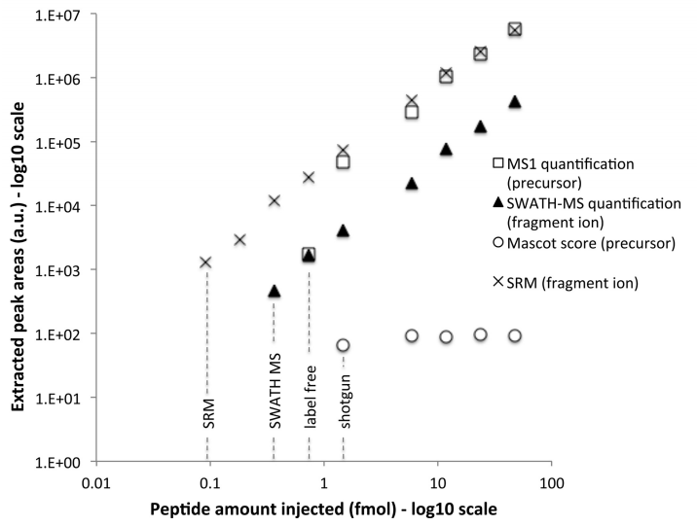
Dynamic Range for PRM?
PRM?
MS1
Gillet, et. al, MCP 2012

Slide 5





Multiple Instrument Vendors

Slide 6
Webinar 1: DDA Workflow Overview
DDA Acquisition
Spectrum Matching
Chromatogram Extraction
Spectral Library
Building
iRT Library
Building
Quantitative
Analysis
Product Ion
Targeting

Slide 7
Webinar 2: DIA Workflow Overview
DDA Acquisition
DIA Acquisition
Product Ion
Targeting
Spectrum Matching
Spectral Library
Building
Chromatogram Extraction
Quantitative
Analysis

Slide 8
DIA Prior Knowledge Workflow
DIA Acquisition
Spectral Library
Relative Ion Abundance
iRT Library
Normalized RT
Product Ion
Targeting
Chromatogram Extraction
Quantitative
Analysis

Slide 9
Label-Free PRM Workflow Overview
Precursor Ion
Targeting
Spectral Library
Relative Ion Abundance
iRT Library
Normalized RT
PRM Acquisition

Slide 10
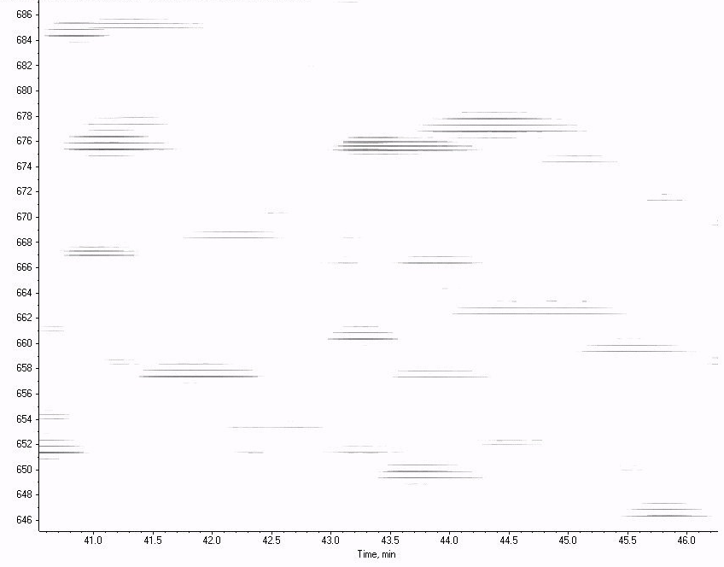
PRM Acquisition
Mass
Analyzer
Q1 / Trap
CID
Ion
Source
2 m/z isolation
m/z
mass
MS2 intensity
time
MS2 intensity
time
MS2 intensity
retention time
time

Slide 11
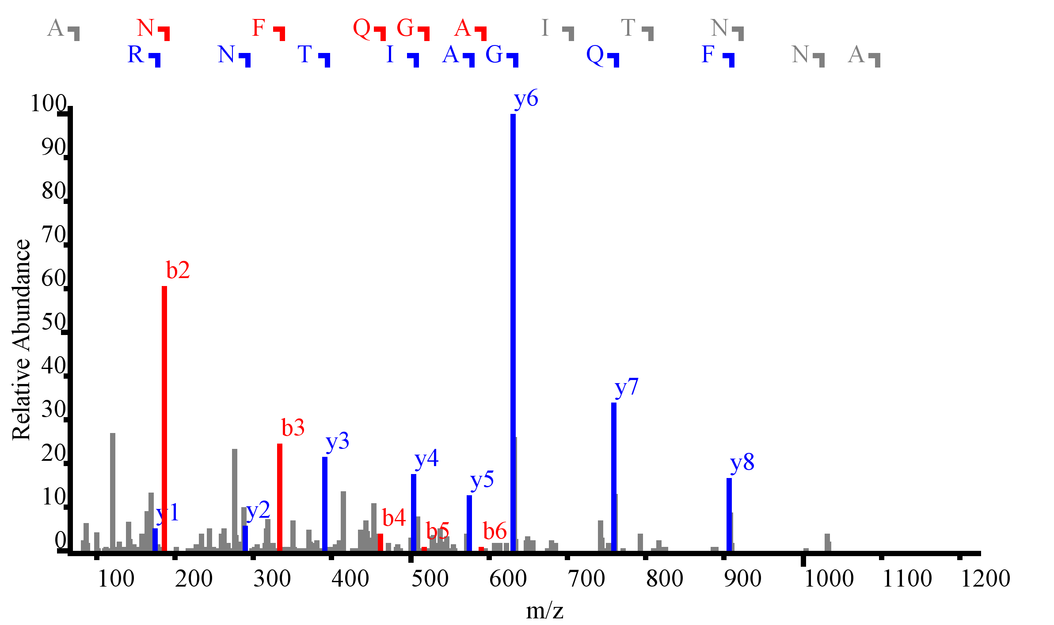
Product Ion Selectivity (PRM and DDA)
2 m/z
ANFQGAITNR
Notes:
Show the spectrum, and the chromatogram
Even with DDA >30% of the spectra are mixed
Quantitation can be limited by interference, show 10 m/z vs. 20 m/z (from overlap experiment)
Spectrum and chromatogram from loq data on a yeast background peptide

Slide 12
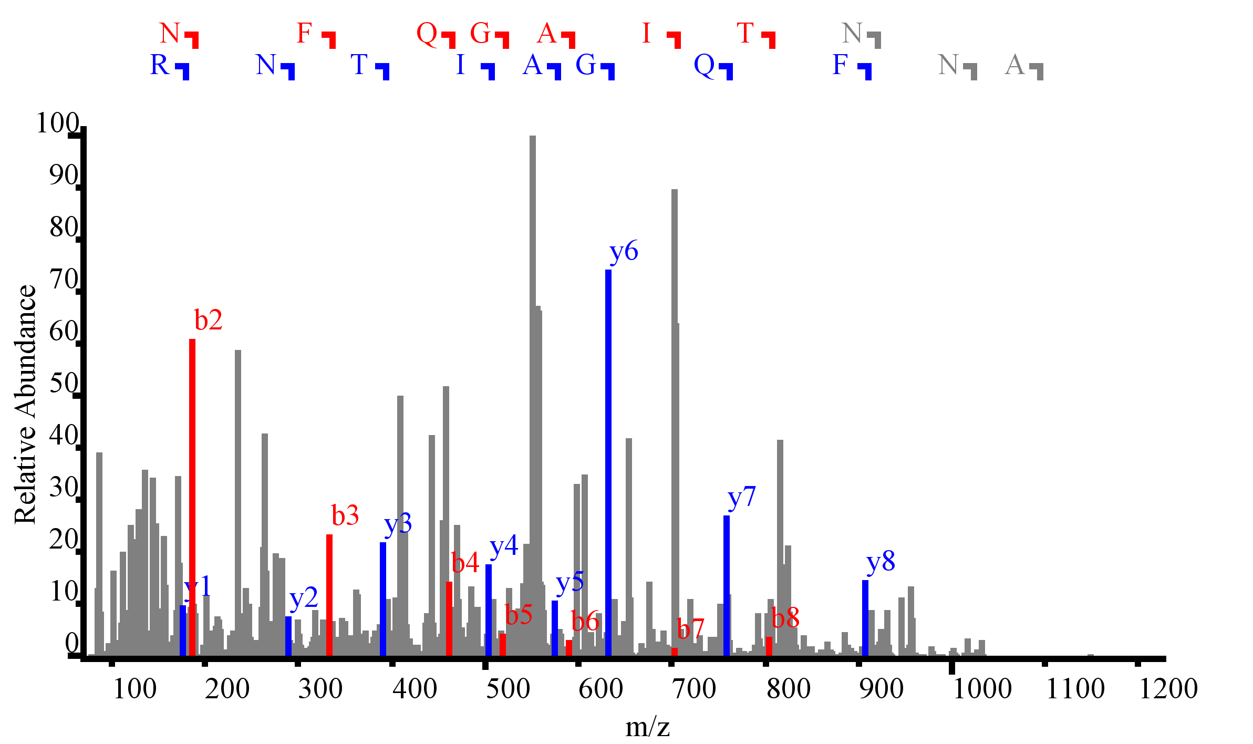
Product Ion Selectivity (DIA)
20 m/z
ANFQGAITNR
Notes:
Show the spectrum, and the chromatogram
Even with DDA >30% of the spectra are mixed
Quantitation can be limited by interference, show 10 m/z vs. 20 m/z (from overlap experiment)
Spectrum and chromatogram from loq data on a yeast background peptide

Slide 13
Label-Free PRM Workflow Overview
Precursor Ion
Targeting
Spectral Library
Relative Ion Abundance
iRT Library
Normalized RT
PRM Acquisition
Spectrum Matching

Slide 14
Label-Free PRM Workflow Overview
Precursor Ion
Targeting
Spectral Library
Relative Ion Abundance
iRT Library
Normalized RT
PRM Acquisition
Spectrum Matching
Spectral Library
Building
Product Ion
Targeting

Slide 15
Label-Free PRM Workflow Overview
Precursor Ion
Targeting
Spectral Library
Relative Ion Abundance
iRT Library
Normalized RT
Chromatogram Extraction
PRM Acquisition
Spectrum Matching
Quantitative
Analysis
Spectral Library
Building
Product Ion
Targeting

Slide 16
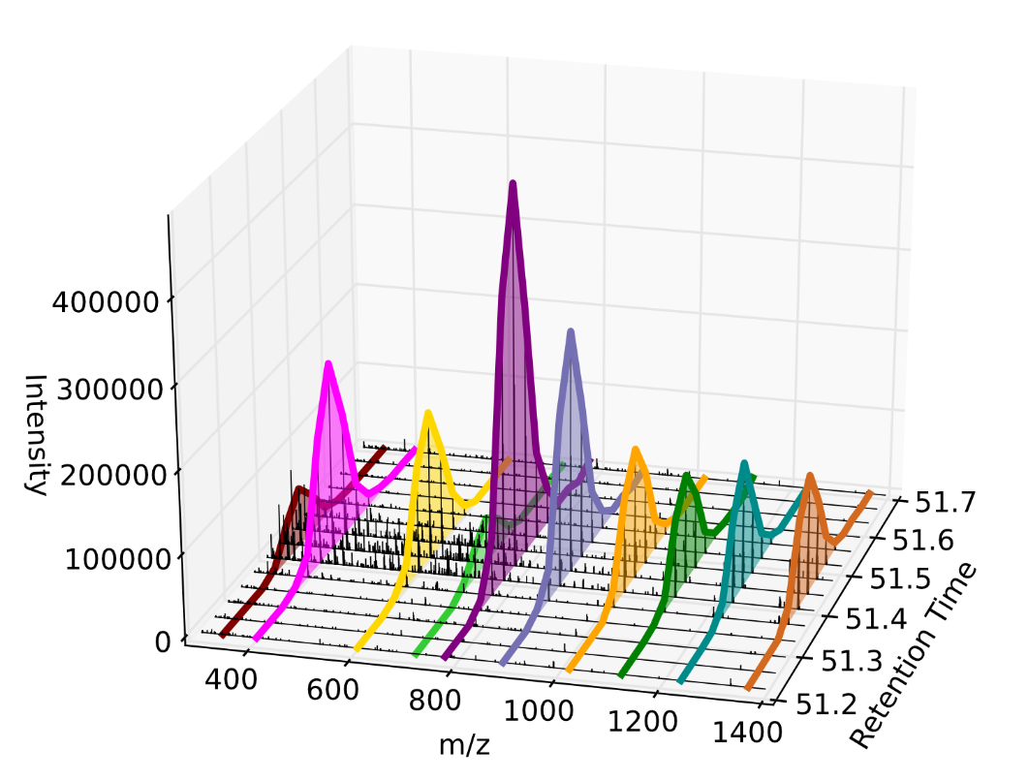
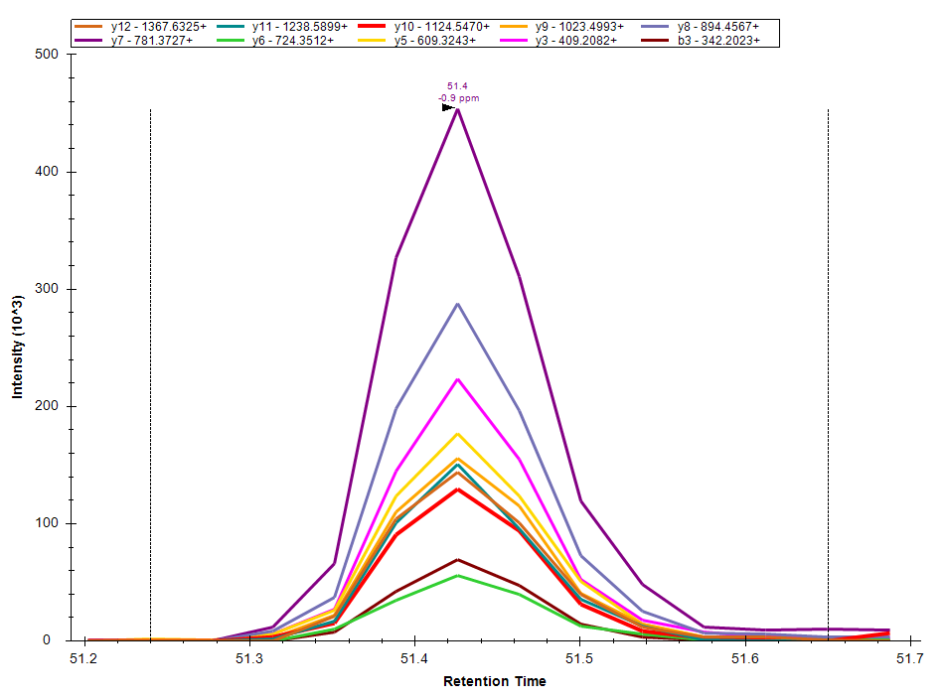
Extraction of Fragment Ions

Slide 17
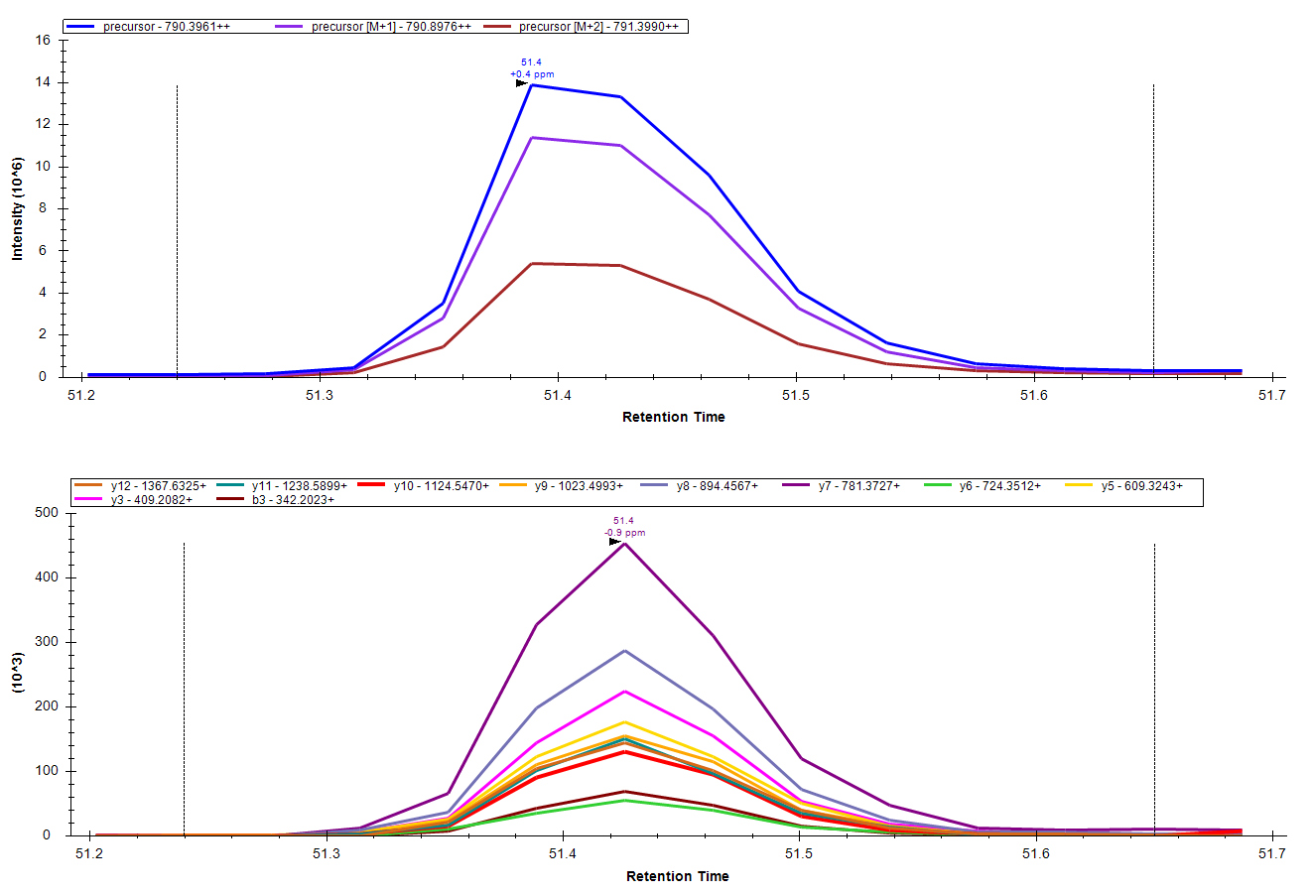
Precursor and Product Ion Information

Slide 18
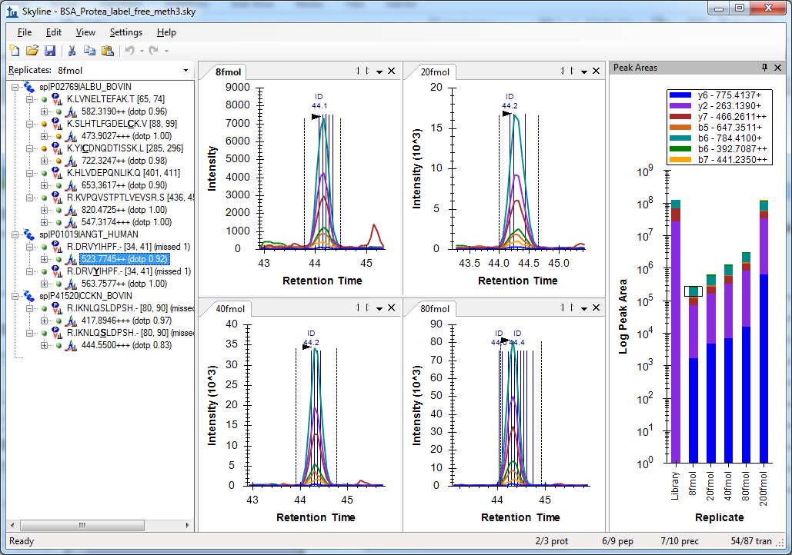
Peptide Search MS/MS from PRM
Sherrod, S. et al. J. Prot. Res. 2012.

Slide 19
Proving Peak ID in Label-Free PRM

Slide 20
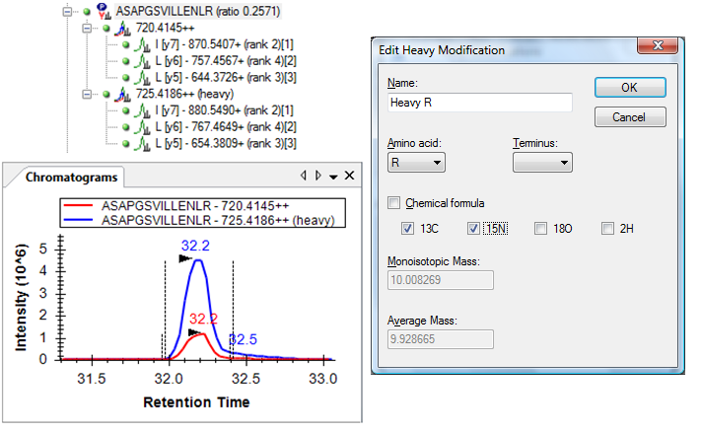
PRM with Labeled Internal Standards
Extensive support in Skyline

Slide 21
Labeled PRM Workflow Overview
Spectral Library
Relative Ion Abundance
Ion Targeting
iRT Library
Normalized RT
PRM Acquisition
Chromatogram Extraction
Quantitative
Analysis

Slide 22
Tutorial
Basic PRM Data Analysis

Slide 23
Learn More
Webinar #4: Tuesday, Feb. 10th – Targeted Method Design
Workshops at US HUPO and ASMS
Weeklong Course in Northeastern University, Boston
  May 18-22
Weeklong Course at ETH, Zurich
  June 22-26
Weeklong Course at PRBB, Barcelona
  November 15-20
More… TBA

Slide 24
Questions?
Ask any questions you have on the topic of PRM experiments with Skyline.
http://tinyurl.com/QA4Skyline
Take the post-webinar survey:
http://tinyurl.com/Survey4Webinar

Slide 25
Tutorial Webinar #3
This ends this Skyline Tutorial Webinar.
Please give us feedback on the webinar at the following survey:
http://tinyurl.com/ocbnzfv
A recording of today’s meeting will be available shortly at the Skyline website.
We look forward to seeing you at a future Skyline Tutorial Webinar.

