Slide 1
Quality Control Overview
Monitor instrument performance over time
Maintain history and capture context
For labs doing SRM, PRM, and DIA
Spike in controls
Run separate targeted QC samples (SRM or PRM)
For labs doing DDA
Run separate targeted QC samples (PRM)
Works with any instrument vendor/type
Inspired by Statistical Process Control in Proteomics (SProCoP), a Skyline external tool

Slide 2
Quality Control Folders
Fully automated workflow with AutoQC
New folder type within Panorama
Expected usage pattern is one folder per instrument
User interface focused on showing QC data
Levey-Jennings and Pareto plots
Not oriented around displaying specific Skyline documents

Slide 3
Basic Quality Control Workflow
Create Skyline document with the precursors/peptides/transitions to monitor
Typically a small number of peptides (10ish)
Run QC sample on instrument
Raw data file auto-loaded into Skyline document
Data automatically pushed to Panorama
View current data, identify issues
Repeat

Slide 4
Levey-Jennings Plots
Shows metric values over time
Retention time, peak area, etc
One plot/series per peptide
Date grouping and zooming

Slide 5
Guide Sets
Establish normal ranges for the assay
Training data
Find period of stable performance
Defined by start and end dates
Calculate mean and standard deviation
Future data is compared with training data
Can have multiple guide sets per folder

Slide 6
Annotations
Capture additional context about the data
Customizable, but typical annotations include:
Instrumentation changes
Reagent changes
Technician changes
Overlaid on Levey-Jennings plots
Helpful for correlating changes with causes

Slide 7
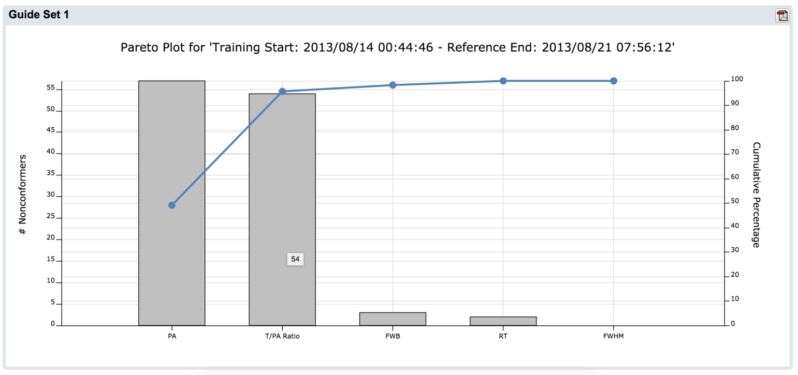
Pareto Plots
Highlight most common QC issues
One bar per metric
New in upcoming 15.3 release

Slide 8
Demo

Slide 9
Future Plans
Filter plots by other criteria
Lab tech
Study type
Cross-instrument dashboard
Monitor multiple folders at once
Highlight likely problems
Ensure QC data is flowing into Panorama
Improved statistical tools
Automated notifications

