Slide 1
Agenda
Welcome from the Skyline team!
Jump start DIA analysis with DDA data in Skyline
Introduction with Brendan MacLean
  Workflow overview
  Method overview and considerations
  Alternative workflows
Live tutorial with Jarrett Egertson – Contributor – DIA
Audience Q&A – submit questions to Google Form:
http://tinyurl.com/QA4Skyline (also in chat window)

Slide 2
Chromatography-based Quantification
Hypothesis testing (Verification)
SRM
MS1 chromatogram extraction
Targeted MS/MS (PRM)
Data independent acquisition (DIA/SWATH)
Acquisition | Targeted | Survey
More Selective | PRM | DIA
Less Selective | SRM | MS1
Got HYPOTHESIS??

Slide 3





Multiple Instrument Vendors

Slide 4
Webinar 1 Overview
DDA Acquisition
Spectrum Matching
Chromatogram Extraction
Spectral Library
Building
iRT Library
Building
Quantitative
Analysis
Product Ion
Targeting

Slide 5
Overview
DDA Acquisition
DIA Acquisition

Slide 6
Prior Knowledge and Consistency
Relative product ion abundance
  Spectral libraries
Retention time
  iRT libraries
Powerful enough to be used cross-lab / cross experiment
  Measure, store, re-use
More powerful run-to-run
Notes:
Confidence in what is being measured

Slide 7
Relative Product Ion Abundance

Slide 8
Retention Time
0.5
DDA run

Slide 9
Retention Time
0.5
DDA run

Slide 10
Retention Time
0.5
DDA run

Slide 11
Retention Time
4
DDA run
DDA run
DDA run
DDA run
DDA run

Slide 12
Data Independent Acquisition (DIA)
20 20 m/z-wide windows = 400 m/z
400
m/z
800
Notes:
Switch to 20, put in some MS1 scans
Usually 1,000 – 5,000 peptides identified by MS/MS
Usually ~25,000 – 50,000 MS features detected
2-20% of Features Annotated
BUT Usually only ~70% overlap in annotated features between runs

Slide 13
Data Independent Acquisition (DIA)
20 20 m/z-wide windows = 400 m/z
400
m/z
800
Scan 1
Notes:
Switch to 20, put in some MS1 scans
Usually 1,000 – 5,000 peptides identified by MS/MS
Usually ~25,000 – 50,000 MS features detected
2-20% of Features Annotated
BUT Usually only ~70% overlap in annotated features between runs

Slide 14
Data Independent Acquisition (DIA)
20 20 m/z-wide windows = 400 m/z
400
m/z
400
Scan 1
Scan 2
Notes:
Switch to 20, put in some MS1 scans
Usually 1,000 – 5,000 peptides identified by MS/MS
Usually ~25,000 – 50,000 MS features detected
2-20% of Features Annotated
BUT Usually only ~70% overlap in annotated features between runs

Slide 15
Data Independent Acquisition (DIA)
20 20 m/z-wide windows = 400 m/z
400
m/z
800
Scan 1
Scan 2
Scan 3
Scan 4
Scan 5
Scan 6
Scan 7
…
Scan 20
Scan 21
Notes:
Switch to 20, put in some MS1 scans
Usually 1,000 – 5,000 peptides identified by MS/MS
Usually ~25,000 – 50,000 MS features detected
2-20% of Features Annotated
BUT Usually only ~70% overlap in annotated features between runs

Slide 16
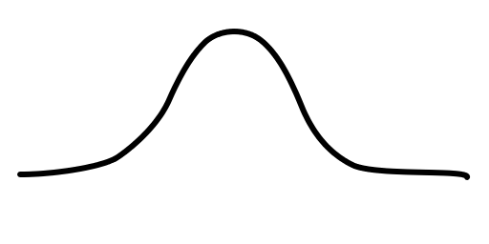
Data Independent Acquisition (DIA)
20 20 m/z-wide windows = 400 m/z
400
m/z
800
~2 seconds
Time
~30 seconds
Venable, J.D. et al. Nat. Meth. 2004. Gillet, L.C. et al. MCP 2012
Notes:
Add in MS1 scans here

Slide 17
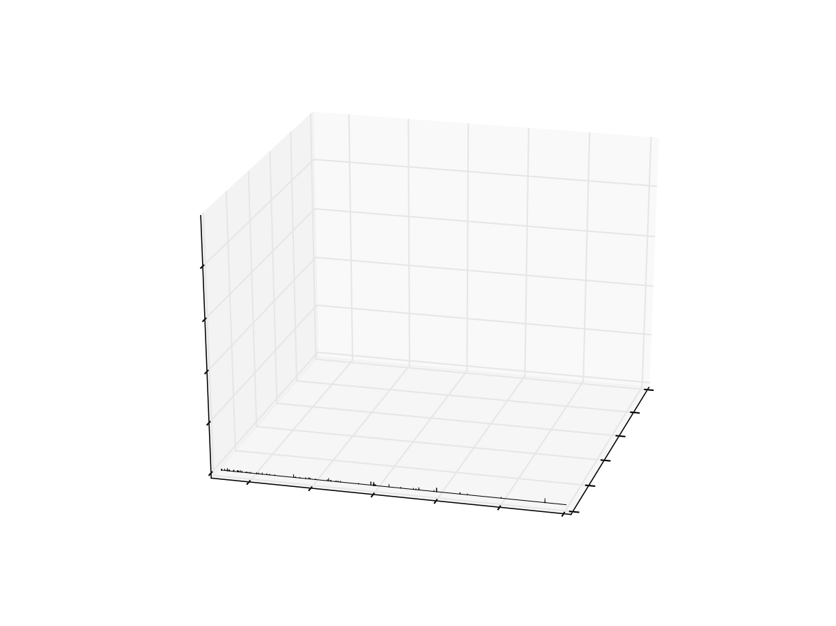
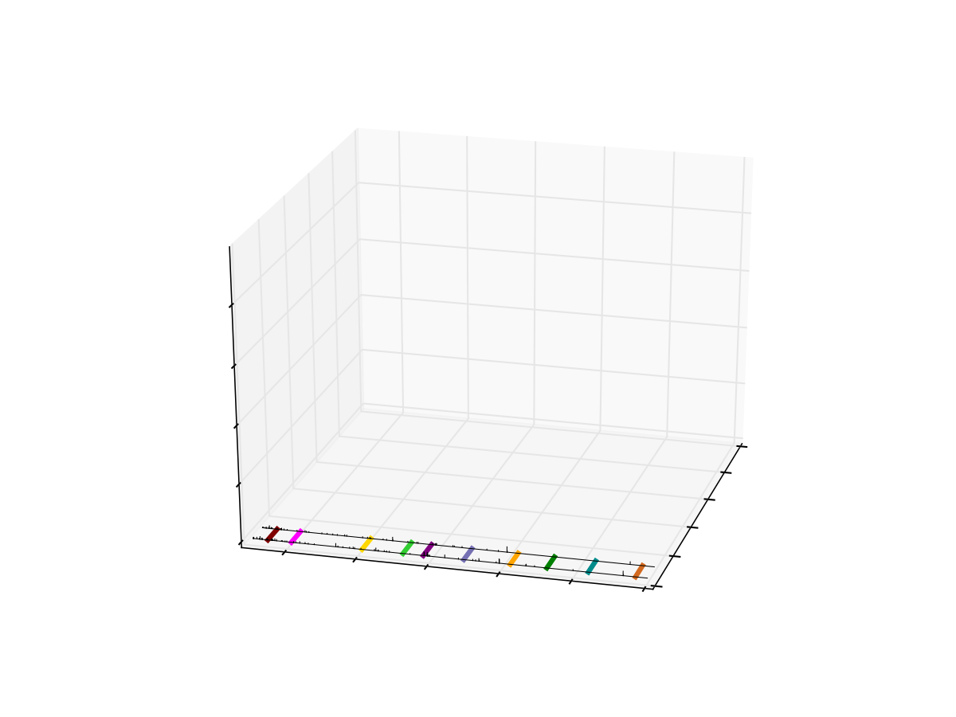
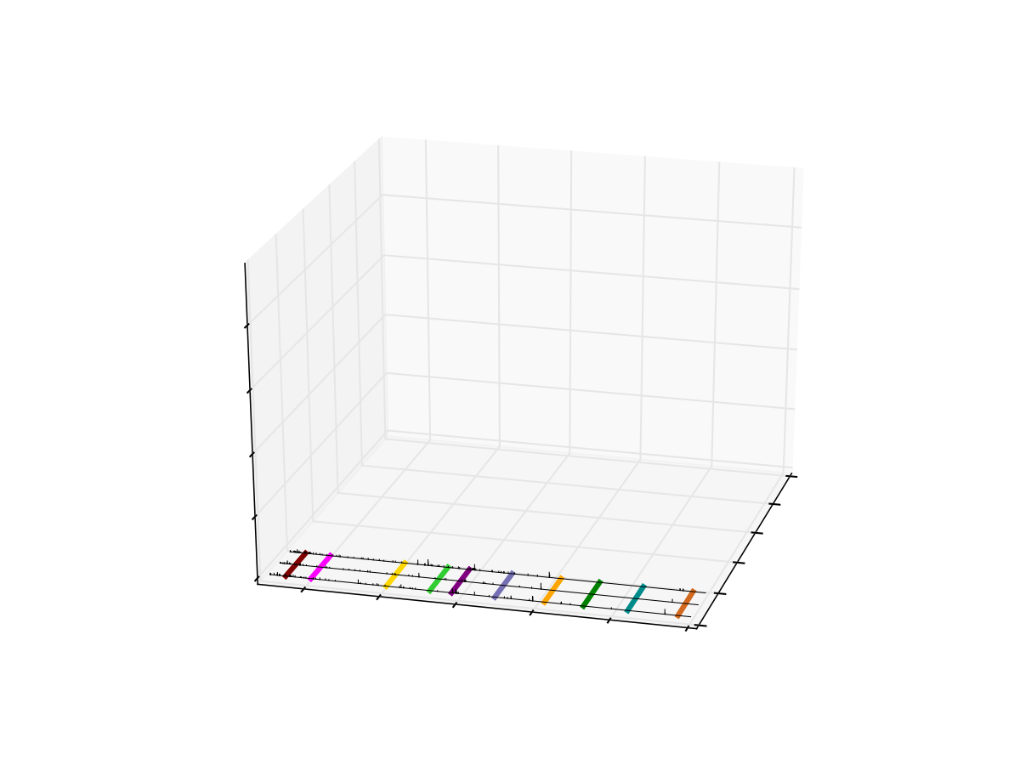
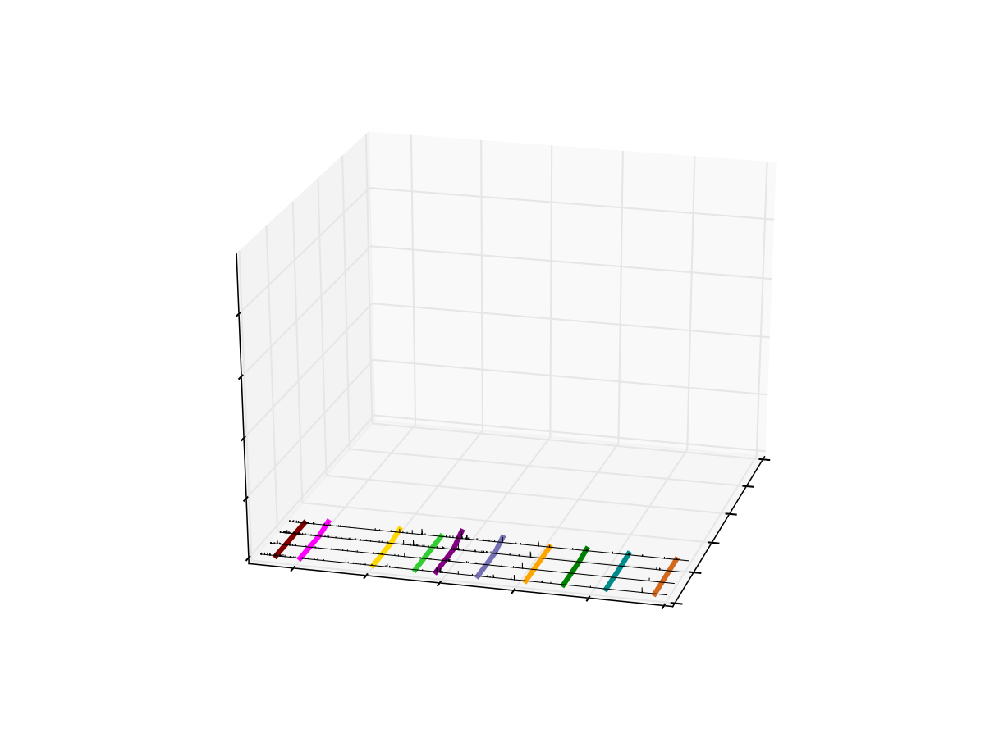
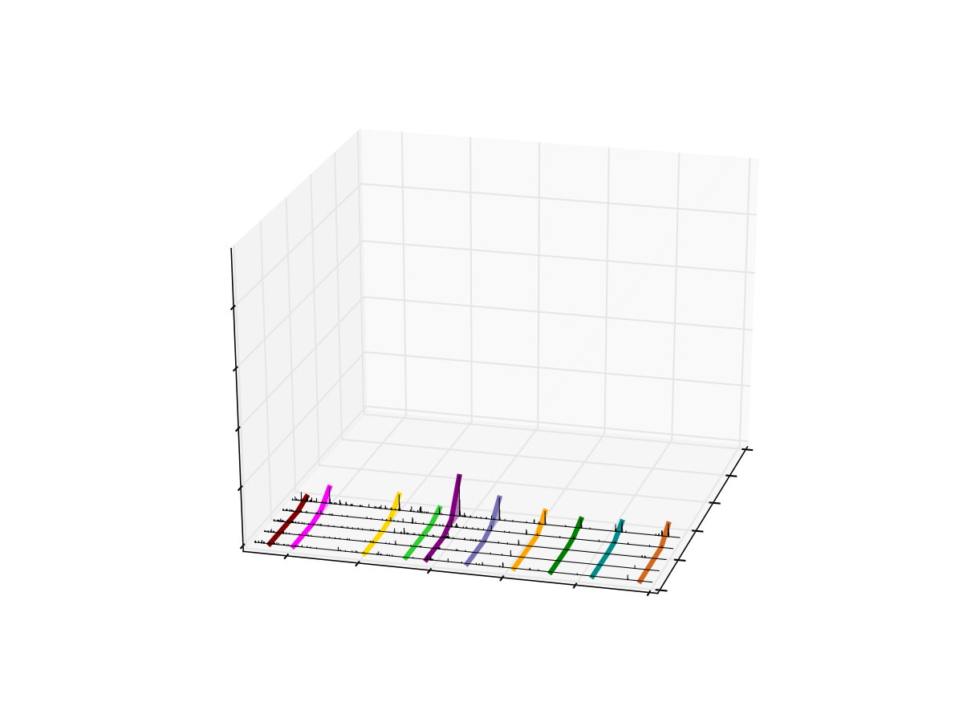
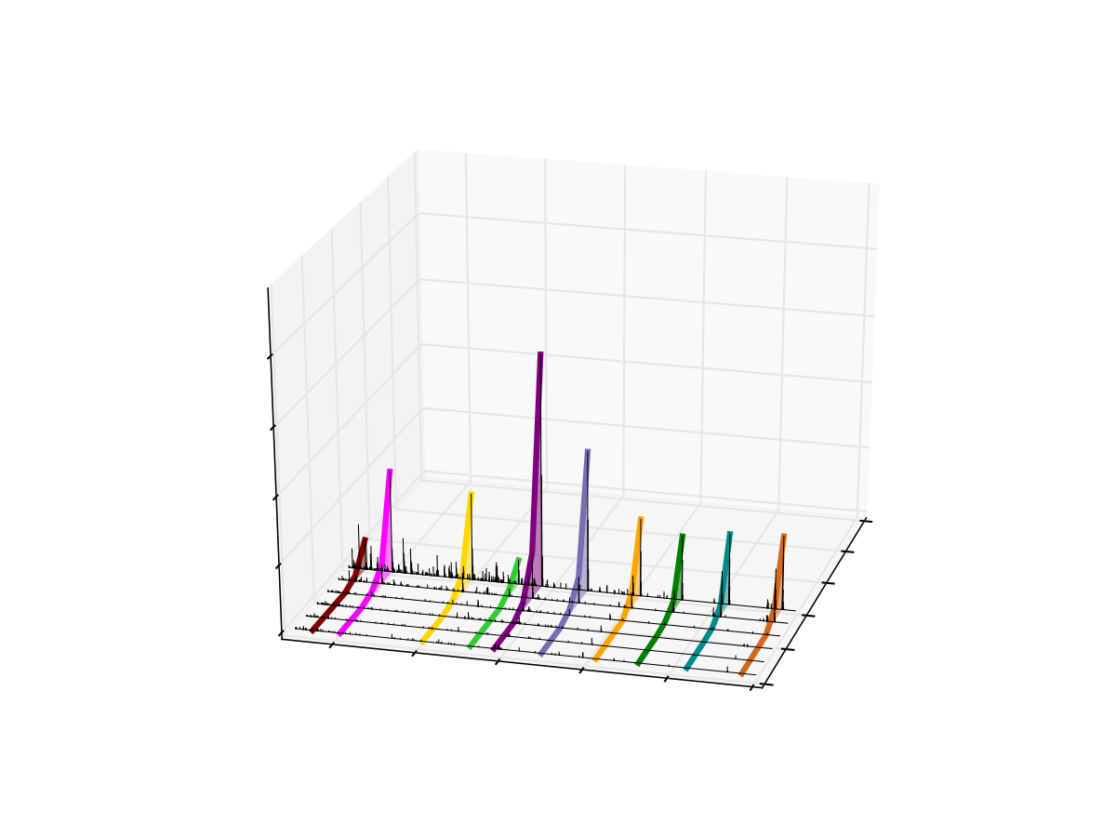
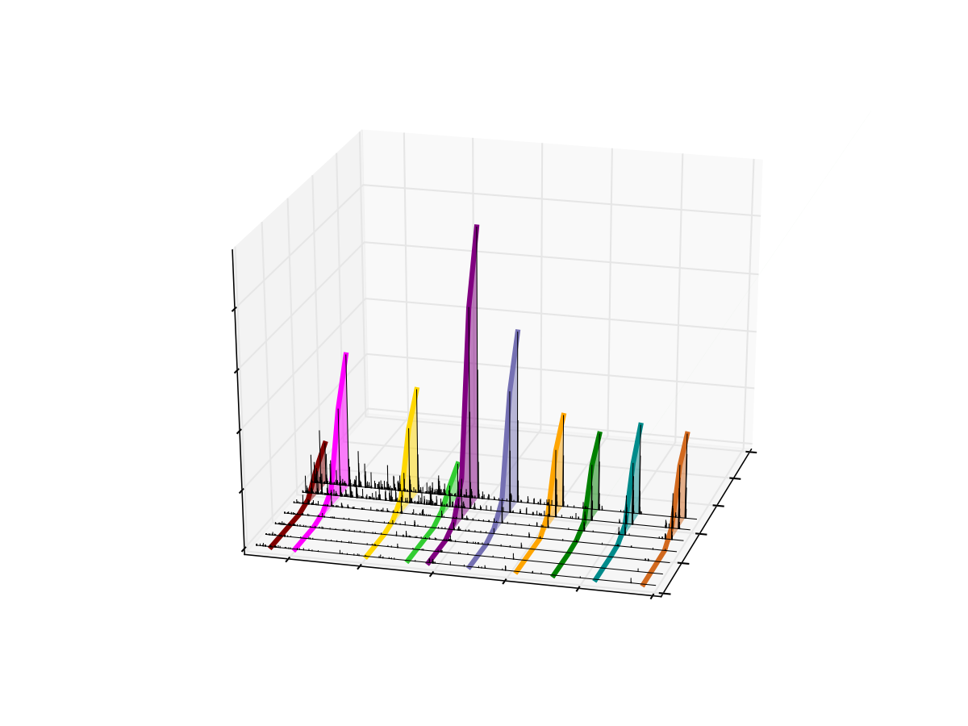
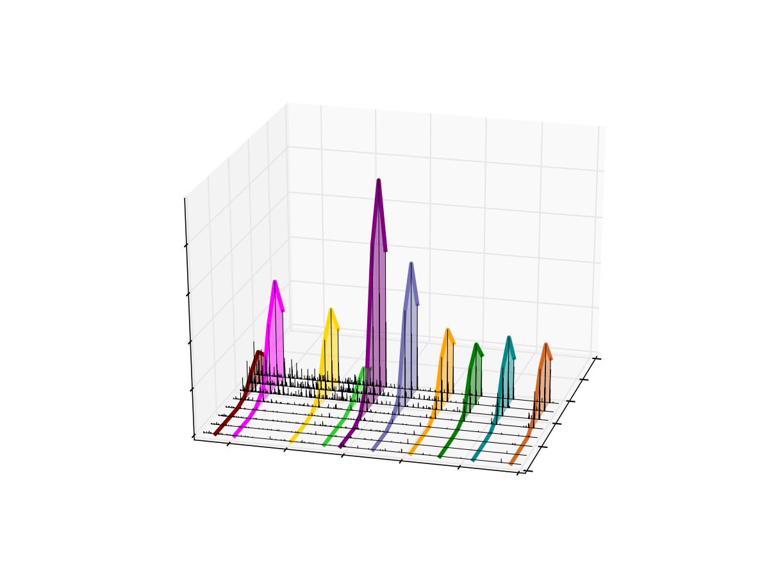
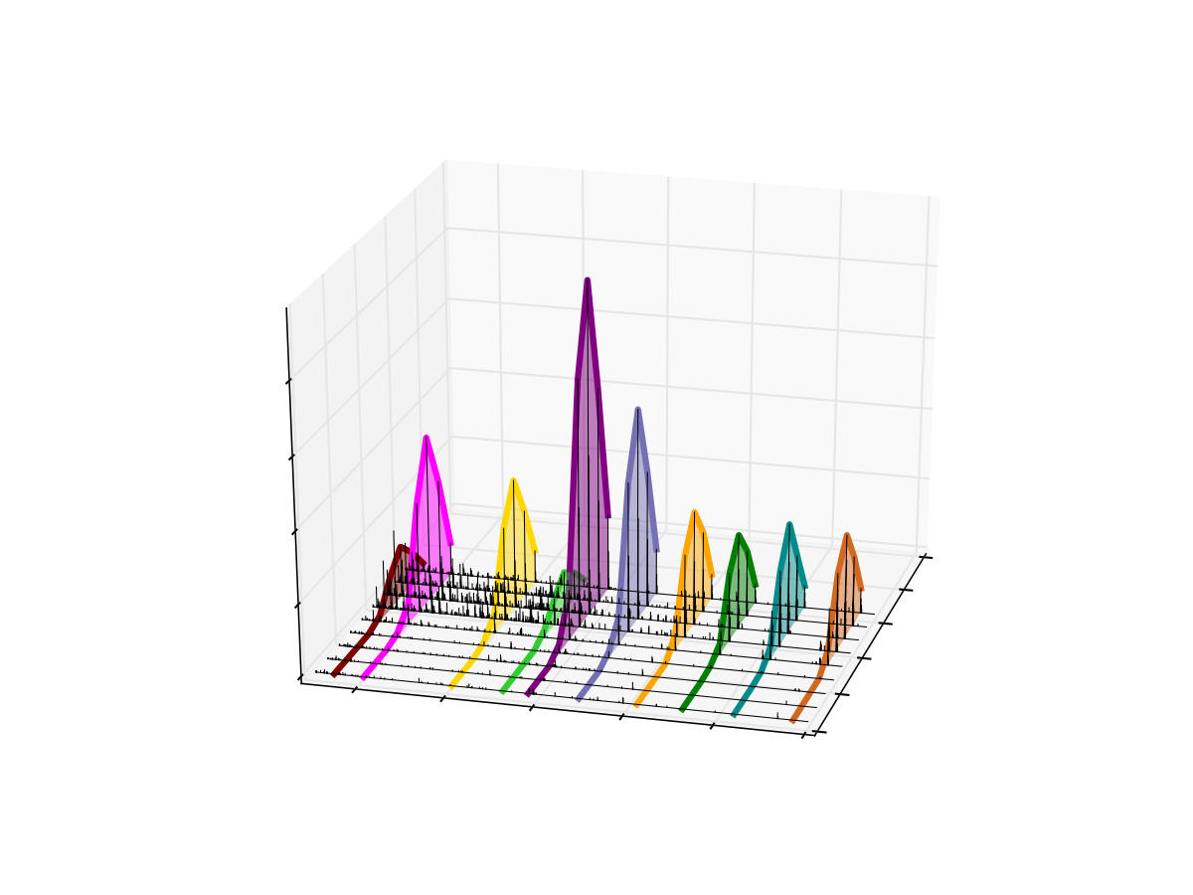
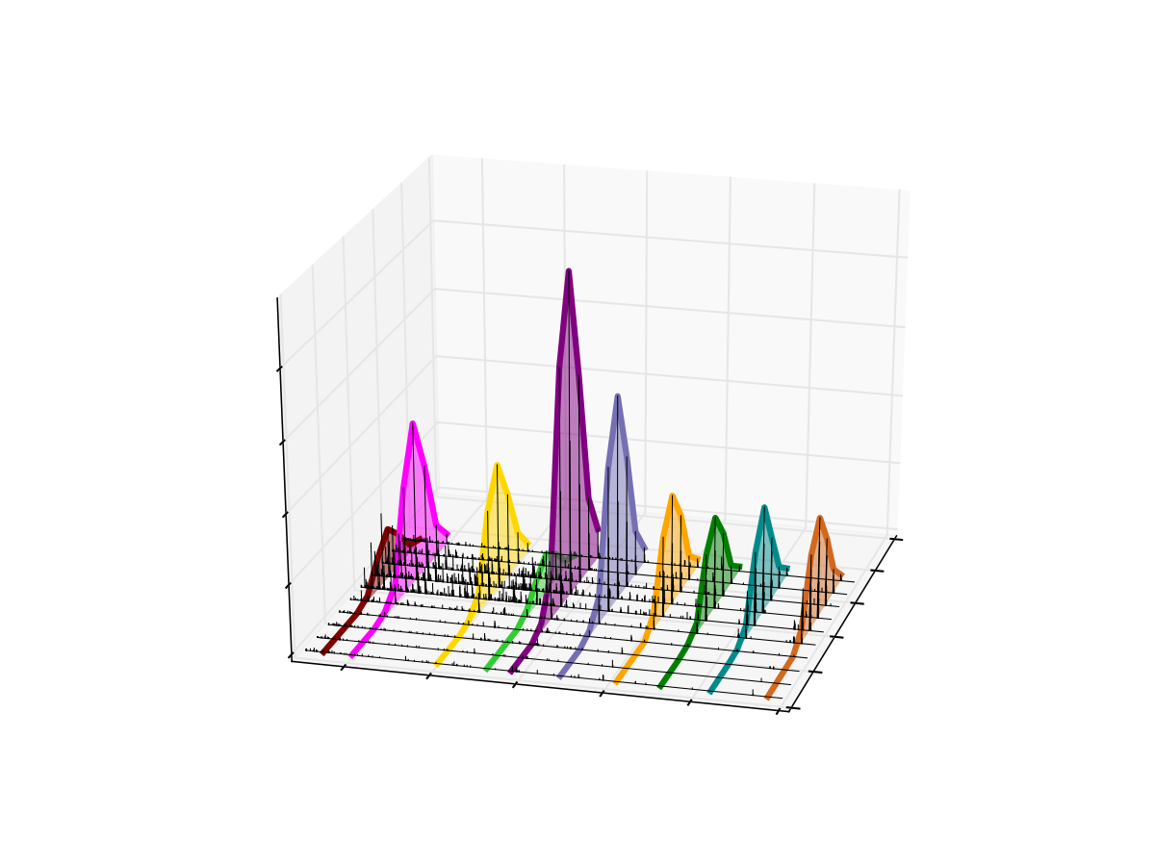
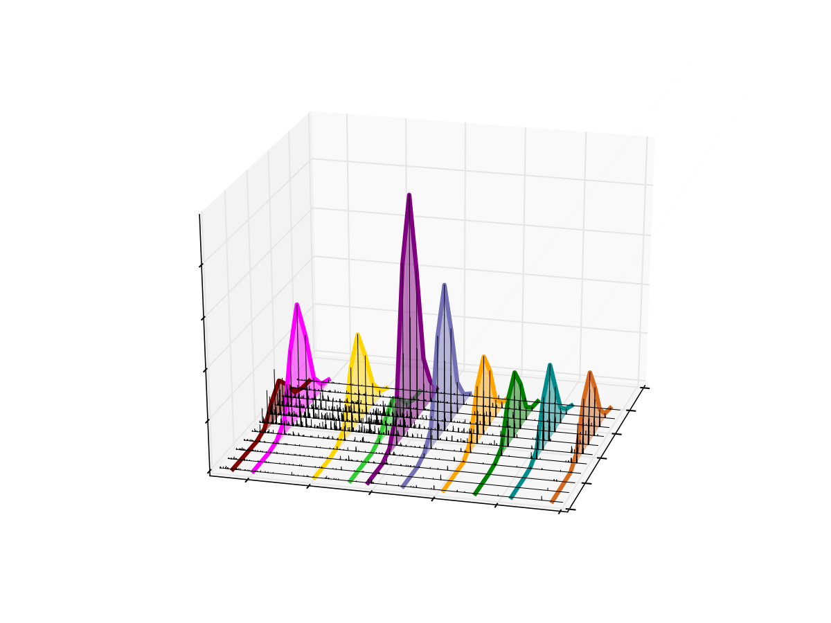

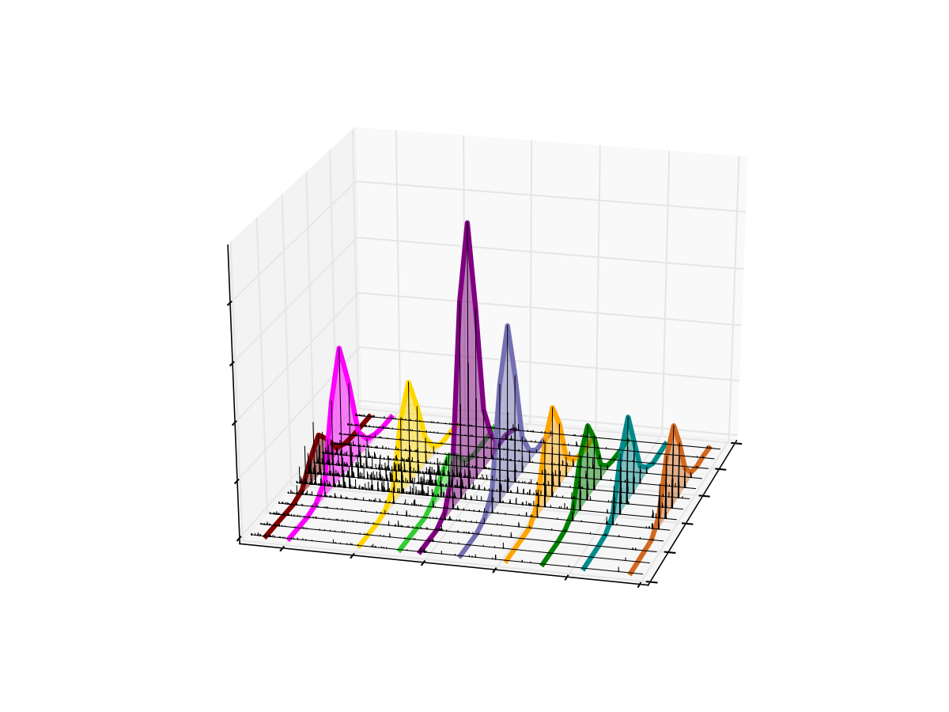
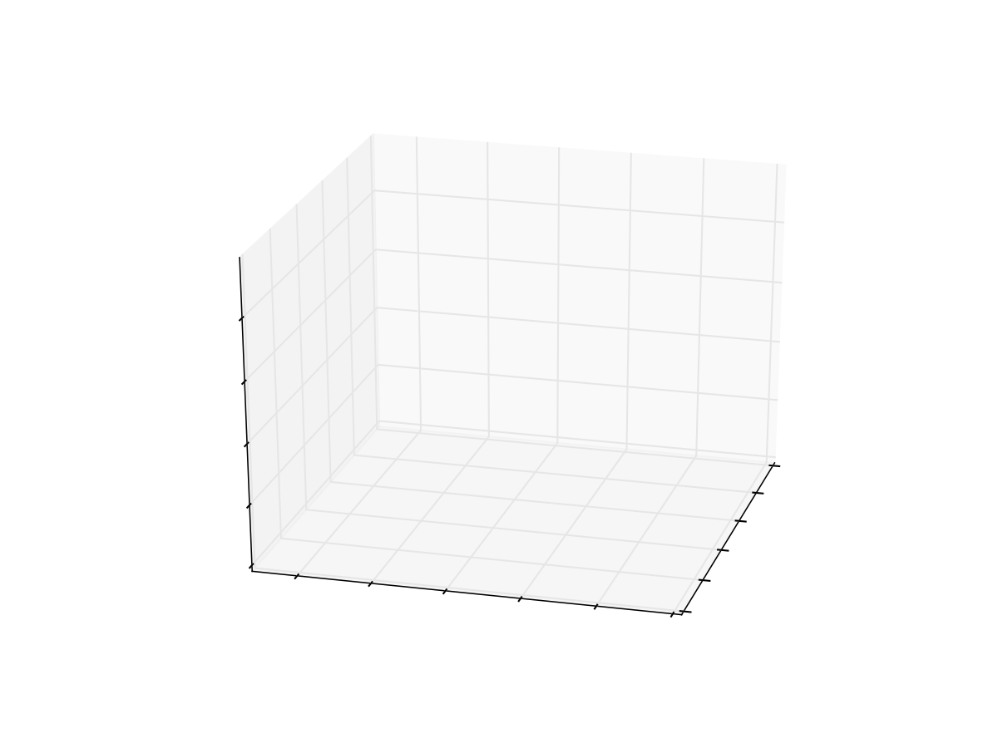
Extraction of Fragment Ions
500
m/z
900
4
3
Intensity x 10⁻⁵
2
51.7
51.6
1
51.5
51.4
0
Retention Time
400
51.3
600
800
1000
51.2
1200
1400
m/z

Slide 18
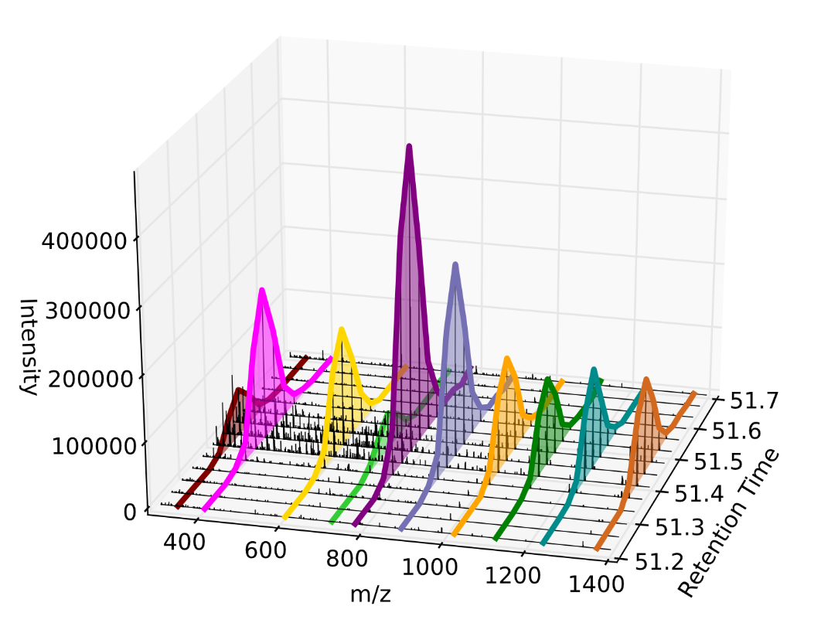
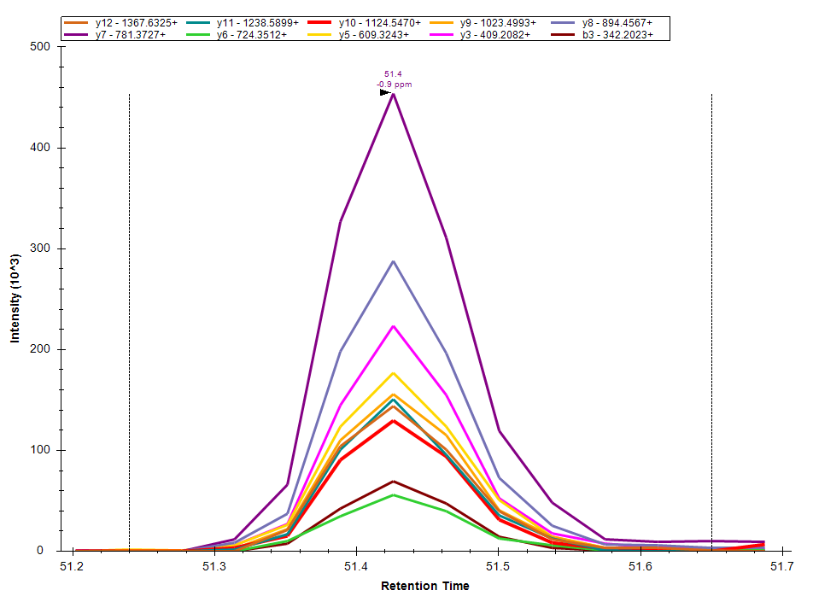
Extraction of Fragment Ions

Slide 19
Measuring Precursor Ions
20 20 m/z-wide windows = 400 m/z
400
m/z
800
MS Scan
~2 seconds
Time
Notes:
Add in MS1 scans here

Slide 20
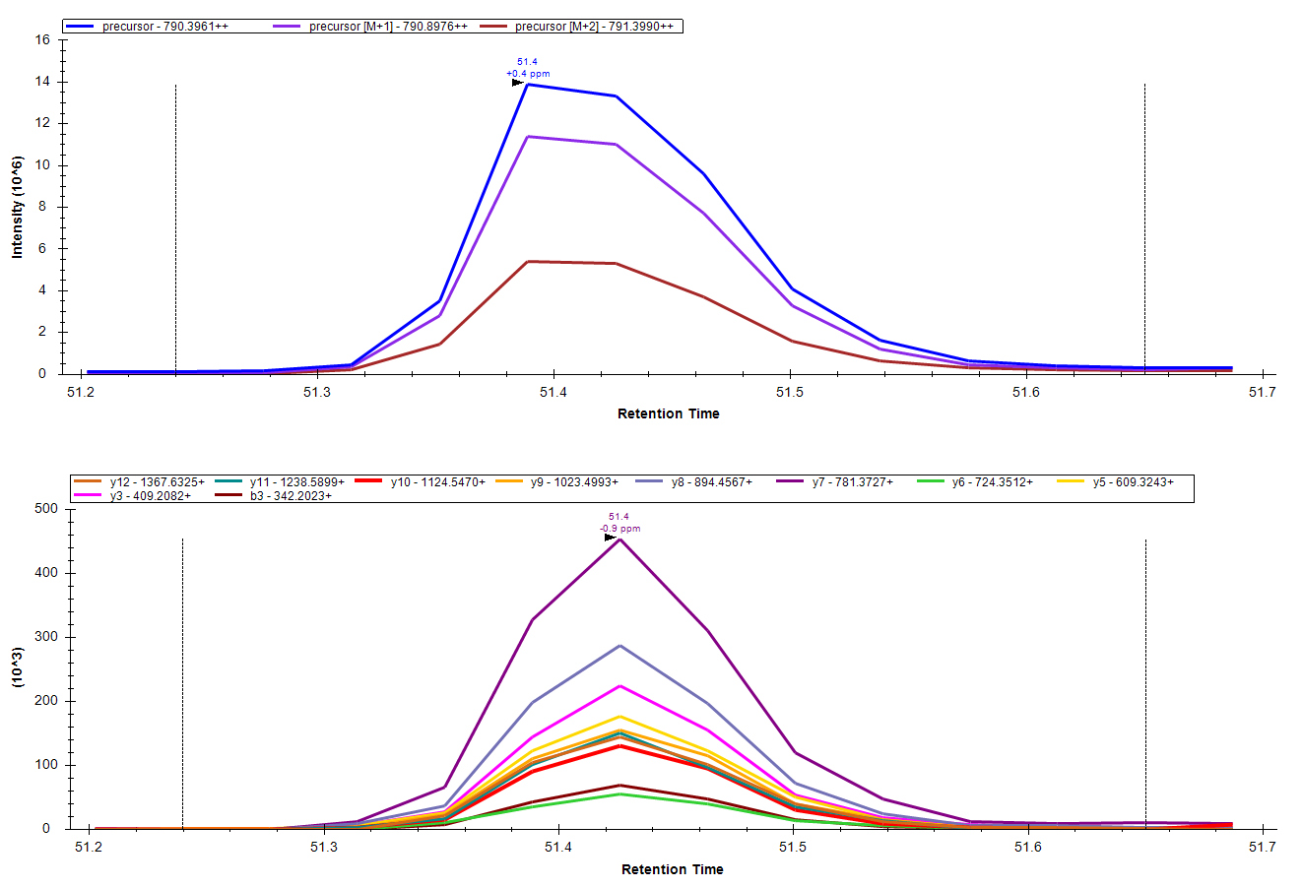
Precursor and Product Ion Information

Slide 21
DIA Chromatogram Extraction
Mass
Analyzer
Q1 / Trap
CID
Ion
Source
20 m/z isolation
MS/MS scans
m/z
m/z
m/z
intensity
m/z
time (scan #)

Slide 22
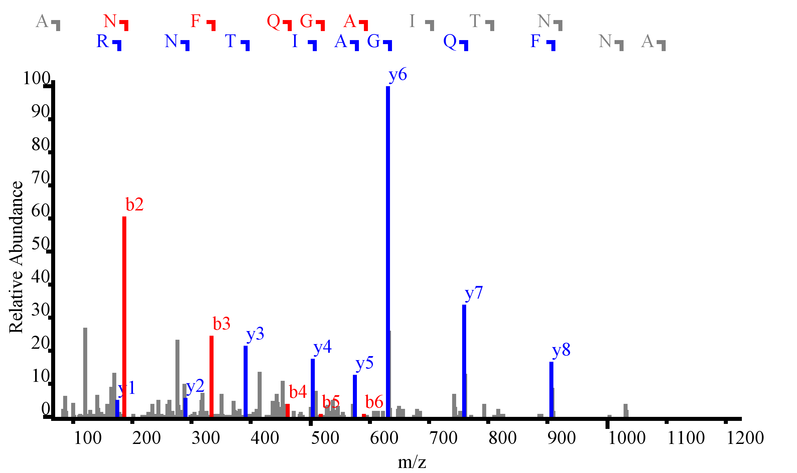
Product Ion Selectivity
2 m/z
ANFQGAITNR
Notes:
Show the spectrum, and the chromatogram
Even with DDA >30% of the spectra are mixed
Quantitation can be limited by interference, show 10 m/z vs. 20 m/z (from overlap experiment)
Spectrum and chromatogram from loq data on a yeast background peptide

Slide 23
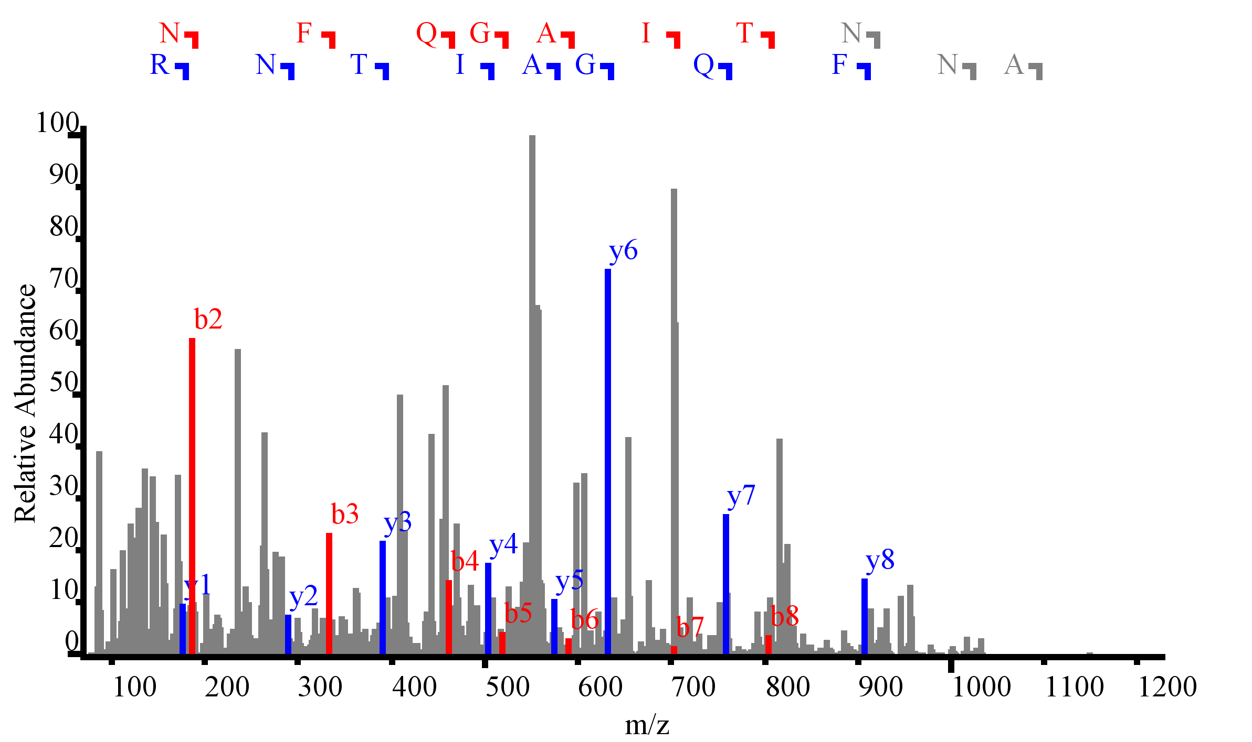
Product Ion Selectivity (DIA)
20 m/z
ANFQGAITNR
Notes:
Show the spectrum, and the chromatogram
Even with DDA >30% of the spectra are mixed
Quantitation can be limited by interference, show 10 m/z vs. 20 m/z (from overlap experiment)
Spectrum and chromatogram from loq data on a yeast background peptide

Slide 24
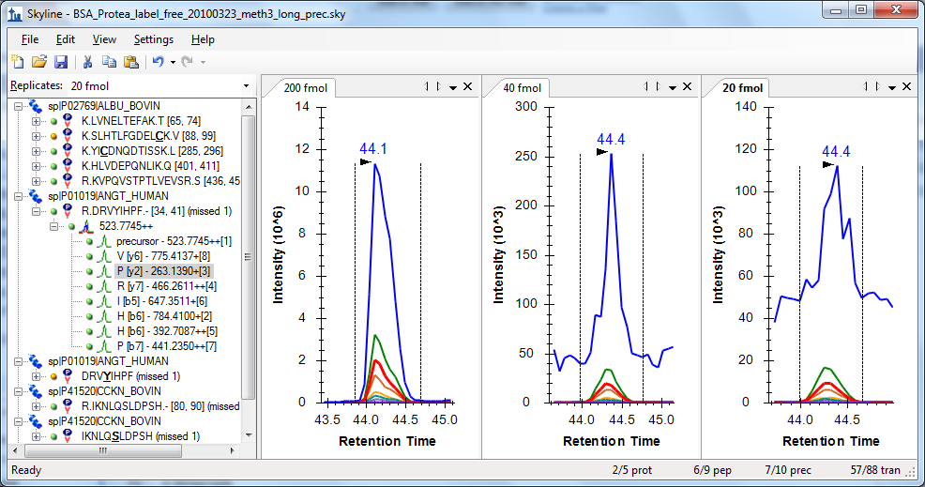
When Selectivity Becomes Sensitivity
Decreasing noise increases signal-to-noise

Slide 25
DIA Trade-Offs
Selectivity
Cycle time
Measured range
All ion digital record – image quality?

Slide 26
Overview
DDA Acquisition
DIA Acquisition
Product Ion
Targeting
Spectrum Matching
Got HYPOTHESIS??
Spectral Library
Building
Chromatogram Extraction
Quantitative
Analysis

Slide 27
DIA-Centric Workflow
DIA Acquisition
Product Ion
Targeting
Peptide Detection
Got HYPOTHESIS??
Spectral Library
Building
Chromatogram Extraction
Quantitative
Analysis

Slide 28
DIA-Centric Workflow
DIA Acquisition
Peptide Detection
  Pecan - MacCoss
  MS Pathfinder - Smith
  Umpire - Nesvizhskii
  Bandeira

Slide 29
Prior Knowledge Workflow
DIA Acquisition
Spectral Library
Relative Ion Abundance
iRT Library
Normalized RT
Product Ion
Targeting
Chromatogram Extraction
Quantitative
Analysis

Slide 30

Prior Knowledge Workflow
DIA Acquisition
Chromatogram Library
Relative Ion Abundance
Normalized RT
Product Ion
Targeting
Chromatogram Extraction
Quantitative
Analysis

Slide 31



Prior Knowledge Workflow
DIA Acquisition
Assay Library
Relative Ion Abundance
Normalized RT
Product Ion
Targeting
Chromatogram Extraction
Spectronaut
PeakView
Quantitative
Analysis

Slide 32
Tutorial
DIA using interspersed DDA

Slide 33
Learn More
Webinar #3: Tuesday, Jan. 13th – PRM
Weeklong Targeted Proteomics Course at UW
  March 23-27 (apply by Nov. 21)
Workshops at US HUPO and ASMS
Weeklong Course at ETH, Zurich
  June 22-26
Weeklong Course at PRBB, Barcelona
  November 15-20
Weeklong Course in Boston
  TBA

Slide 34
Questions?
Ask any questions you have on the topic of using DDA data in Skyline.
http://tinyurl.com/QA4Skyline
Take the post-webinar survey:
http://tinyurl.com/Survey4Webinar

