Slide 1
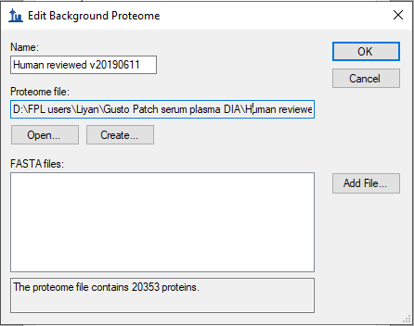
NAFLD cohort PD result
1735 protein groups from 3904 proteins
15,561 peptide groups
166,614 PSMs
From 8 fractions X 3 injections
Verified # of proteins in background proteome is correct:
Human canonical only sequences

Slide 2
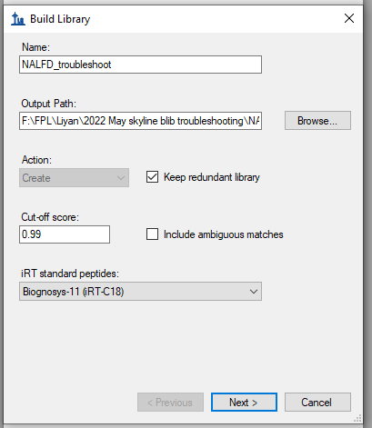
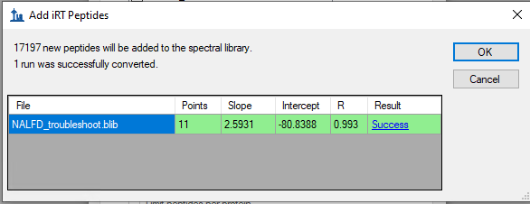
Single build from PD file on v19

Slide 3
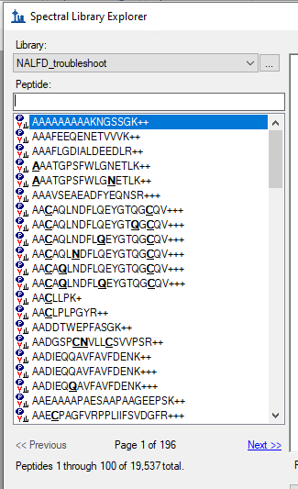
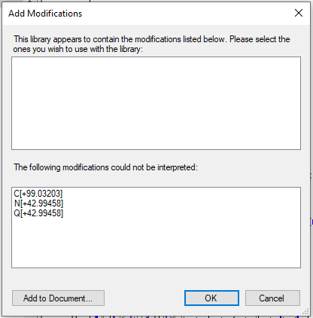
Single build from PD file on v19

Slide 4
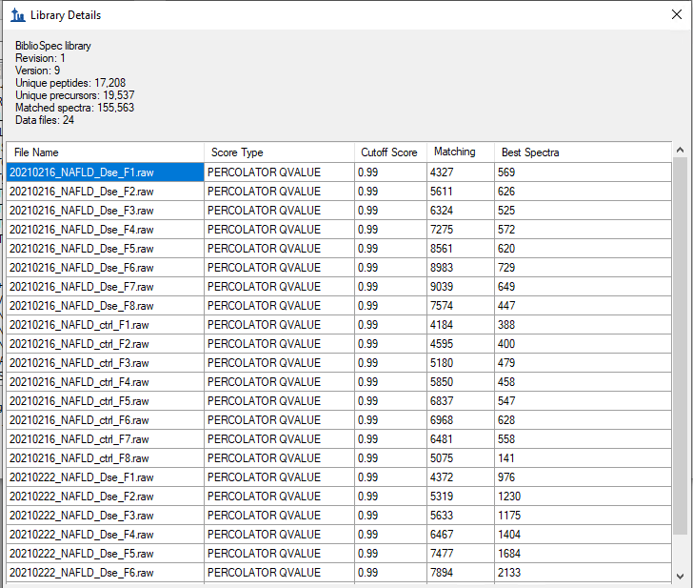
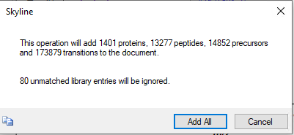
Single build from PD file on v19

Slide 5
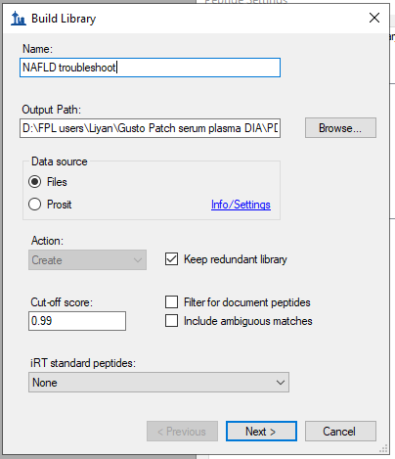
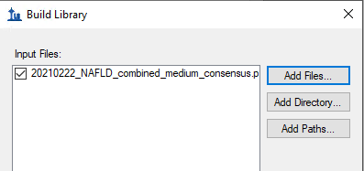
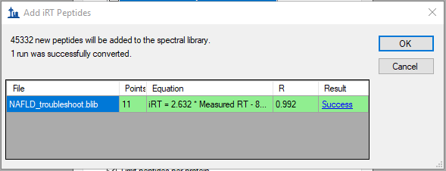
Re-build from PD file on v21 – new server

Slide 6
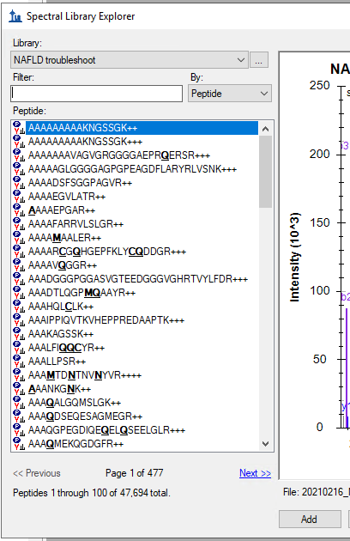
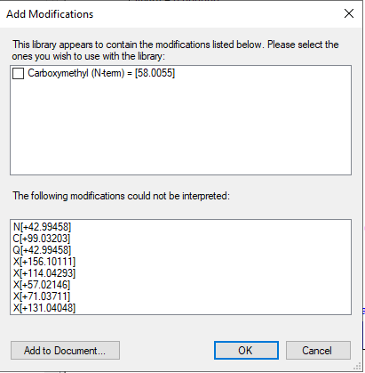
Re-build from PD file on v21 – new server
Something is odd here, as original PD result file and library on v19 have only 17, 000 peptides
Unknown mods also present

Slide 7
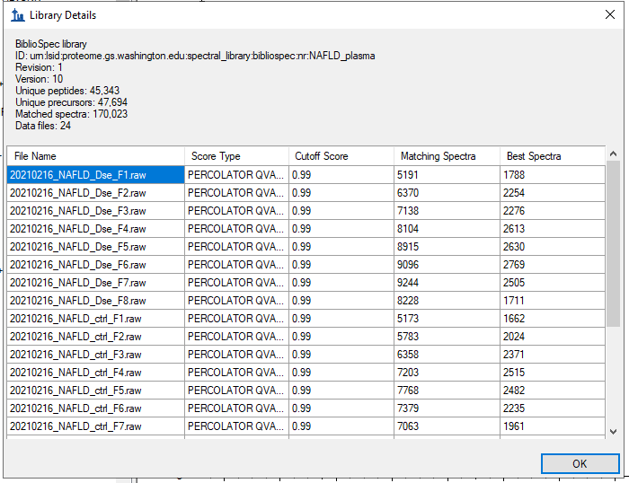
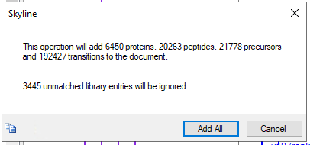
Re-build from PD file on v21 – new server
Excessive protein number in the document come from excessive peptides in Skyline v21 library build compared to v19 build on same file source

