Slide 1
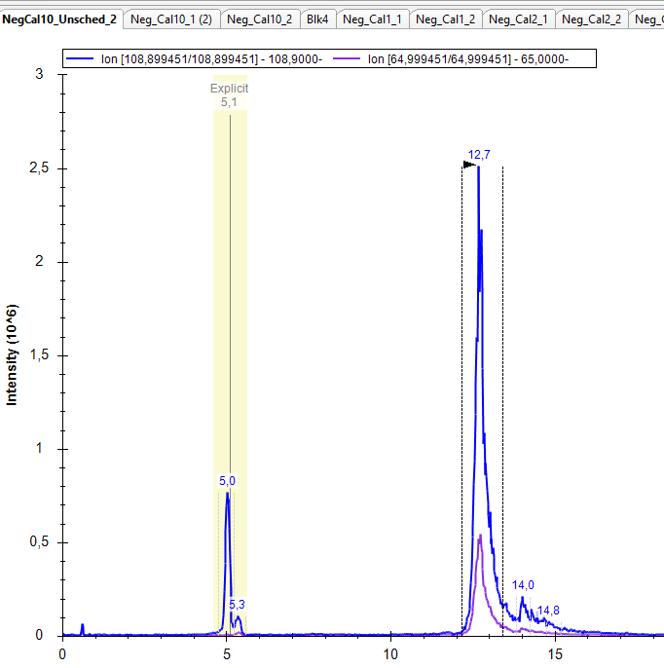
Skyline - how to detect peaks with the same MRM transition?
Unscheduled run
5.0 min = 3,5-Dihydroxybenzoic acid
5.3 min = Protocatechuic acid
12.7 min = 2,6-Dihydroxybenzoic acid

Slide 2
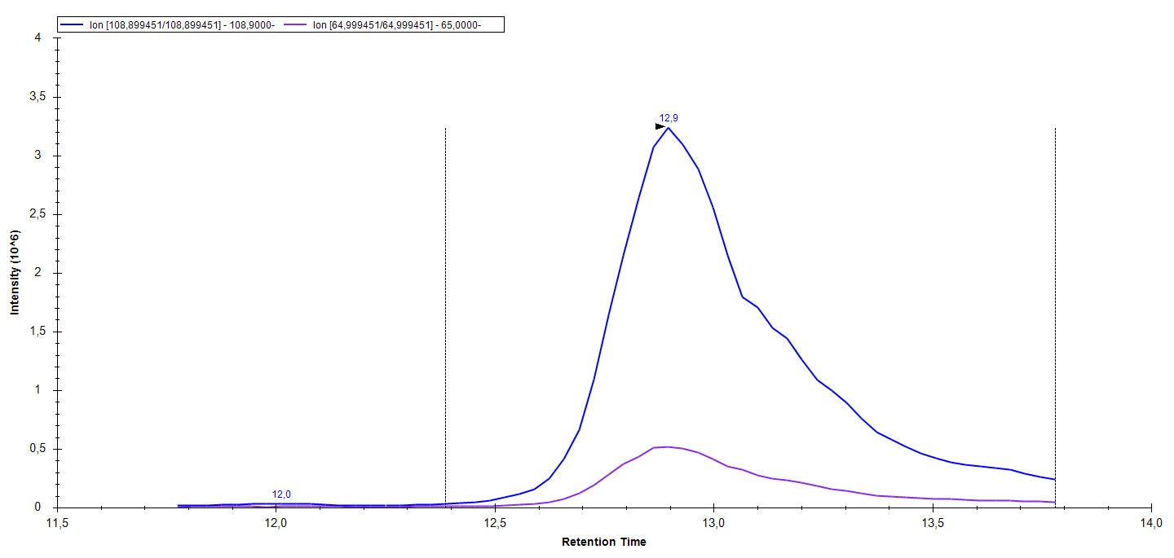
3,5-Dihydroxybenzoic acid – But wrong RT picked by Skyline – (same for Protocatechuic acid)
Scheduled MRM

Slide 3
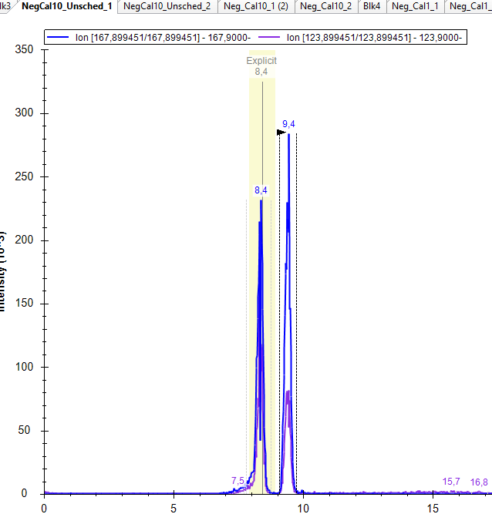
Skyline - how to detect peaks with the same MRM transition?
Unscheduled run
8.4min = 3-O-Methylgallic acid
9.4min = 4-O-Methylgallic acid

Slide 4
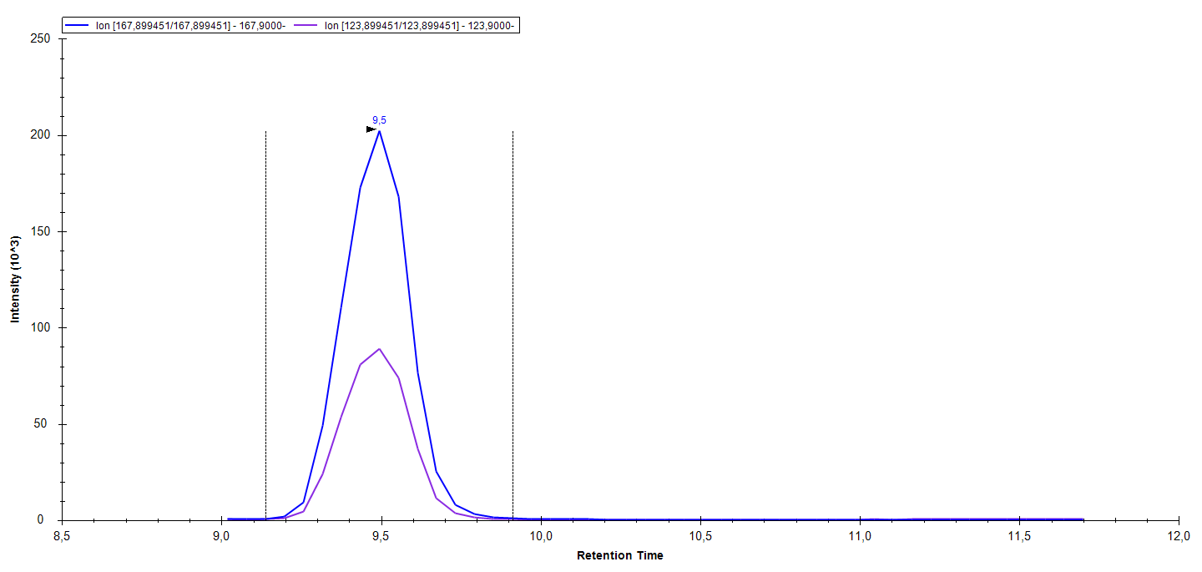
3-O-Methylgallic- acid but wrong RT picked by Skyline – Should be 8.4 min
Scheduled MRM

Slide 5
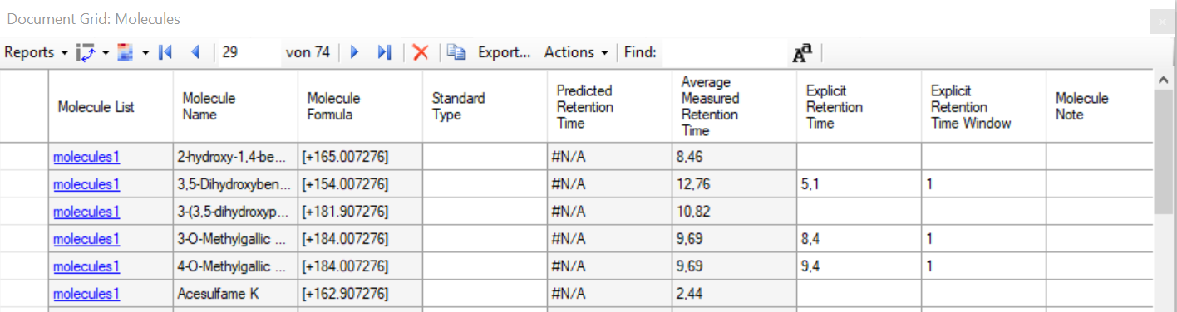
Explicit RT entered into document grid (only to selected targets)

Slide 6
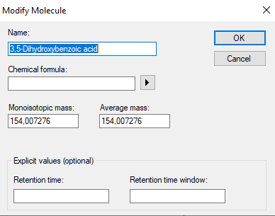
Explicit RT entered into document grid (only to selected targets)
Also Tried entering in Modify Molecule

Slide 7
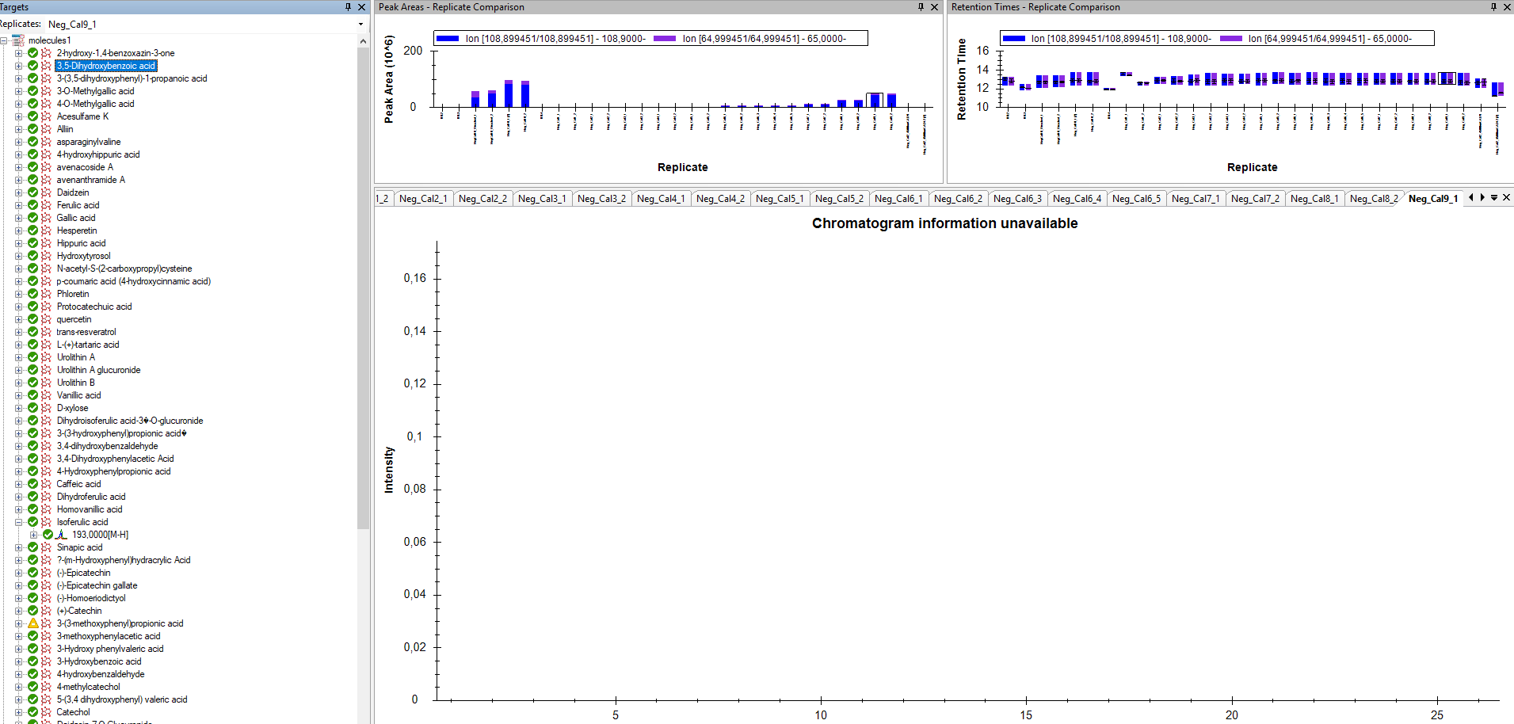
Explicit RT entered into document grid (to selected targets)
3,5-Dihydroxybenzoic acid. Peaks disappear from the scheduled run data(??) Peaks re-appear when explicit RT is removed from the Document Grid or Modify Molecule

Slide 8
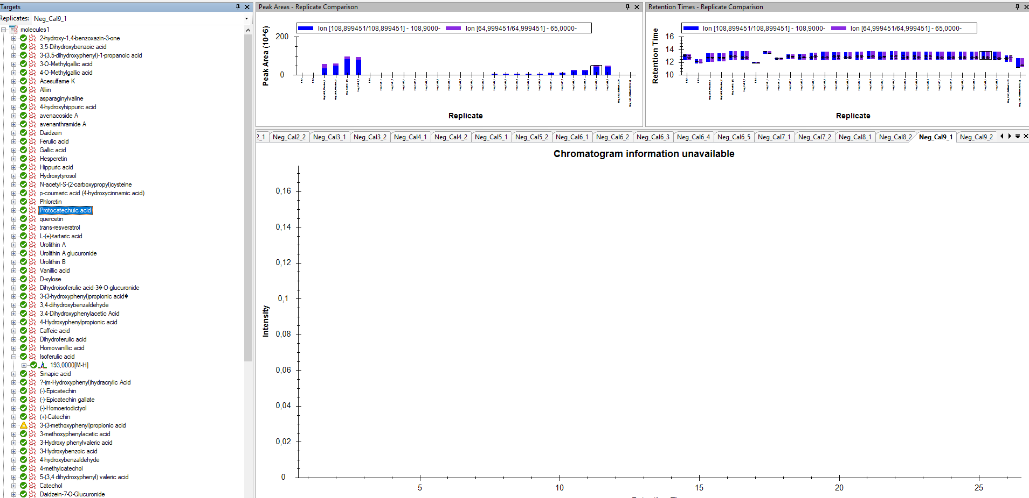
Explicit RT entered into document grid (not to all targets)
Protocatechuic acid . Peaks disappear from the scheduled run data(??) Peaks re-appear when explicit RT is removed from the Document Grid or Modify Molecule

Slide 9
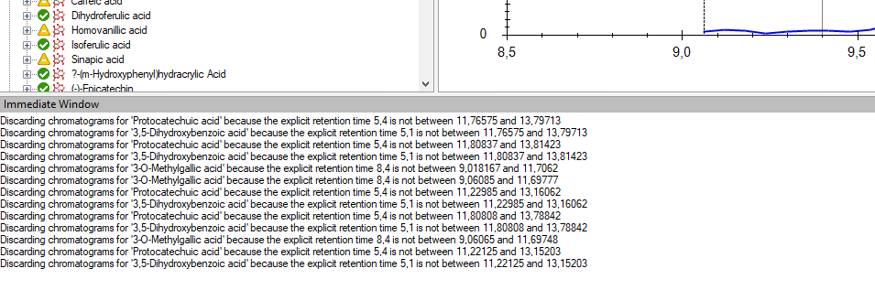
When I try to import data, it discards the chromatograms with the errors below

Slide 10
