Slide 1
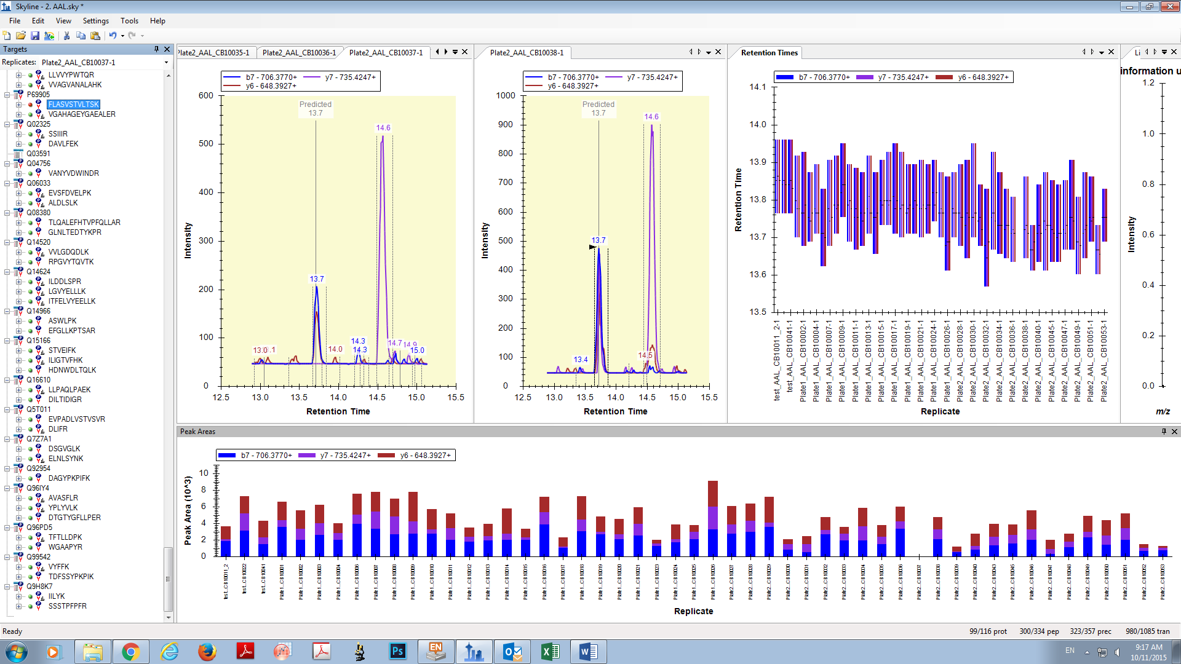
Peak not selected because it is above Q value cutoff
Peak automatically selected in rest all the sample runs

