Slide 1
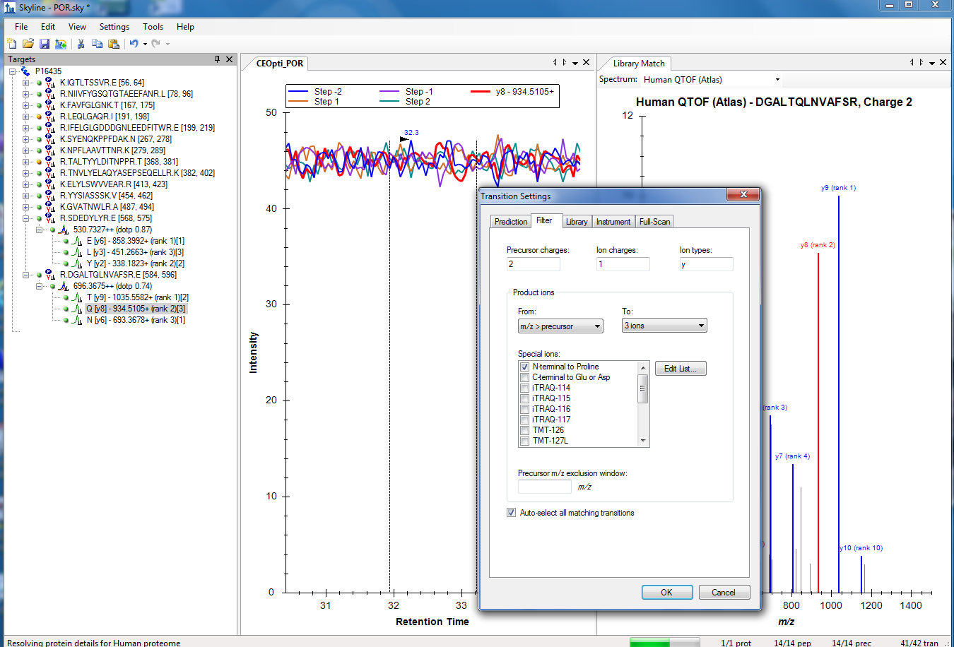
Import Result for CE Optimization

