Slide 1
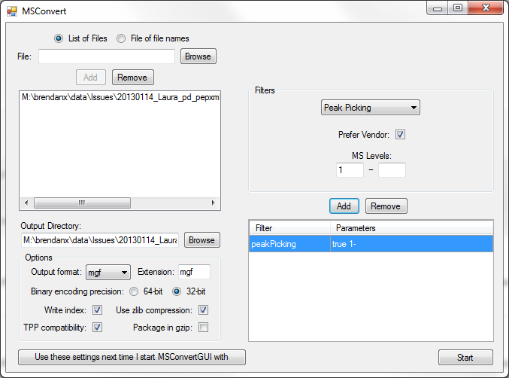
MSConvertGUI for MGF Files

