Slide 1
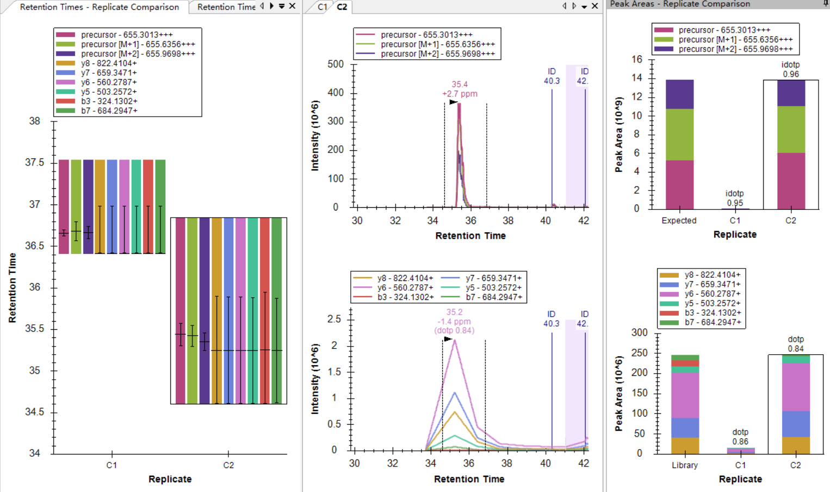
C2: the retention time window is okay to cover the peptide

Slide 2
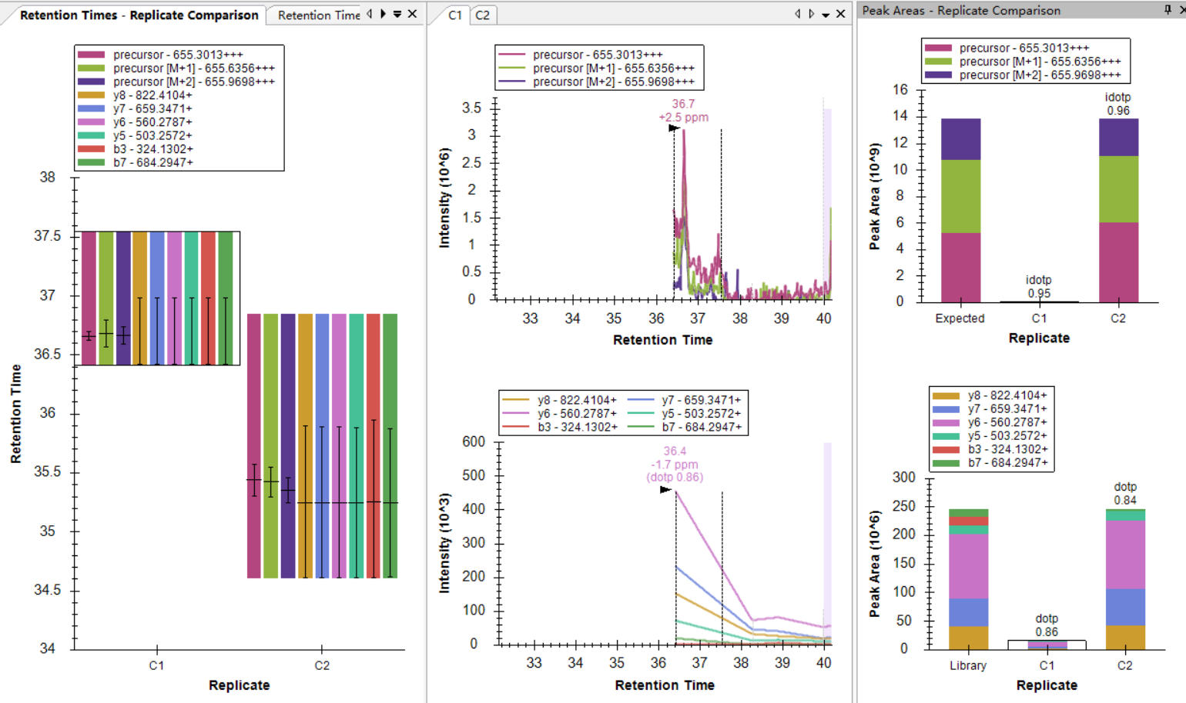
C1: the retention time window below 35min is cut by Skyline, resulting in loss of the peptide information

