Slide 1
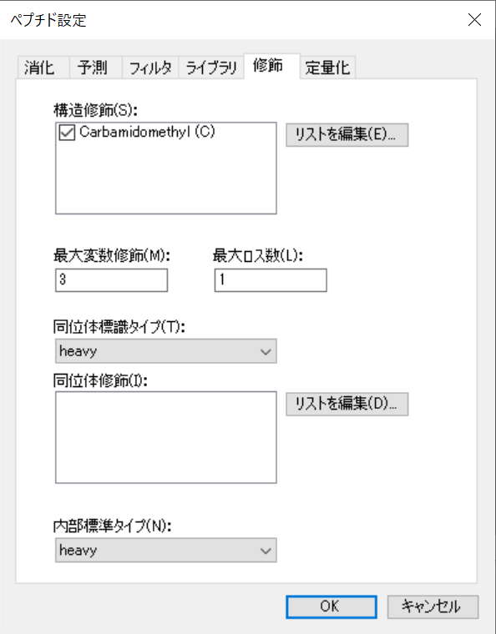
Peptides settings (Modifications)
Cysteine ​​is modified with carbamidemethyl

Slide 2
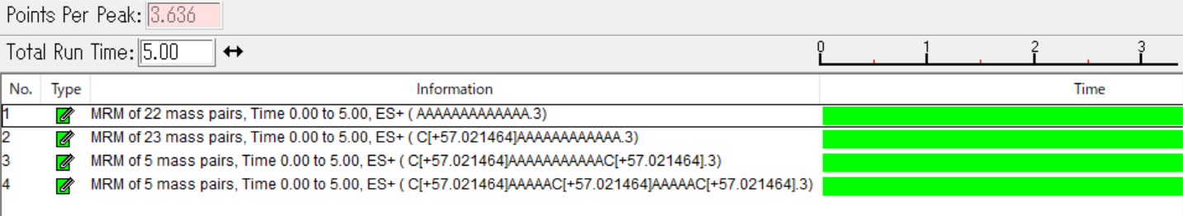
Exported Method
C is not included
（5 or more channels）
Only one C is included
（5 or more channels）
Contains two or more C（5 channels）

Slide 3
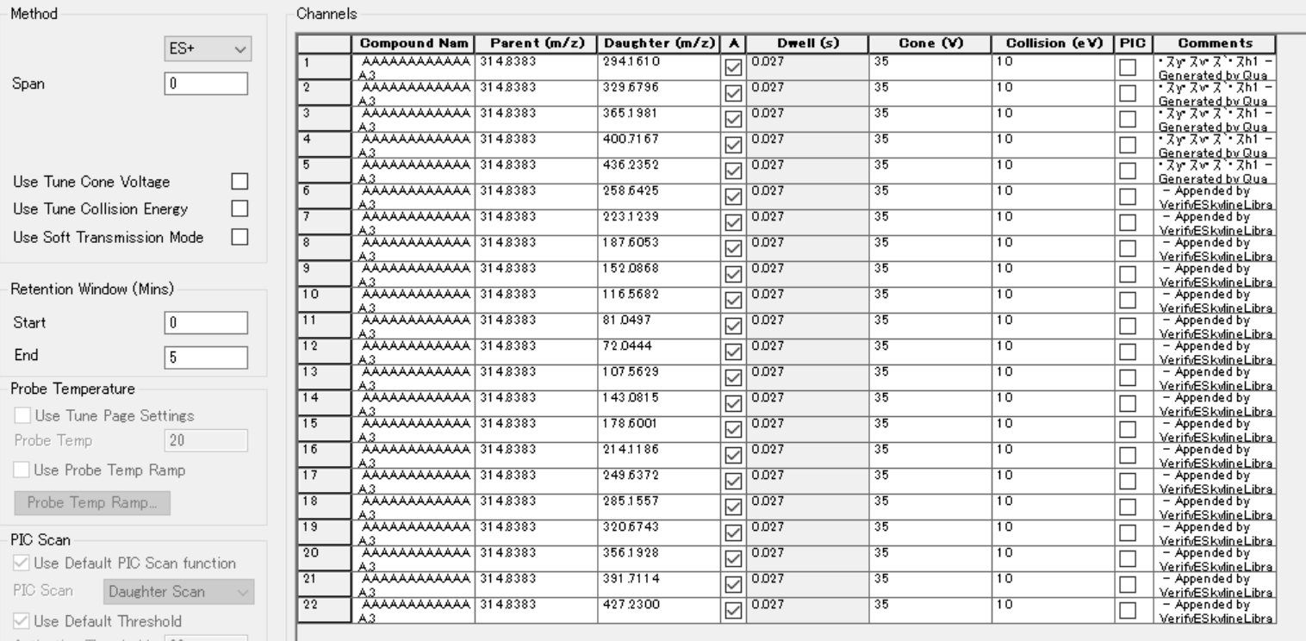
C is not included and Only one C is included
Generated by Quanpedia（5 channels）
Appended by VerifyESkylineLibrary
(5 or more channels)

Slide 4
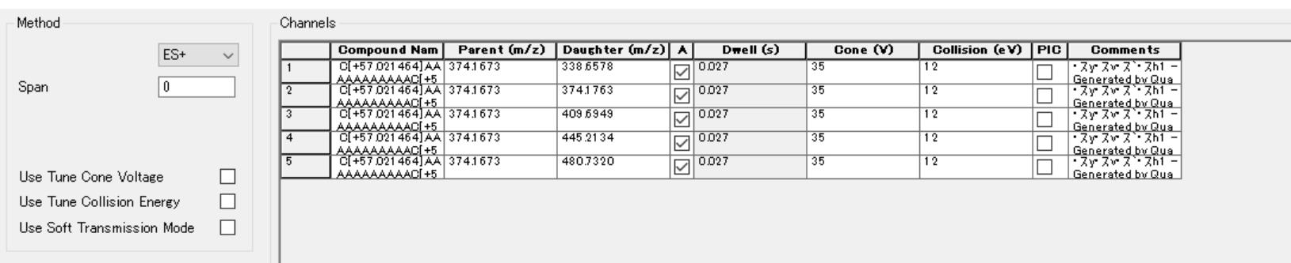
Contains two or more C
Only
Generated by Quanpedia（5 channels）

