Slide 1
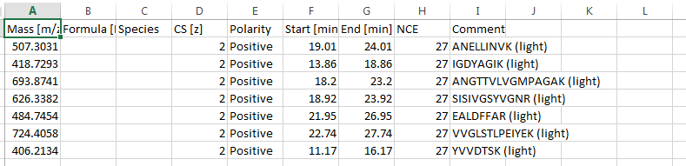
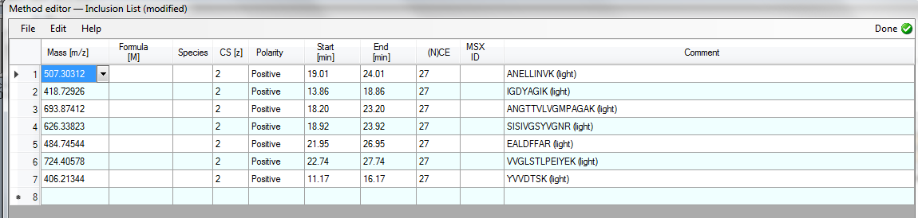
Isolation list export from Skyline (Q-Exactive settings)
Imported isolation list: Q-Exactive Xcalibur 4.0

Slide 2
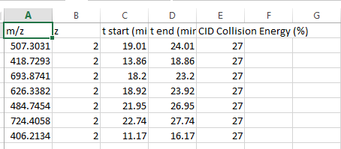
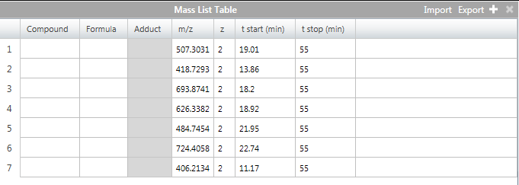
Isolation list export from Skyline (Fusion settings)
Imported isolation list: Fusion Lumos Tune 3.0.2022.16

