Slide 1
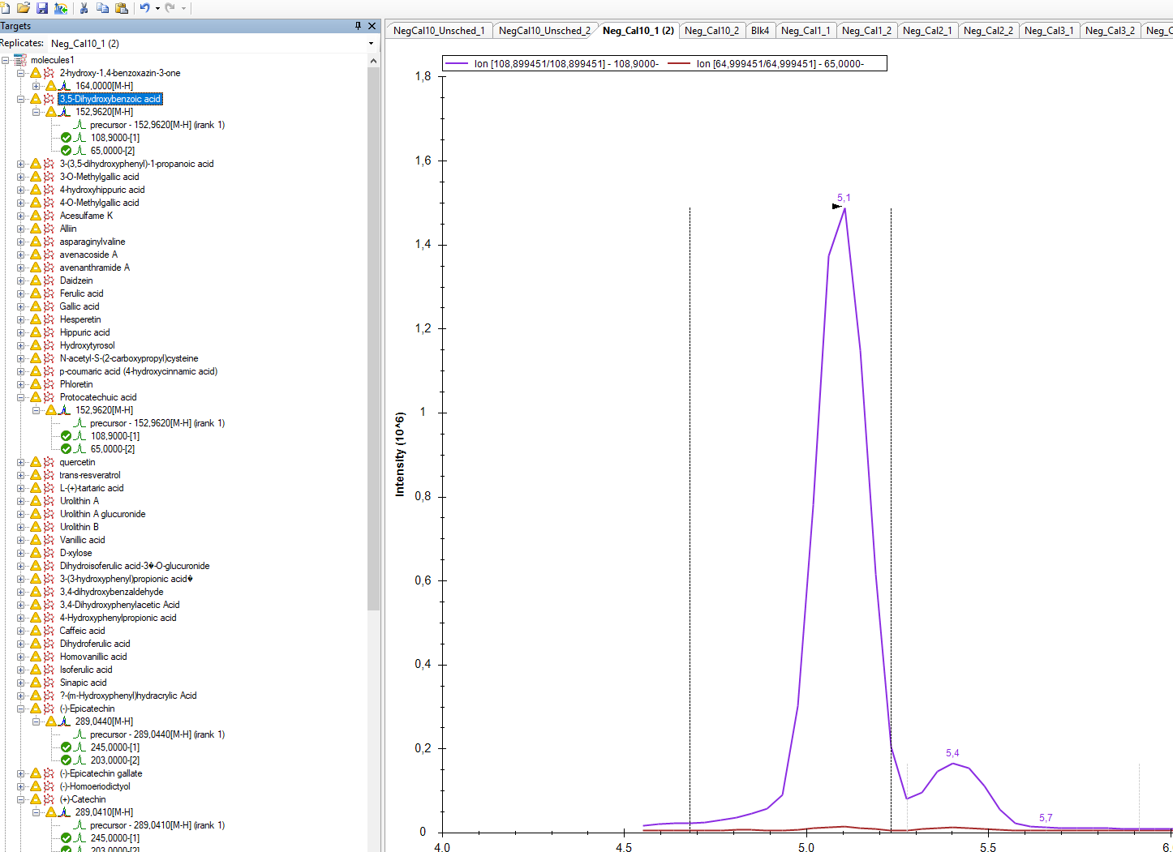
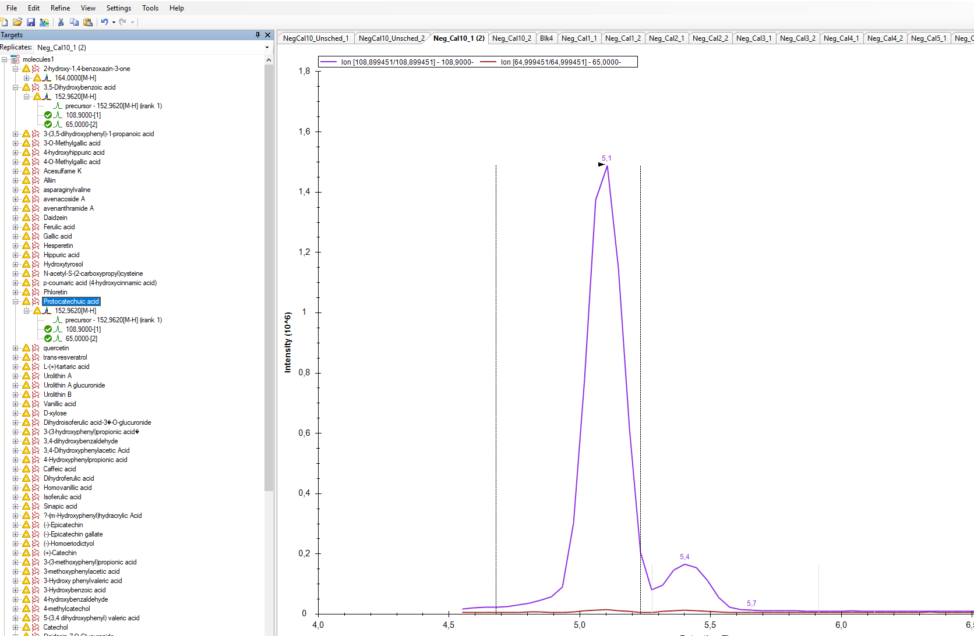
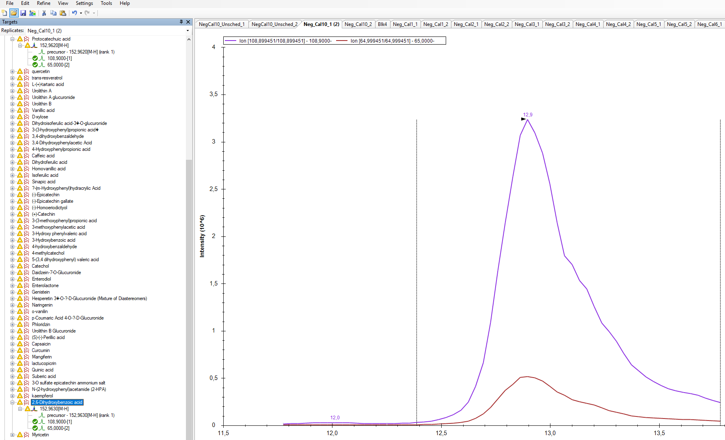
Correct peak assignment after correcting the Q1 value to match instrument value (no rounding in Excel)

Slide 2
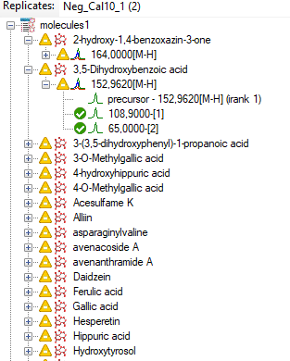
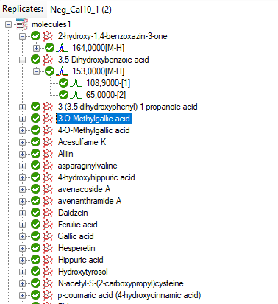
After correcting Q1 values for selected targets. New Symbols appear. What is the differnce and why?
New Symbols
Old Symbols

