Slide 1
More Recently (June 2016)
Bruker reports much higher detections with Spectronaut
  MaxQuant DDA library with 19,500 peptide precursors
Dataset 1
  Spectronaut 10,500 peptide precursors detected
Dataset 2
  Spectronaut 17,500 peptide precursors detected
  Skyline 14,000 peptide precursors detected
25% more!

Slide 2
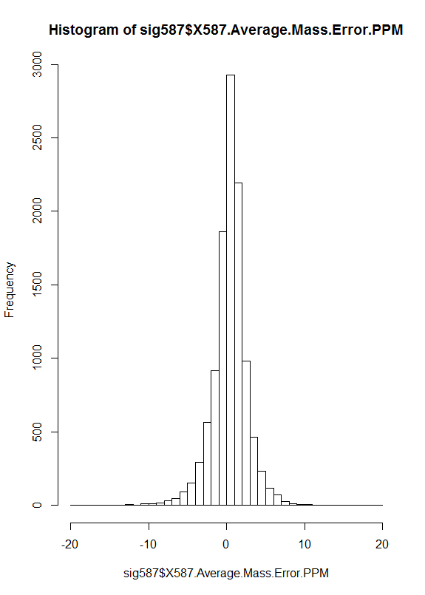
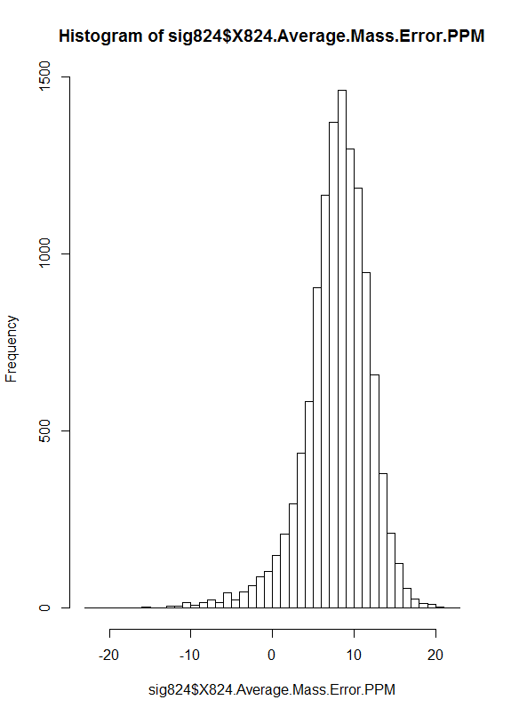
Mass Error Issue
Dataset 1
Dataset 2
First clue histograms
Frequency
Frequency
Mass Error (PPM)
Mass Error (PPM)
Mean = 0.47
Mean = 8.0
SD = 2.3
SD = 4.1

Slide 3
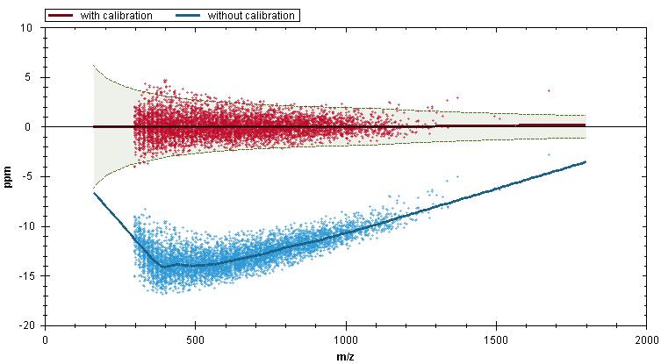
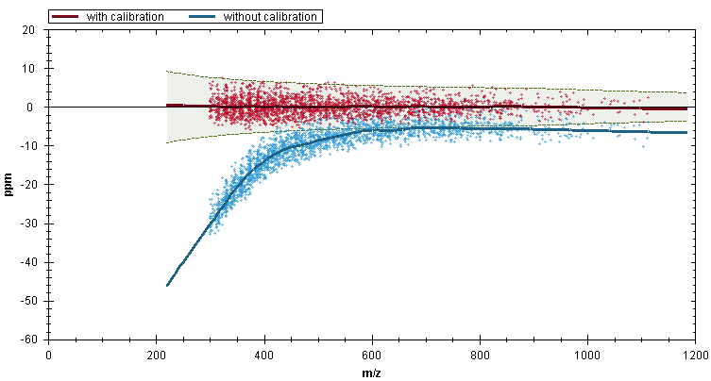
Spectronaut Mass Error Correction
Dataset 1
Dataset 2

Slide 4
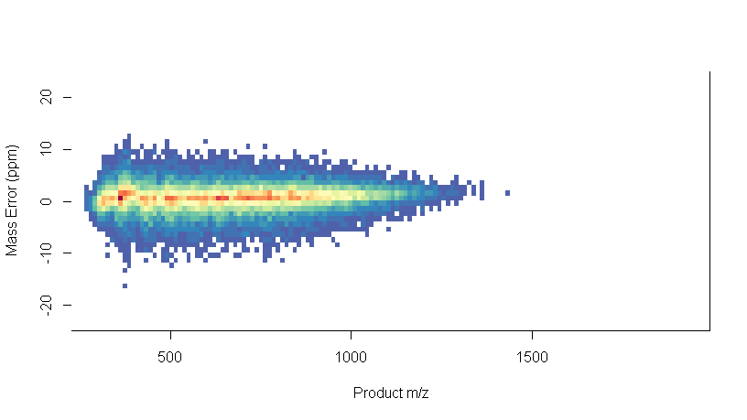
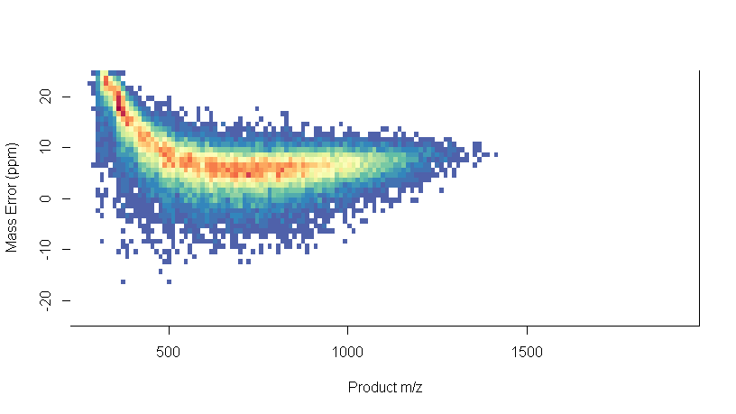
Mass Errors from Skyline Reports (R plots)
Dataset 1
Dataset 2

Slide 5
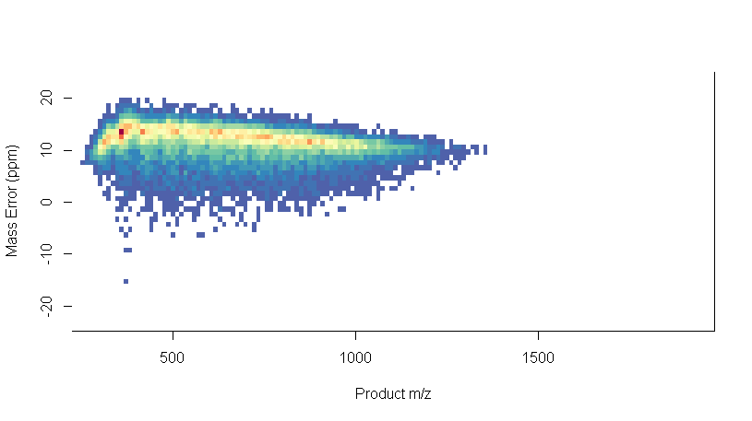
Mass Errors from Skyline Reports (R plots)
Dataset 1
Dataset 2
Read-Time Calibration Off

Slide 6
Skyline Mass Error Graph – Data Set 2

Slide 7
Bruker Re-calibrated m/z – Data Set 2

Slide 8
After Bruker Calibrated Dataset 2 (July 2016)
Dataset 1
  Skyline 13,800 peptide precursors detected
  Spectronaut 10,500 peptide precursors detected
Dataset 2
  Skyline 16,700 peptide precursors detected
  Spectronaut 17,500 peptide precursors detected

