Slide 1
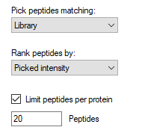
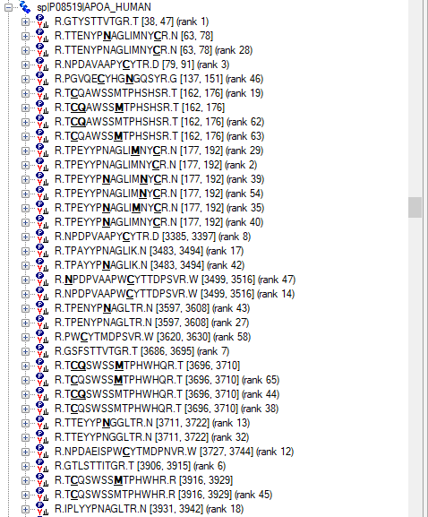
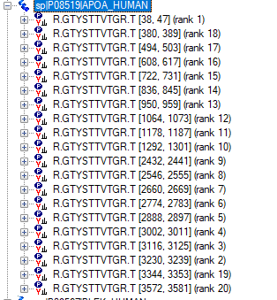
Issue with nPeptide/protein limit
No limit & 20 peptides under library tab
Refine>Advanced: auto-select peptides
Peptides that were previously ranked 2-20 disappear, and are replaced by multiple counts of this repeating sequence

