Slide 1
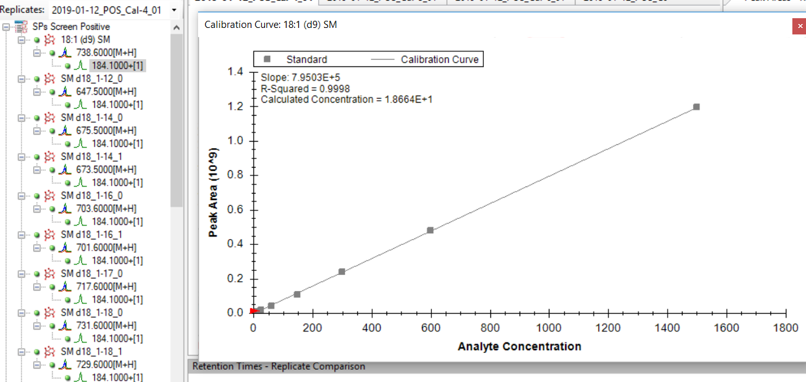
Calibration curve of 18:1(d9)SM

Slide 2
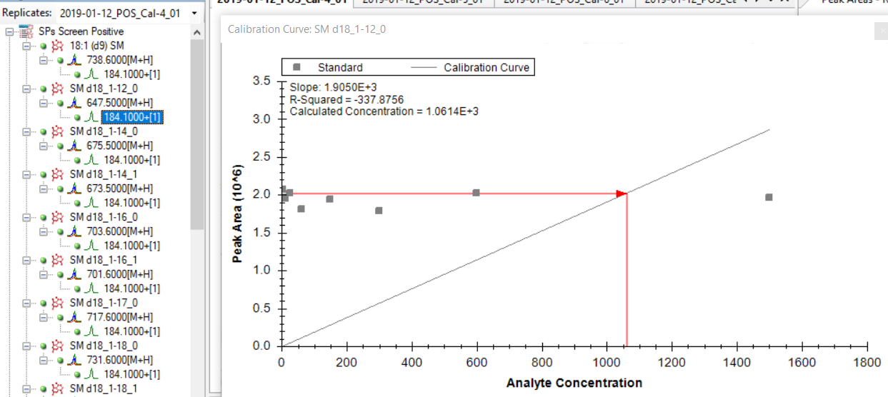
Calibration curve of SM d18_1-12_0

Slide 3

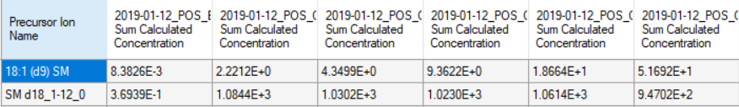
The concentration of SM d18_1-12_0 is from itself calibration curve like the second slide.
How to get the concentration of SM d18_1-12_0 from the calibration curve of 18:1(d9)SM, like the first slide?

