Slide 1
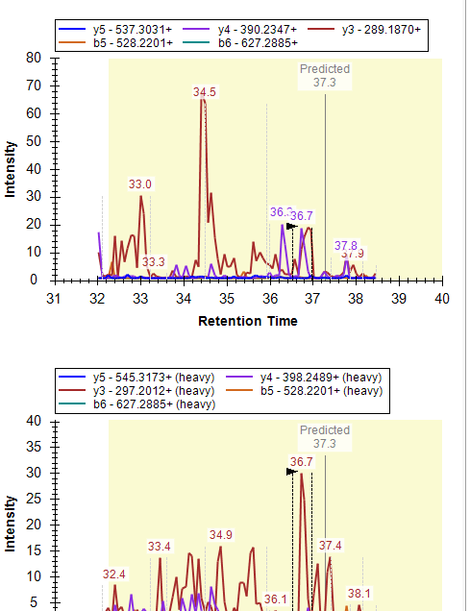
Peptide 1 in sample 1

Slide 2
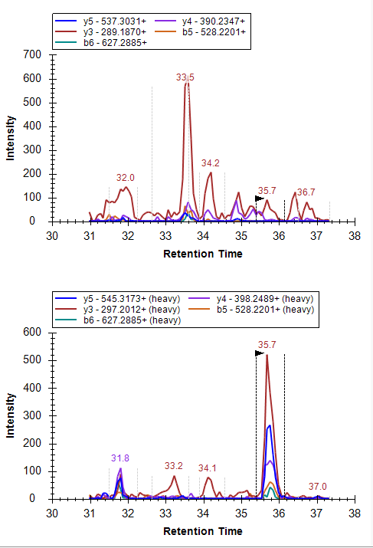
Peptide 1 in sample 2

