Slide 1
Instrument method with Scheduled RTs

Slide 2
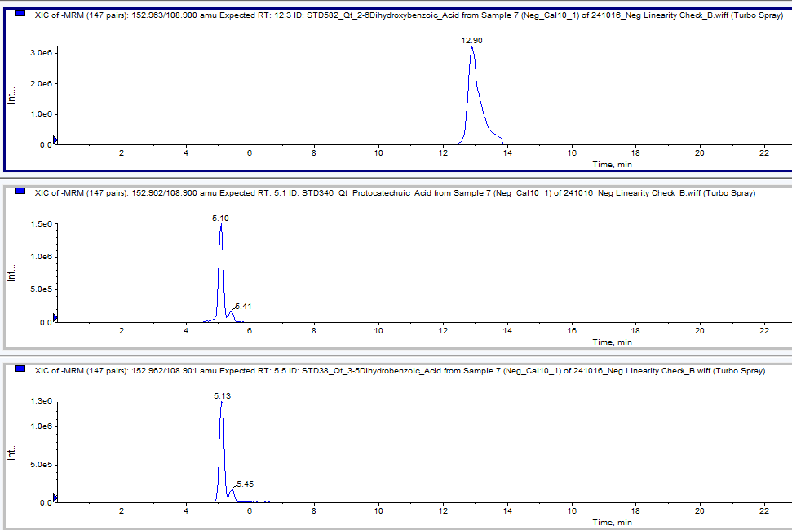
Correct results are shown on SCIEX analyst (Scheduled MRM)

Slide 3
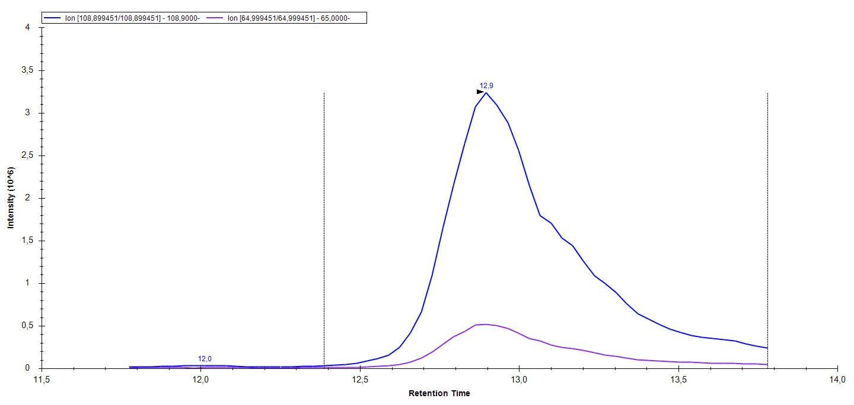

But Skyline show only result at 12,9 min regardless of the RT (sheduled MRM)
How to show on Skyline the result from the 5 min mark?

Slide 4

Correct peak is at 5 min (sheduled MRM)
How to show on Skyline the result from the 5 min mark?

Slide 5

This is the correct chromatogram for 2,6-Dihydroxybenzoic acid sheduled MRM

Slide 6
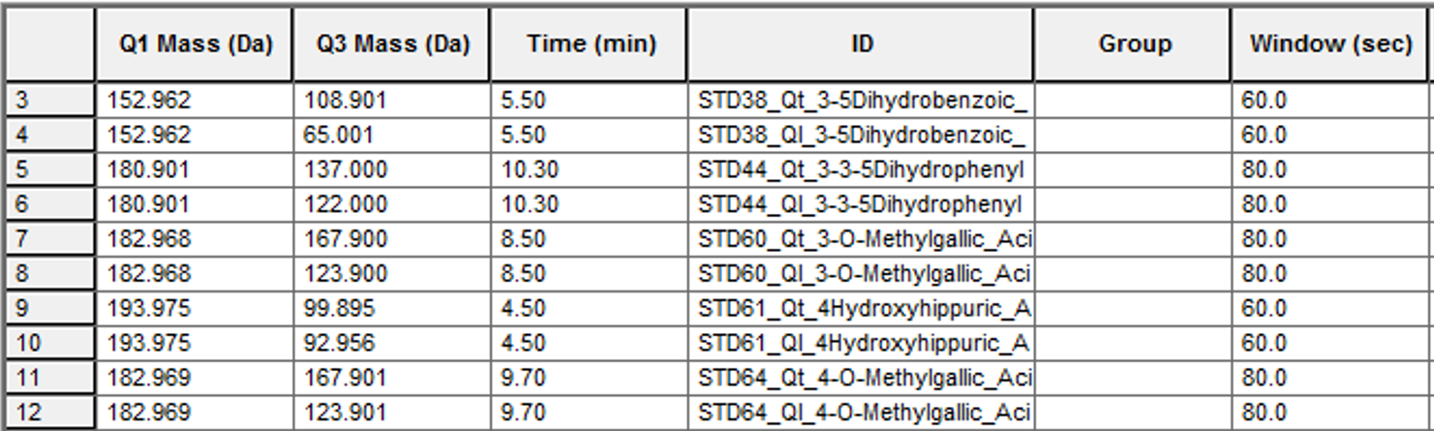
3 and 4 –O-methylgallic acid

Slide 7
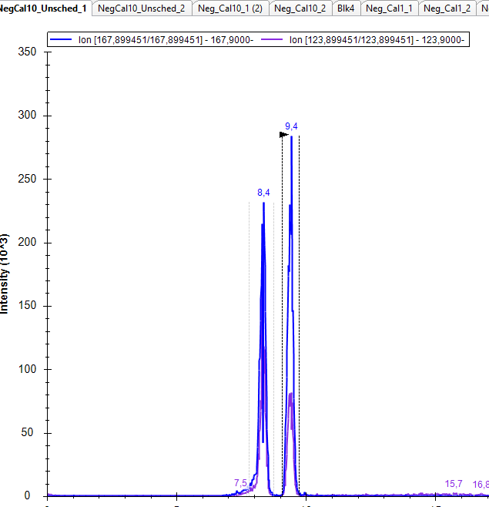
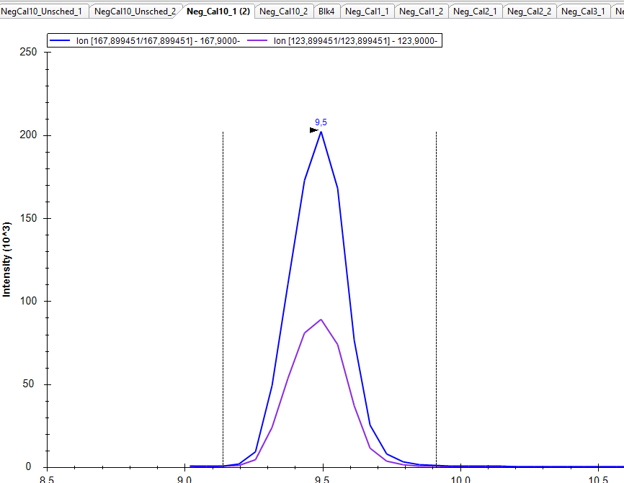
Unscheduled MRM
Scheduled MRM. Correct peak is 8,4 but only peak at 9,4 min is shown
How do I tell Skyline to pick the earlier peak?

