Slide 1
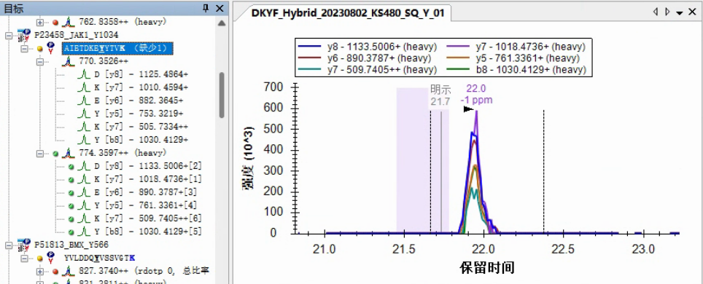
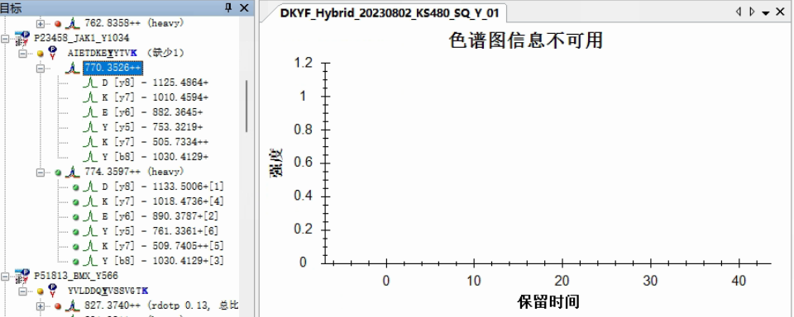
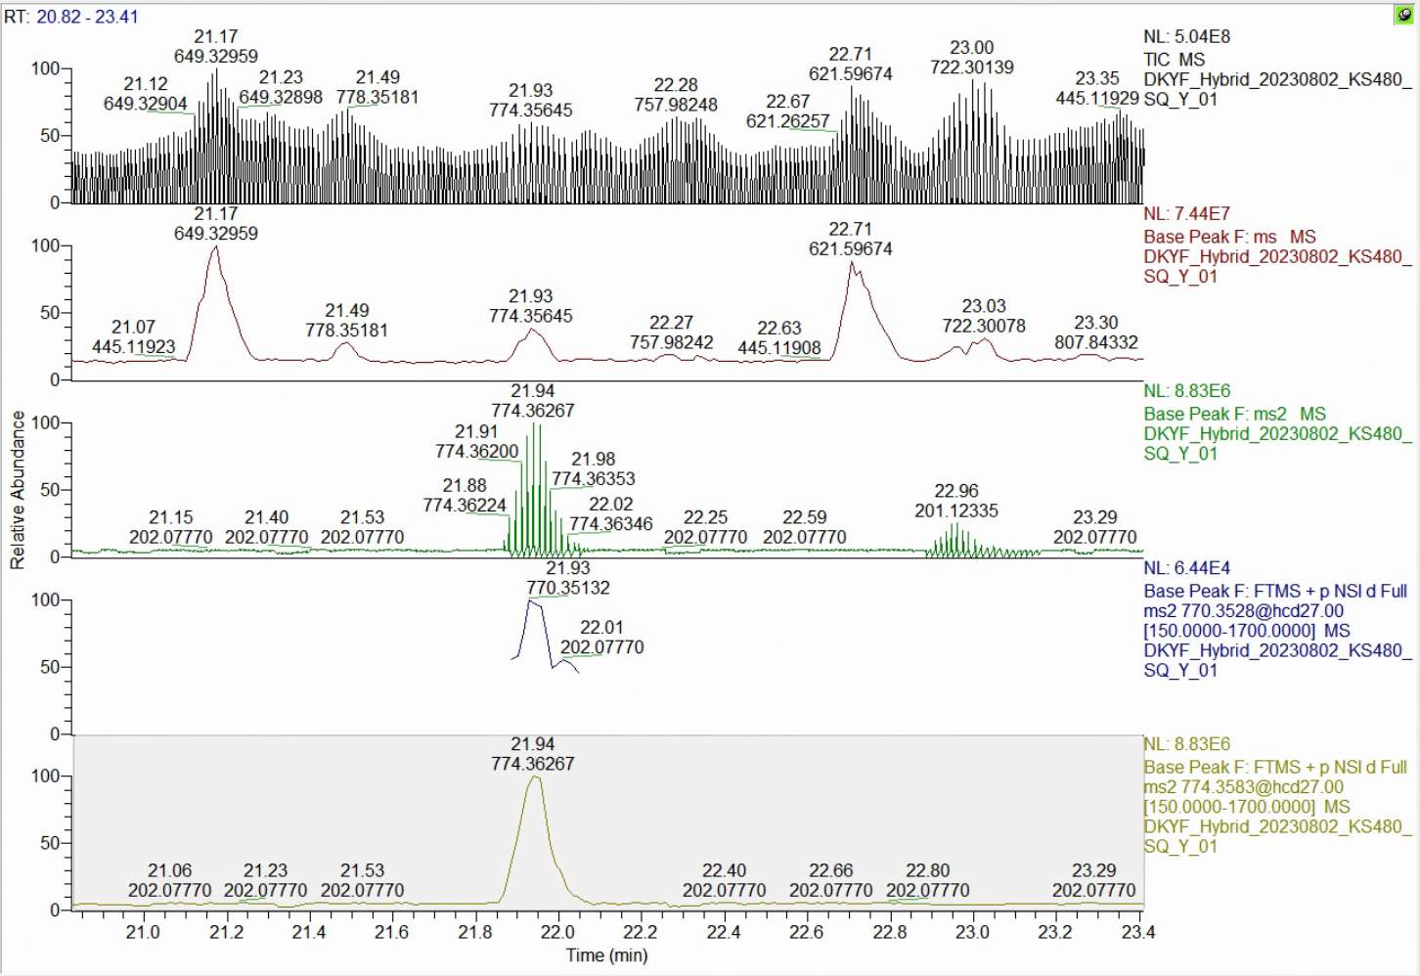
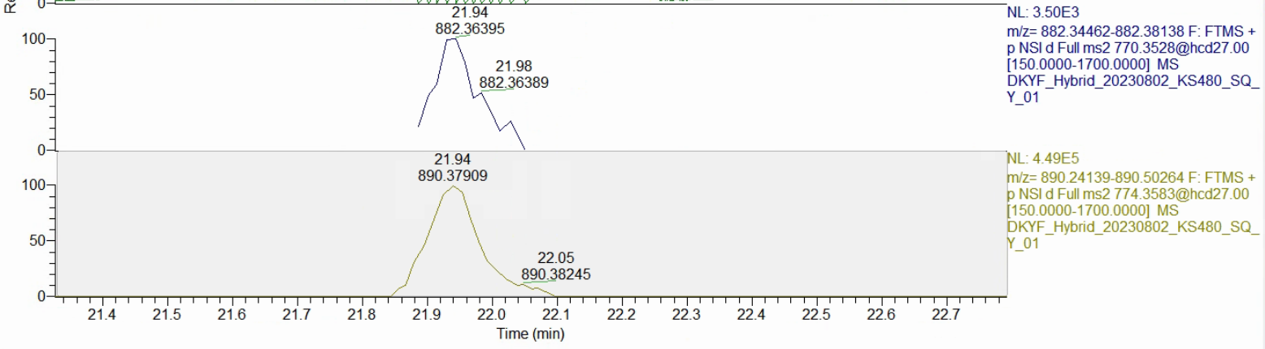
Heavy peptide
770.3526
Light peptide
774.3597
Light peptide
Frgment of 770.3526
Heavy peptide
Fragment of 774.3597
Light peptide extraction failed
Light peptide
770.3526
Heavy peptide
774.3597

