Slide 1
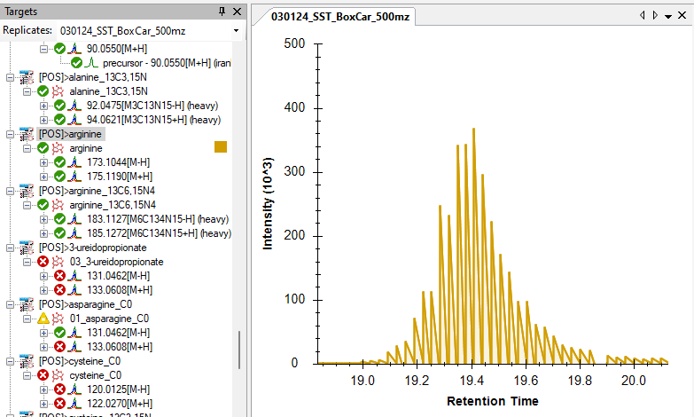
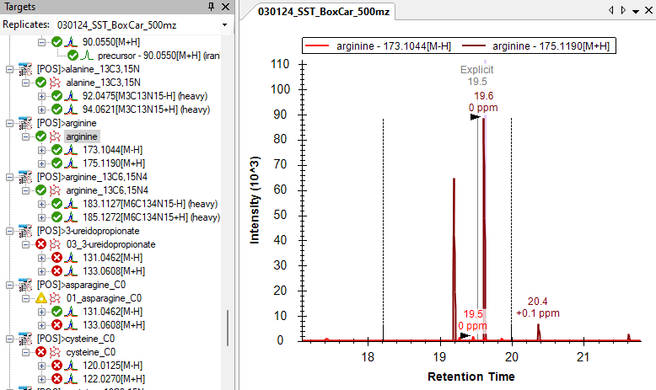
The rugged peak shape is only visible when clicking on the title including transitions for both polarities, but not when clicking on the individual precursor.
The image on the left shows the case when we click the title, while the one on the right shows the case when we clicked the individual precursor as shown in red box.

