Slide 1
Corruption of MRM3 data
3 May 2024

Slide 2
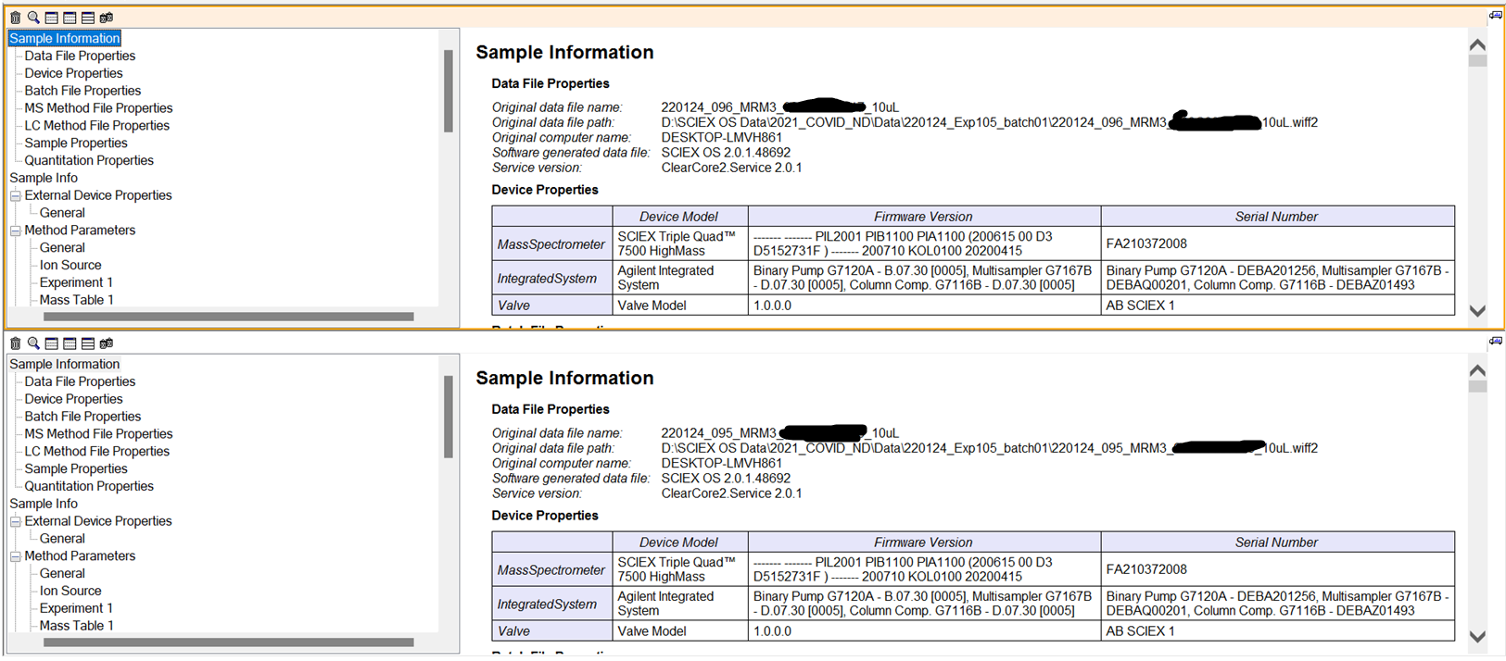
Sample information of Sample 95 and 96
Sample 96
Sample 95
I am not sure how this information is retrieved, if it is embedded as a predefined report, or if it is accessed on the fly from the same source Skyline would retrieve it. Original file name has been redacted.

Slide 3
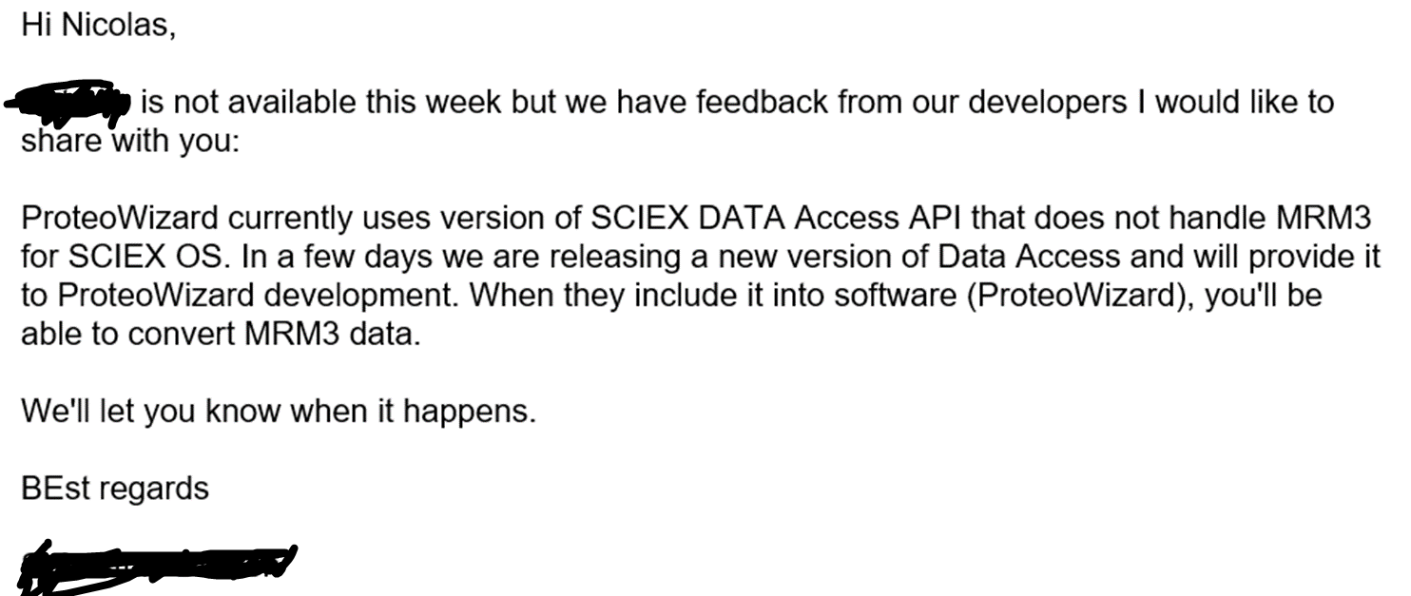
Information from Sciex
(Not sure if I may share the names of the Sciex people, so I blotted them out.)

Slide 4
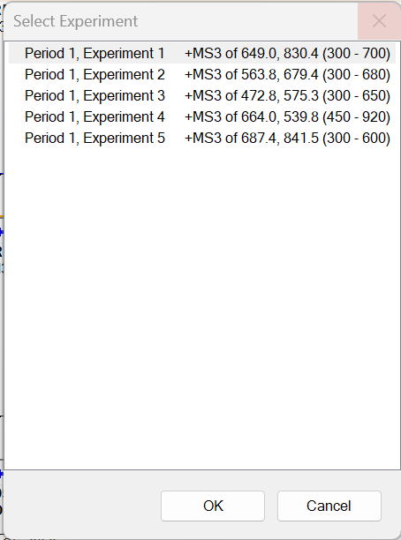
TIC and XIC of samples 95 and 96
Sciex OS allows me to show the TIC, and XIC data.
We have 5 transitions in our dataset, but there is only one that needs to return an actual spectrum always, that is Experiment 3: AGL peptide of a histone.
The other peptides are most of the time not there, in ~10% they are detected.

Slide 5
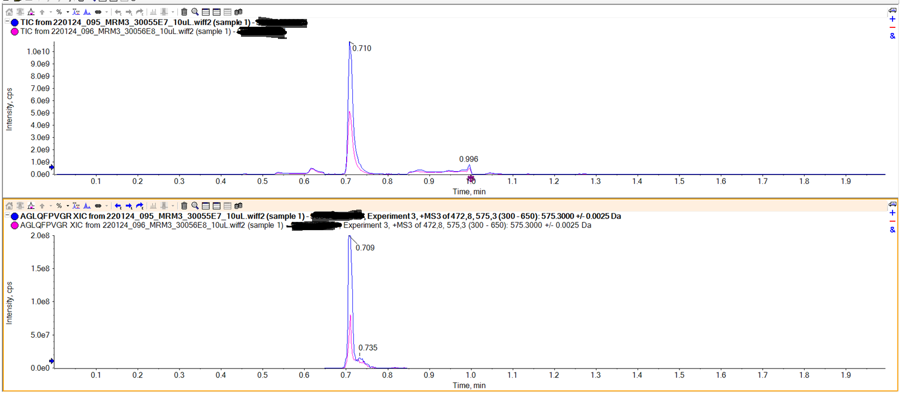
TIC and XIC (of AGL) of samples 95 and 96
TIC
XIC
Transition 3

Slide 6
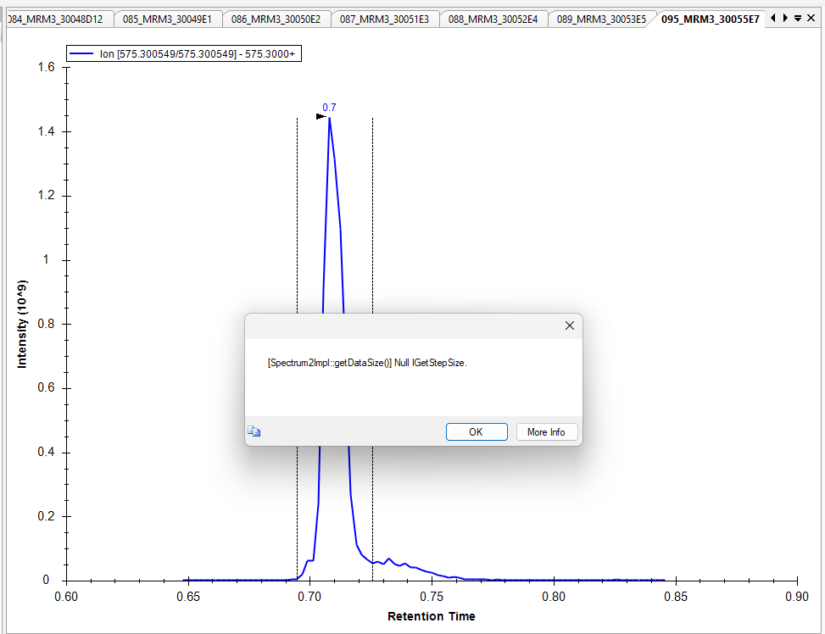
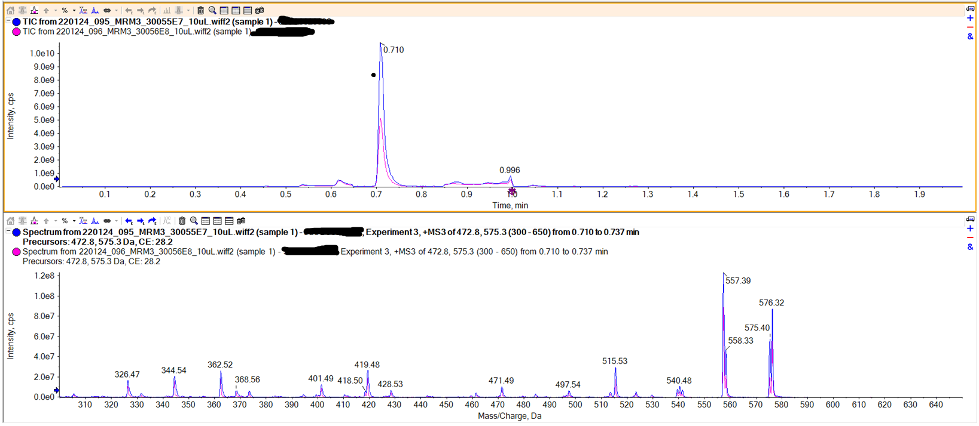
AGL in sample 95 with ‘spectrum’
But we do see the spectrum in Sciex OS
Indeed, we also sdo not see a spectrum in Skyline

