Slide 1
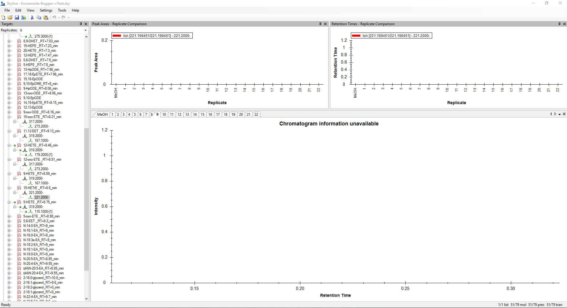
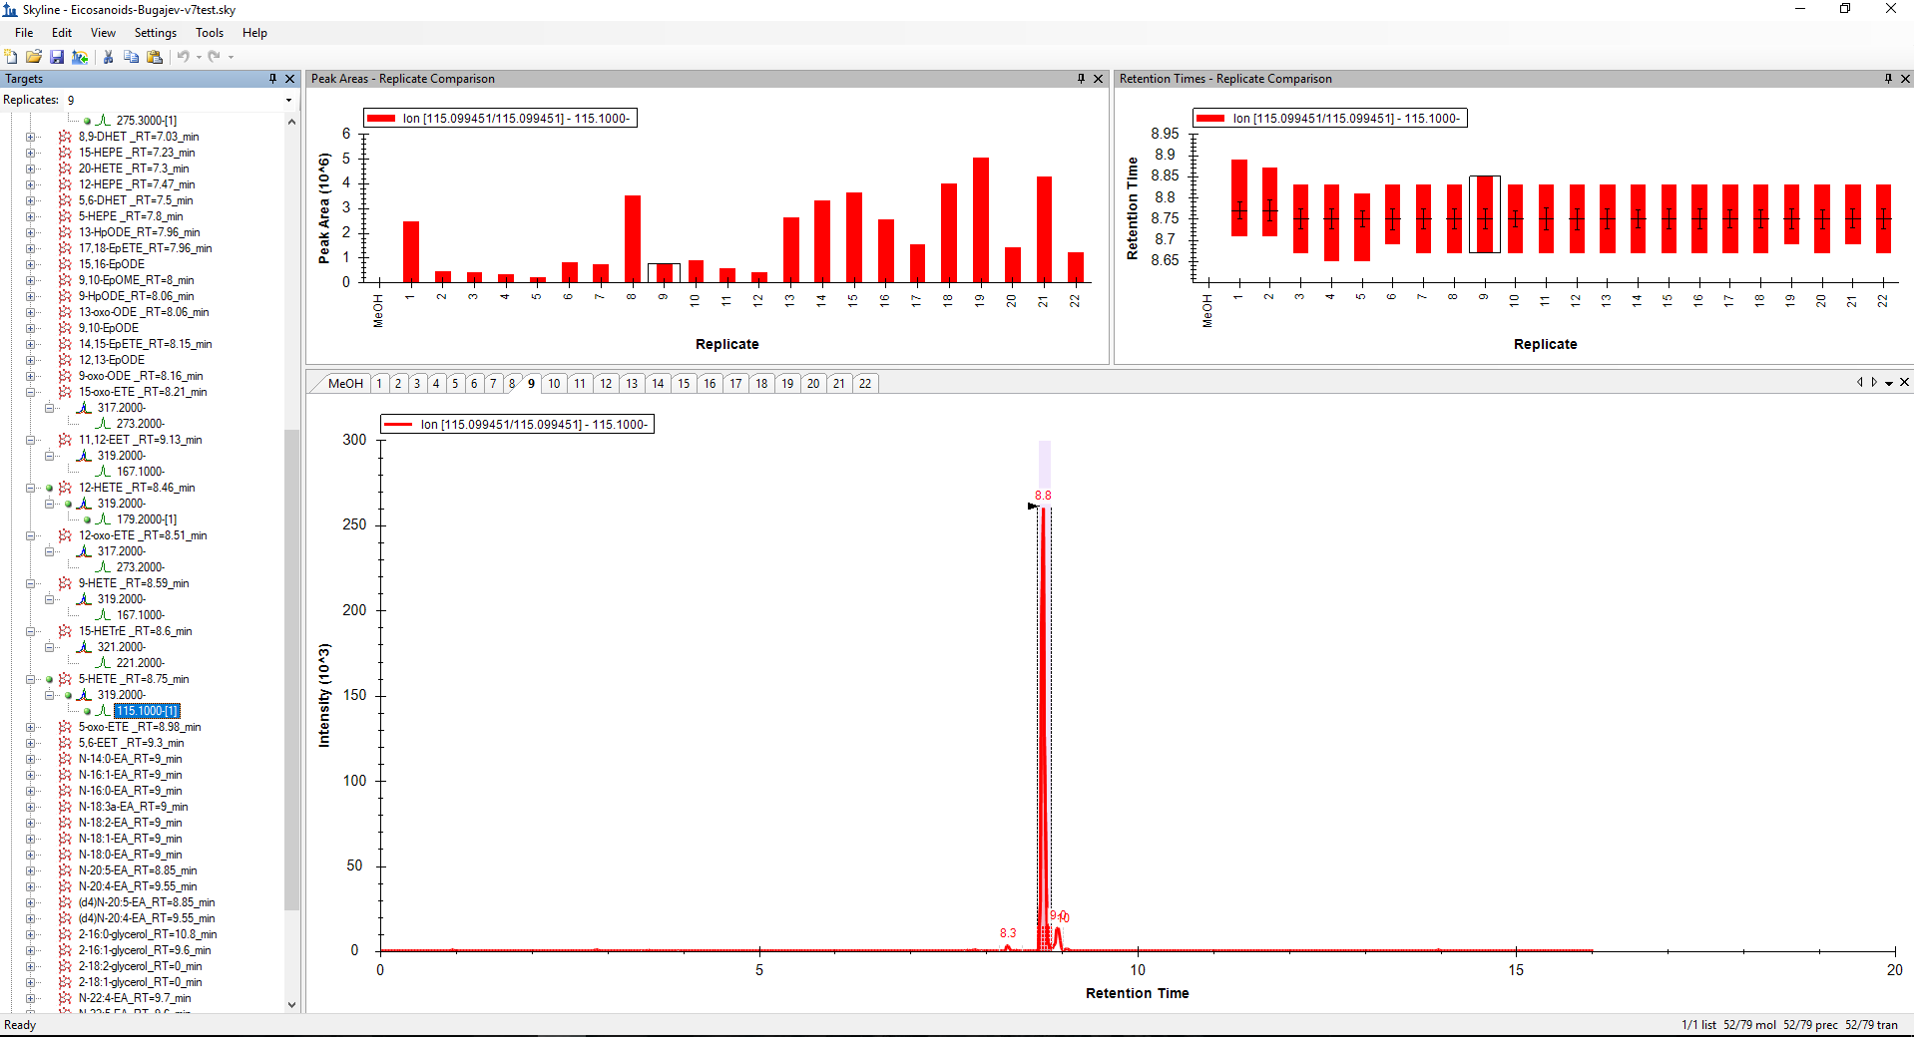
For analytes, which product m/z is written with –[1] at the end is chromatogram information available every time. I created transition list according to your video tutorial.

Slide 2
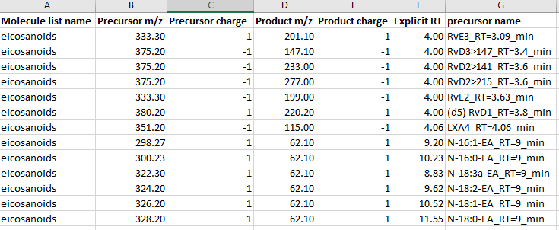
Example of what I copy to transition list

