Slide 1

Skyline Online: Advanced Proteomics Topics
Glycoproteomics Demo
Juan C. Rojas E.
October 17, 2025
Center for Proteomics and Metabolomics
Leiden University Medical Center

Slide 2
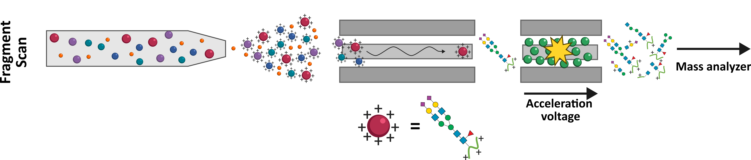
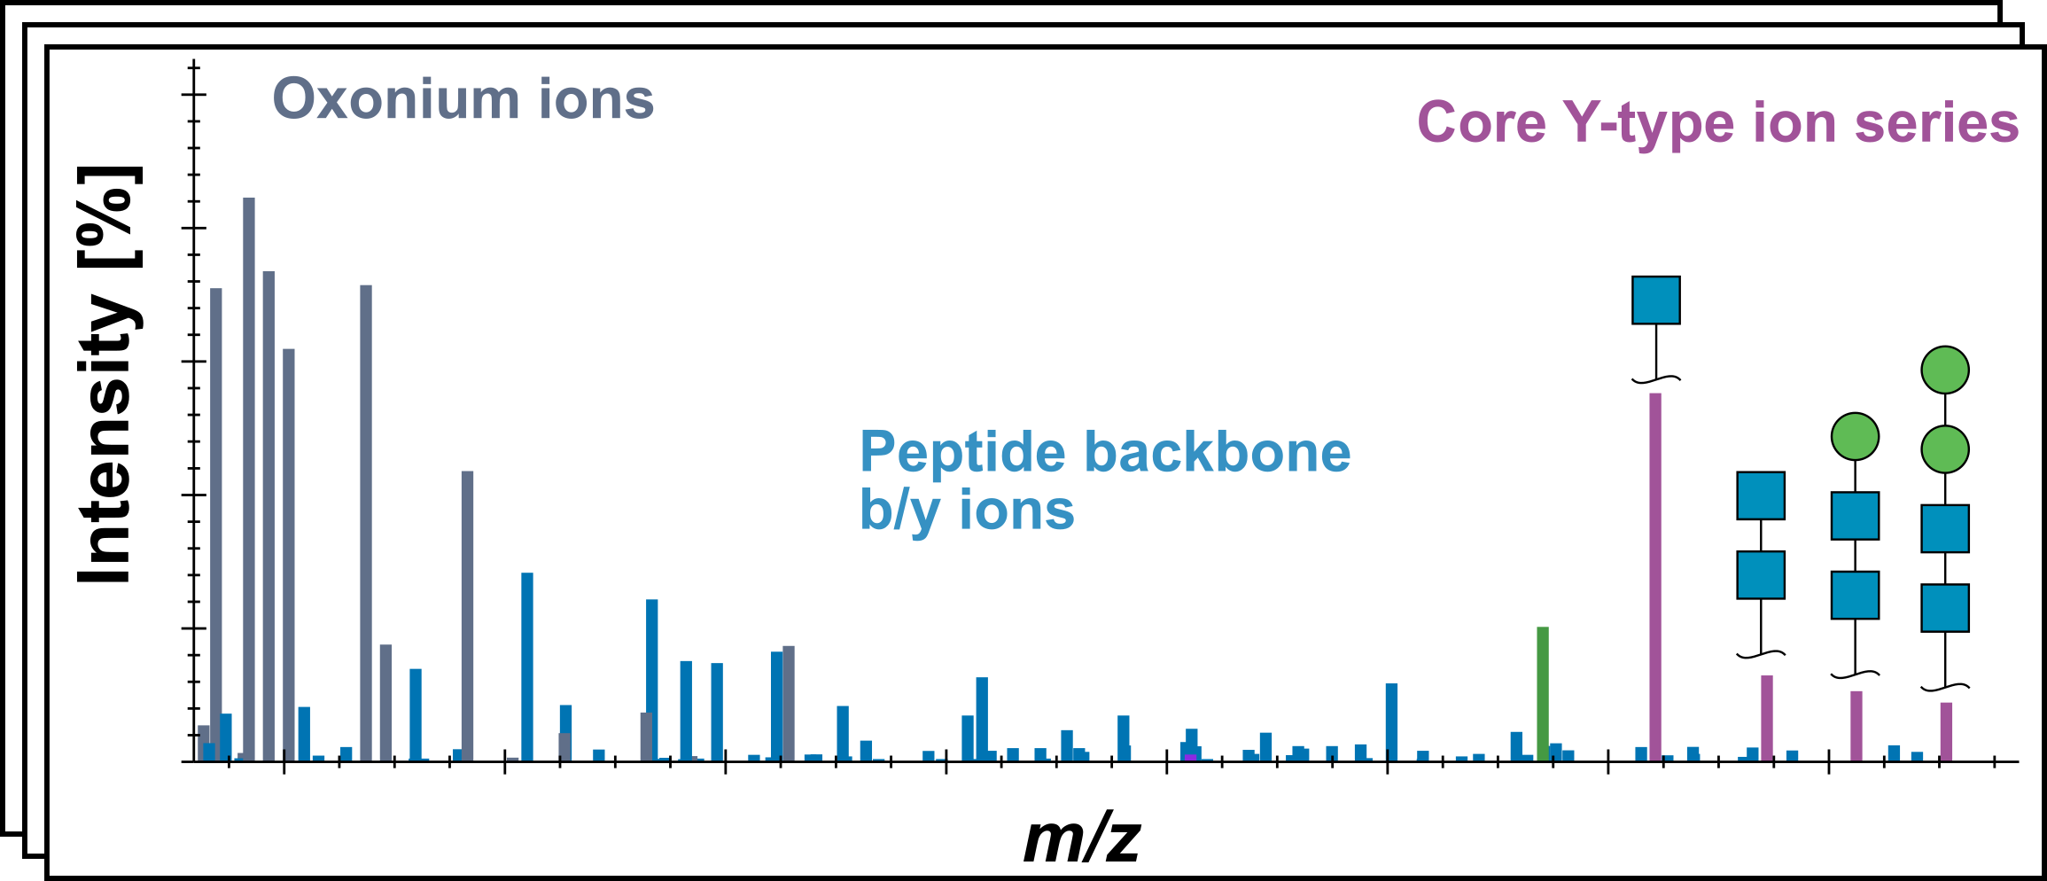
Glycopeptide fragmentation
2
Confirm peptide identity
Glycan structural classification refinement
Caval et al. 2021

Slide 3
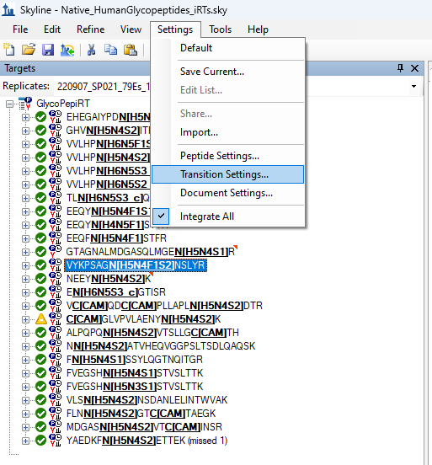
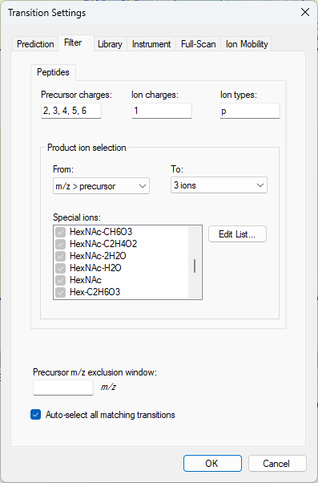
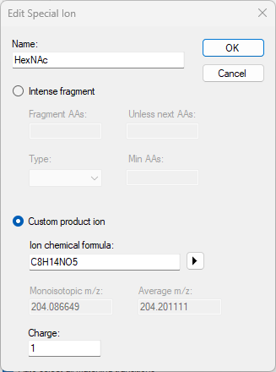
Oxonium ions in Skyline
3
Grey makes the ions to only be considered in spectral library and not added as targets for quantification
Oxonium ions are the dominant fragments from collision induced dissociation
Caval et al. 2021

Slide 4
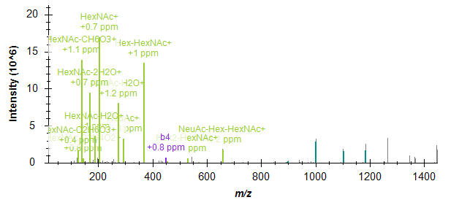
Oxonium ions in Skyline
4
Oxonium Ions
Grey makes the ions to only be considered in spectral library and not added as targets for quantification
Oxonium ions are the dominant fragments from collision induced dissociation
Caval et al. 2021

Slide 5
Y-ions in Skyline
5
Glycan structural classification refinement
Caval et al. 2021

Slide 6
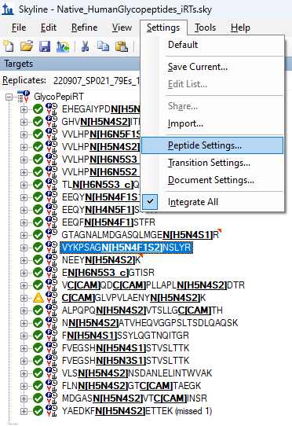
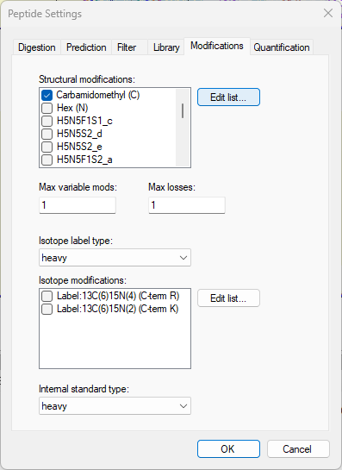
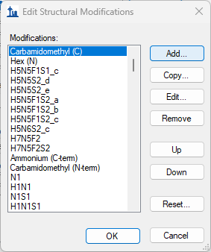
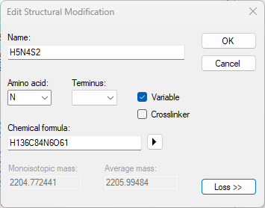
Glycopeptide modifications and Y-ions in Skyline
6
Caval et al. 2021

Slide 7
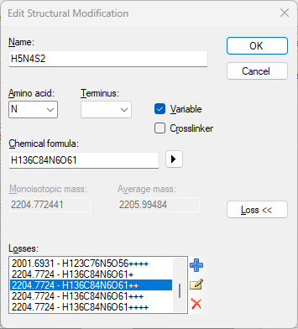
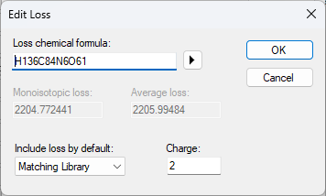
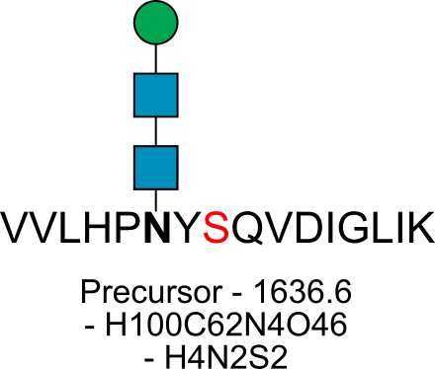
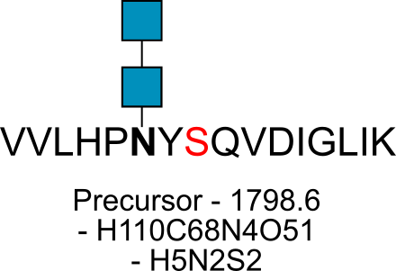
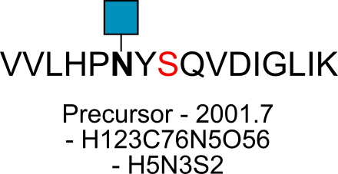
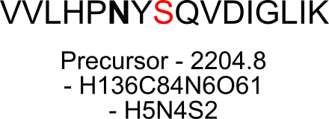
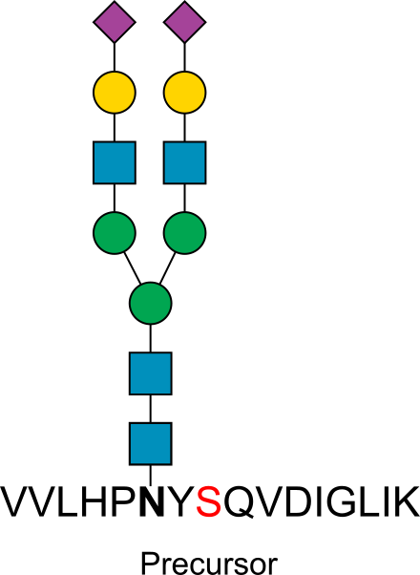


Y-ions in Skyline
7
Skyline improvement request:
- Remove requirement to match charge for glycan losses
N-glycan core
Type on that Skyline Support Board!
Caval et al. 2021

Slide 8
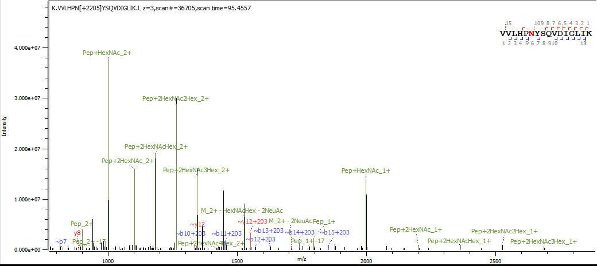

Y-ions in Skyline vs Byonic annotations
8
Pep
Y₀
Pep+HexNAc
Y₁
Pep+2xHexNAc
Y₂
Pep+2xHexNAcHex
Y₃
Caval et al. 2021

Slide 9
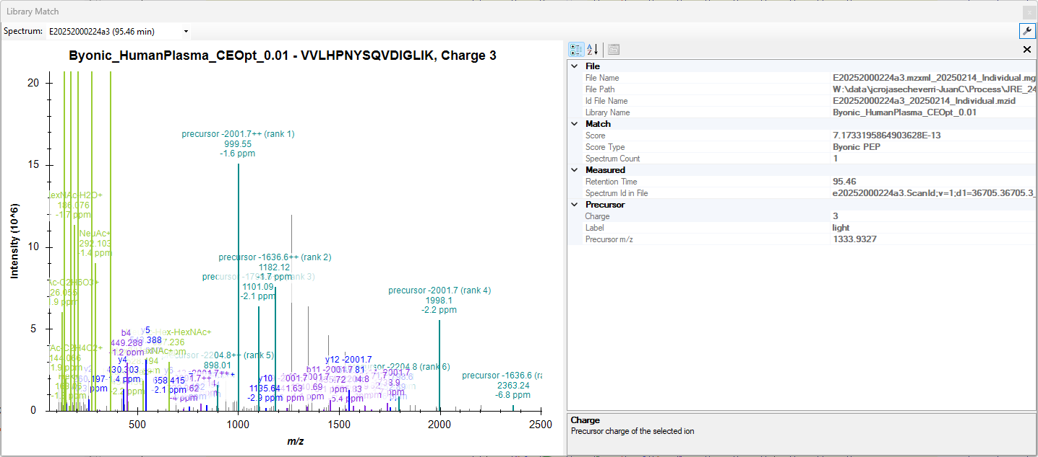
Y-ions in Skyline vs Byonic annotations
9
Pep
Y₀
Pep+HexNAc
Y₁
Pep+2xHexNAc
Y₂
Pep+2xHexNAcHex
Y₃
Y₁
Y₂
Y₃
Y₀
???
Bigger Y-ions
Caval et al. 2021

Slide 10

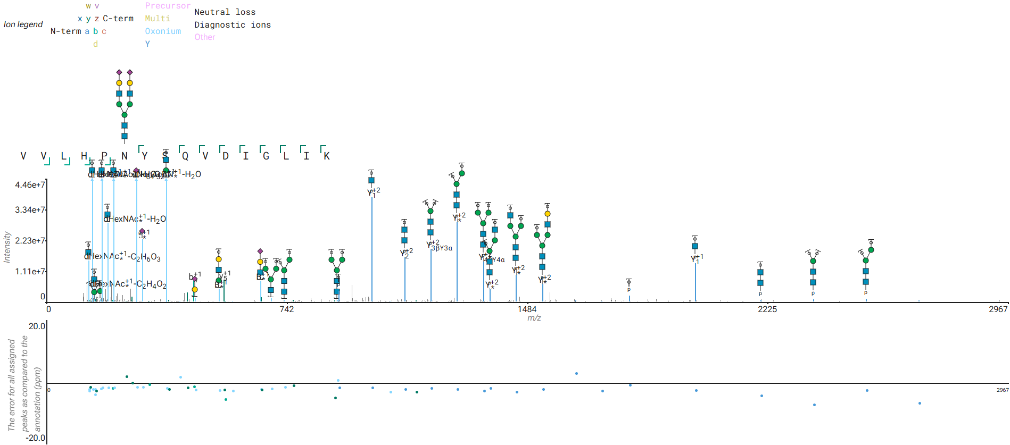
Annotator: assisting glycopeptide visualization
10
Modified peptide sequence format:
VVLHPN[GNO:G43679GQ]YSQVDIGLIK
Requires:
Raw file
Scan number
Modified peptide sequence
Glycan GlyTouCan ID
  Allows using glycan monomer connectivity to filter possible glycan-specific fragments
GitHub:
https://github.com/snijderlab/annotator
Schulte et al. 2025 Analytical Chemistry;
DOI: 10.1021/acs.analchem.5c02832
Caval et al. 2021

Slide 11

Defining hundreds of glycan modifications
11
Having to repeat this hundreds of times…
Caval et al. 2021

Slide 12

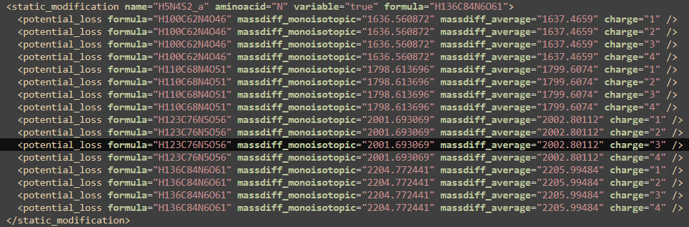
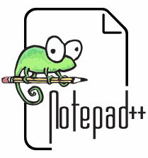

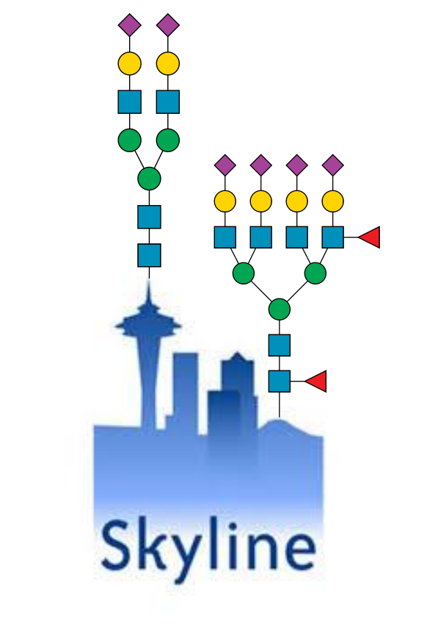


Defining hundreds of glycan modifications
12
<peptide_settings> → <peptide_modifications> → <static_modifications> →
.sky
(XML file)
Empty template file
Oxonium ions defined
Non-glycan modifications
Load search results (spectra library)
Define Peptide and Transition settings
Load raw MS data
Modify Skyline XML file
Updated empty template file
Oxonium ions defined
Non-glycan modifications
Glycan modifications with losses
Glycan database
- Hundreds of custom glycan compositions (e.g. H5N4S2, H5N4F1S2, H6N5S3)
Caval et al. 2021

