Slide 1
Database Steroide
Screen des features du raw pour extraire celles correspondantes
À la DTB
m/z
Rt
Area
Raw Data

Slide 2
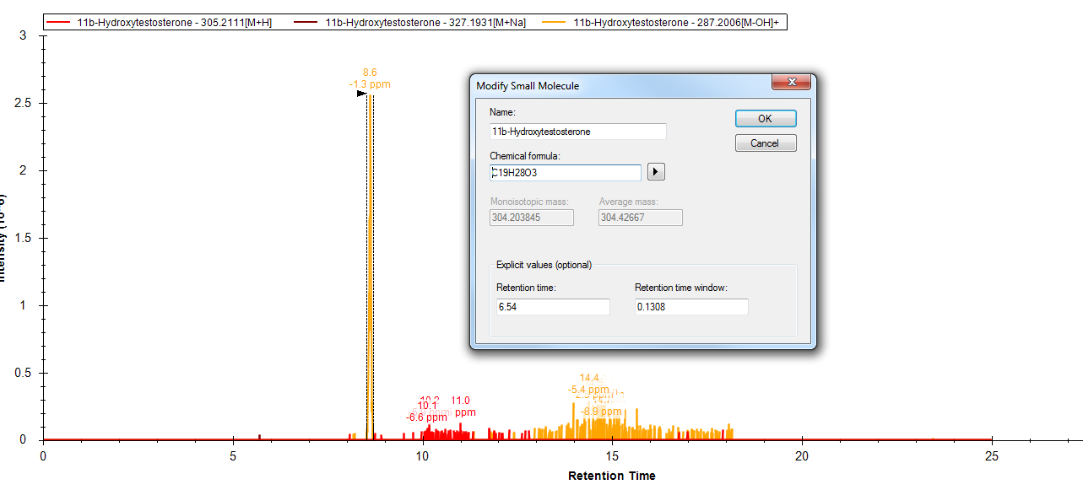


Slide 3
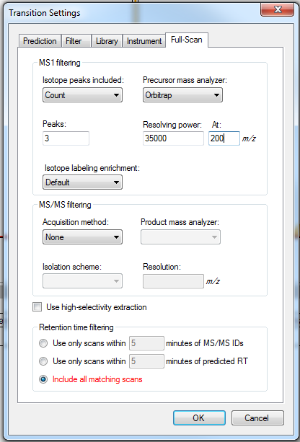
Not enough for ppm accuracy (metabolites can have a smaller difference in mass than 30ppm)
Changing that to 1 doesn’t reduce retention time for ms1 transition list neither

