Slide 1
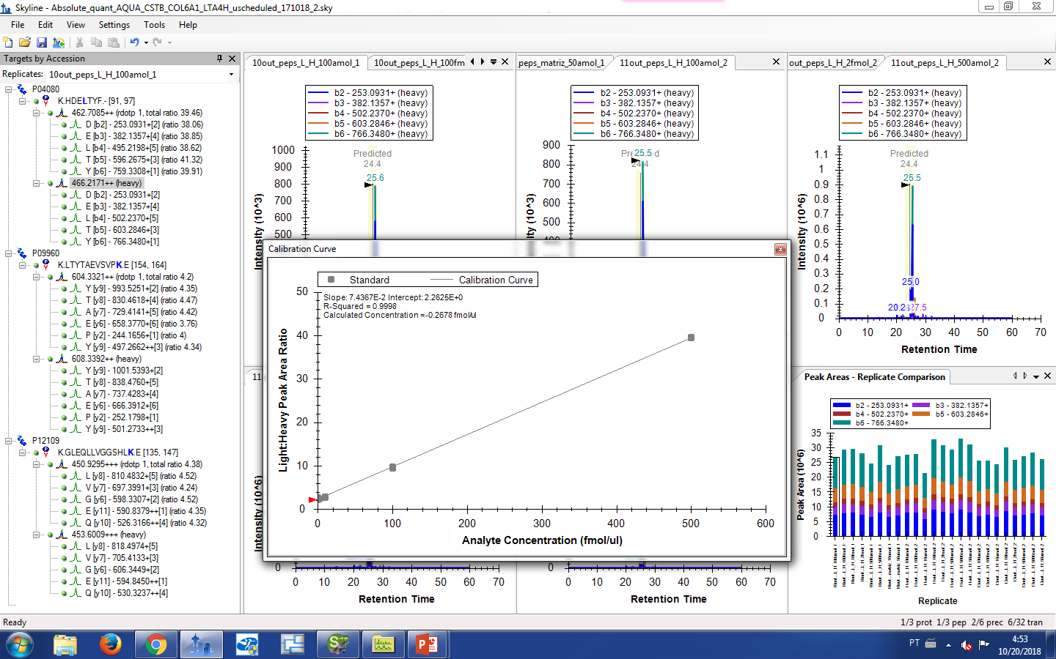
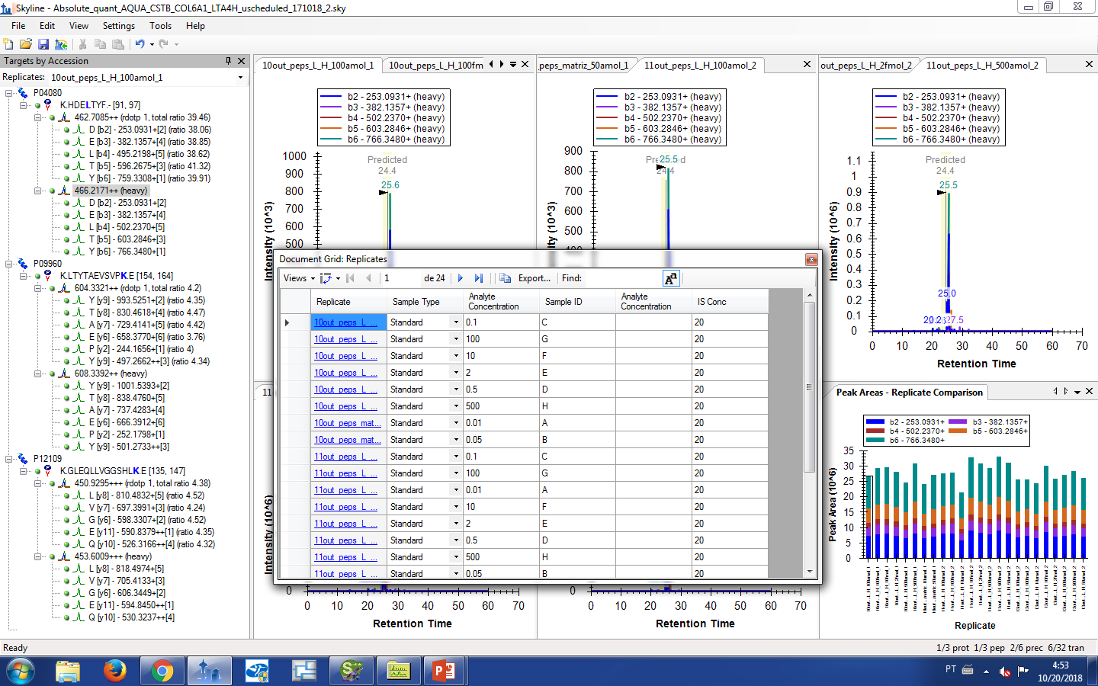
Calibration curve
Document grid
How can I obtain LOD, precision and other parameters?

