Slide 1
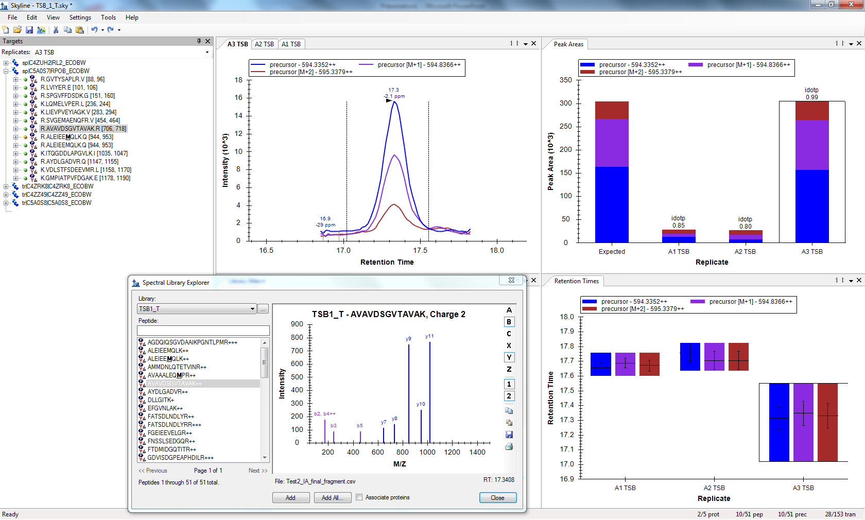
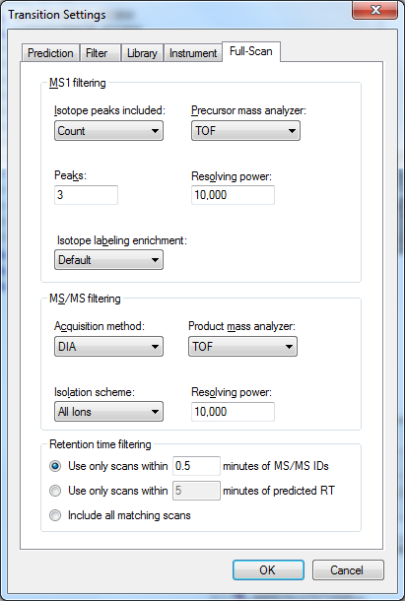
Now it is much better,
as 5 min is the default is 0.5 a to tight window?

Slide 2
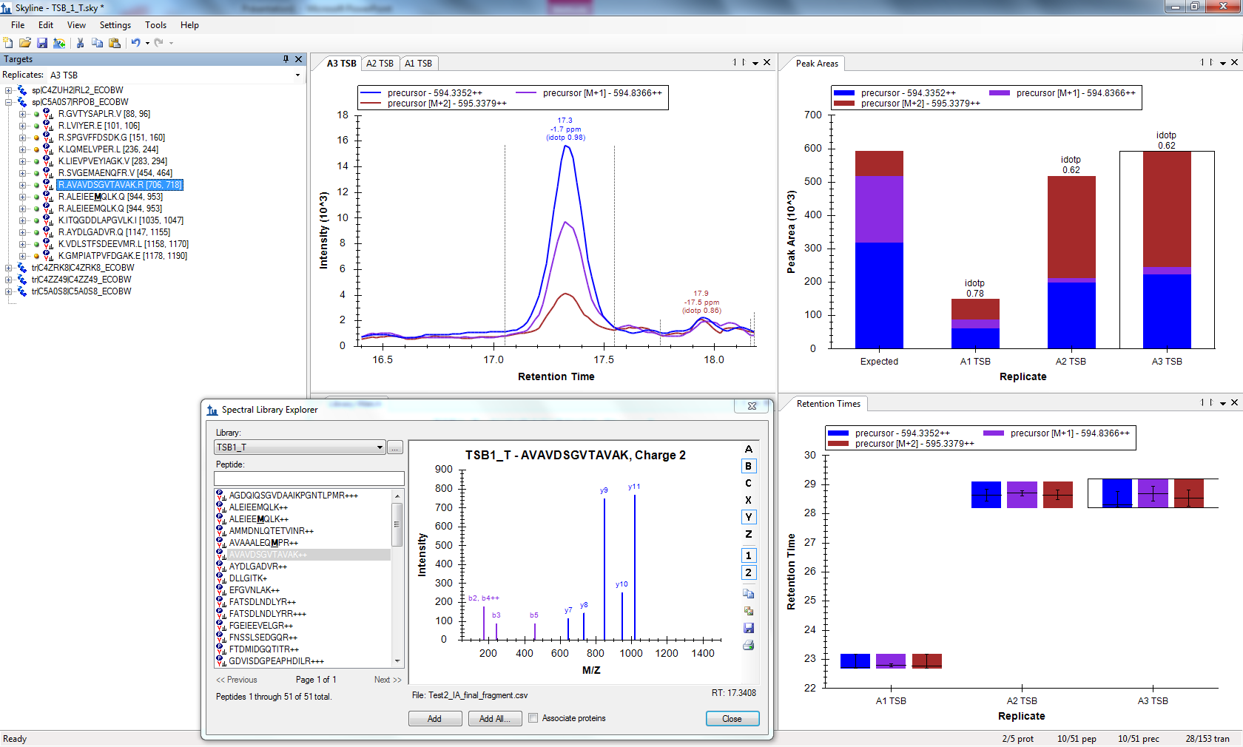
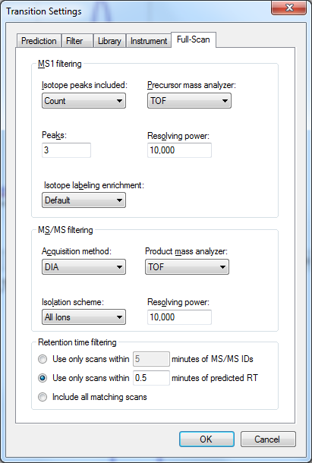
Here, it is worse again, like for the 5 min at the beginning.

