Slide 1
08142017 – requesting help with getting variable mods to show up.

Slide 2
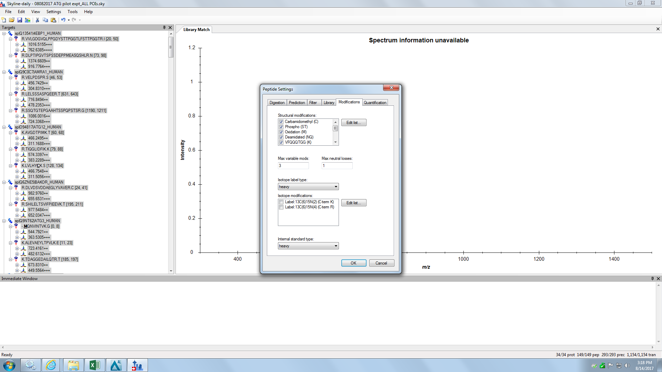

Slide 3
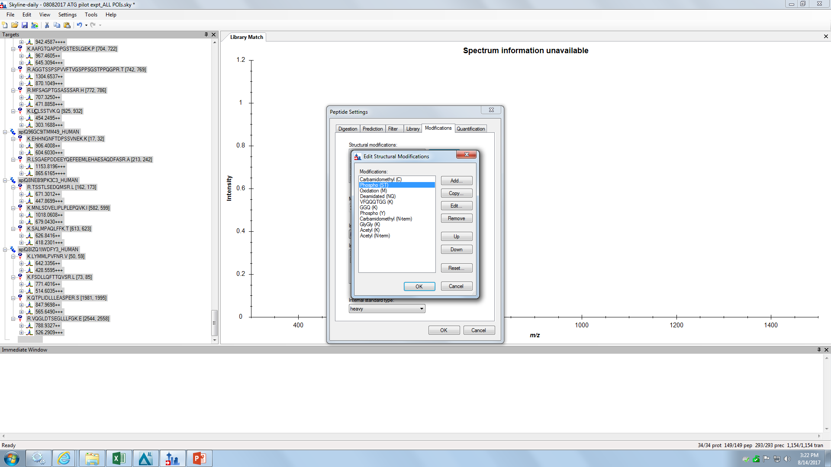

Slide 4
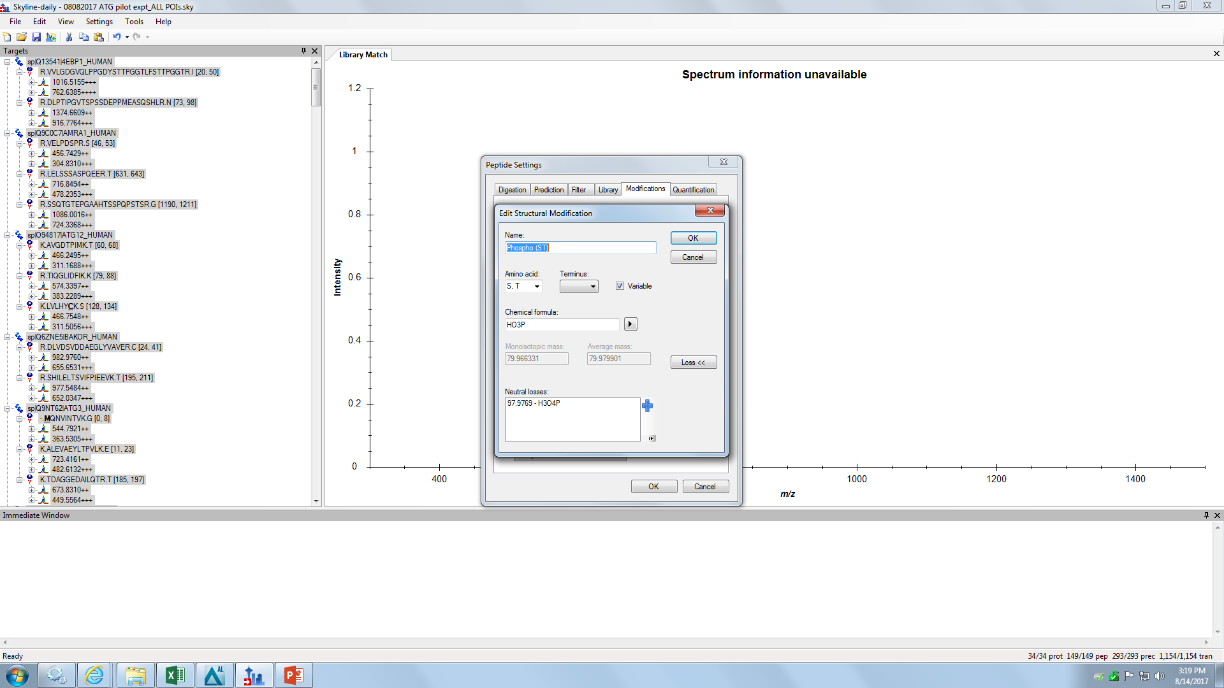

Slide 5
Thanks for any help you can offer!

