Slide 1
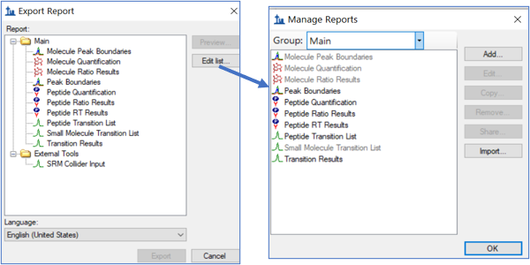
Missing “Peak Area” option

