Slide 1
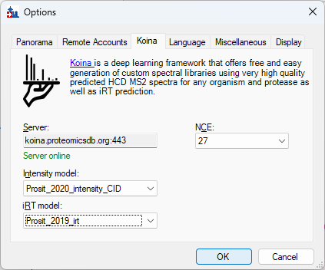
Tools > Options > Koina

Slide 2
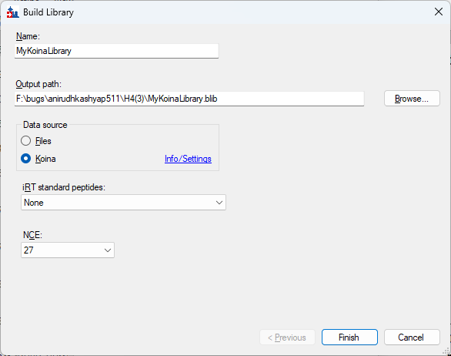
Settings > Peptide Settings > Library > Build

