Slide 1
Error importing MSFragger Library to Skyline using GPF DIA data

Slide 2
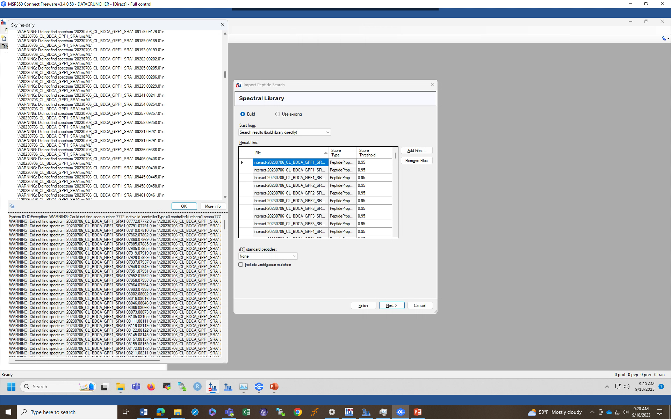
DDA-import-fp9

Slide 3
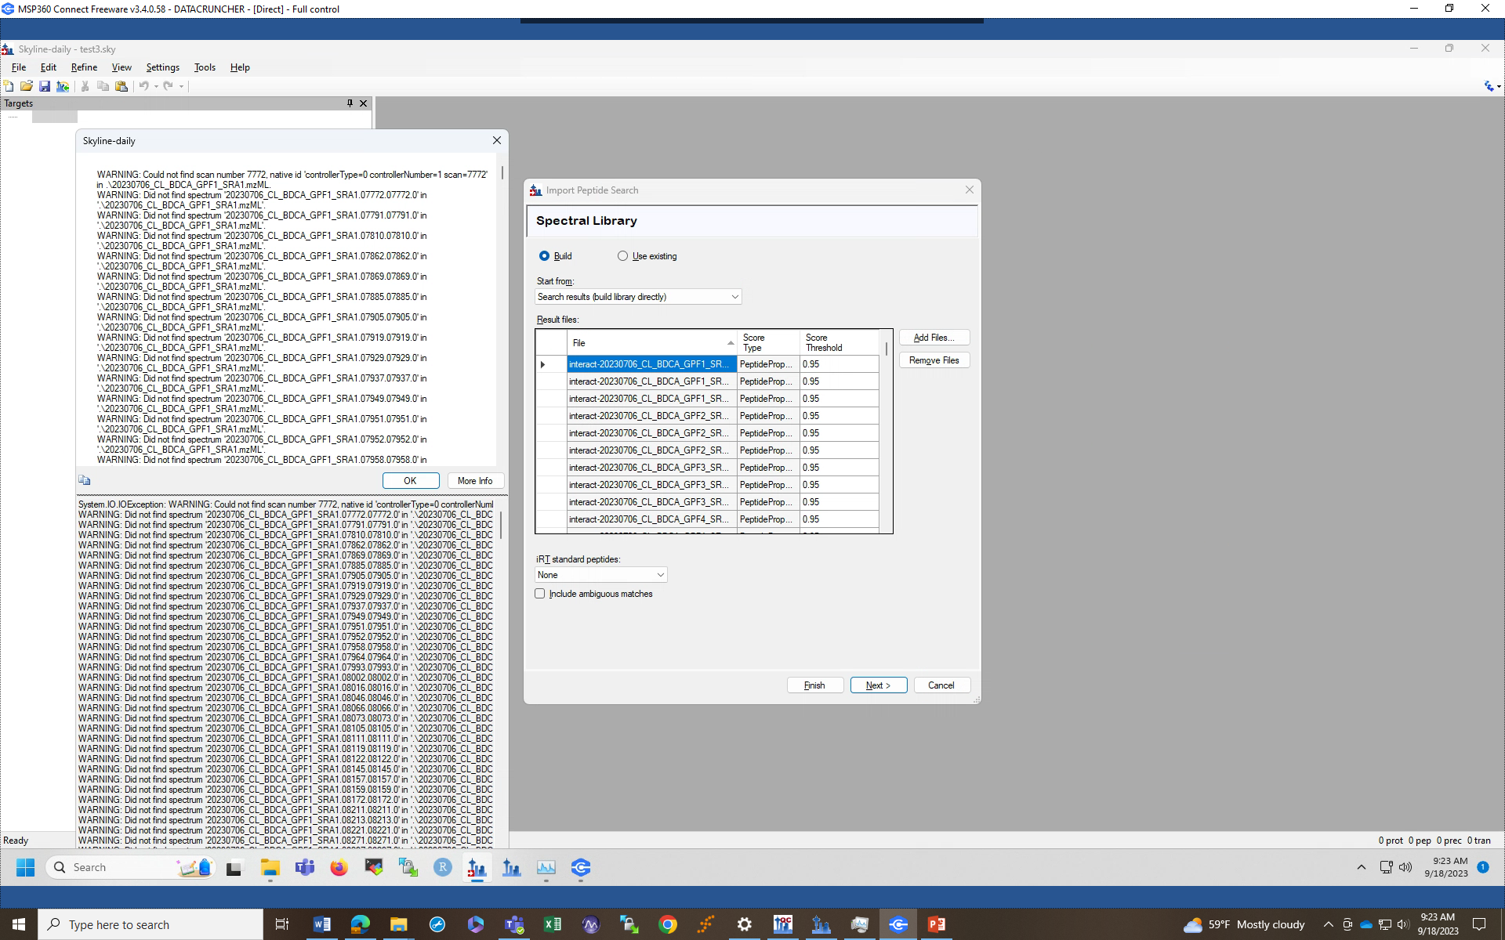
DIA-Import-fp9

