Slide 1
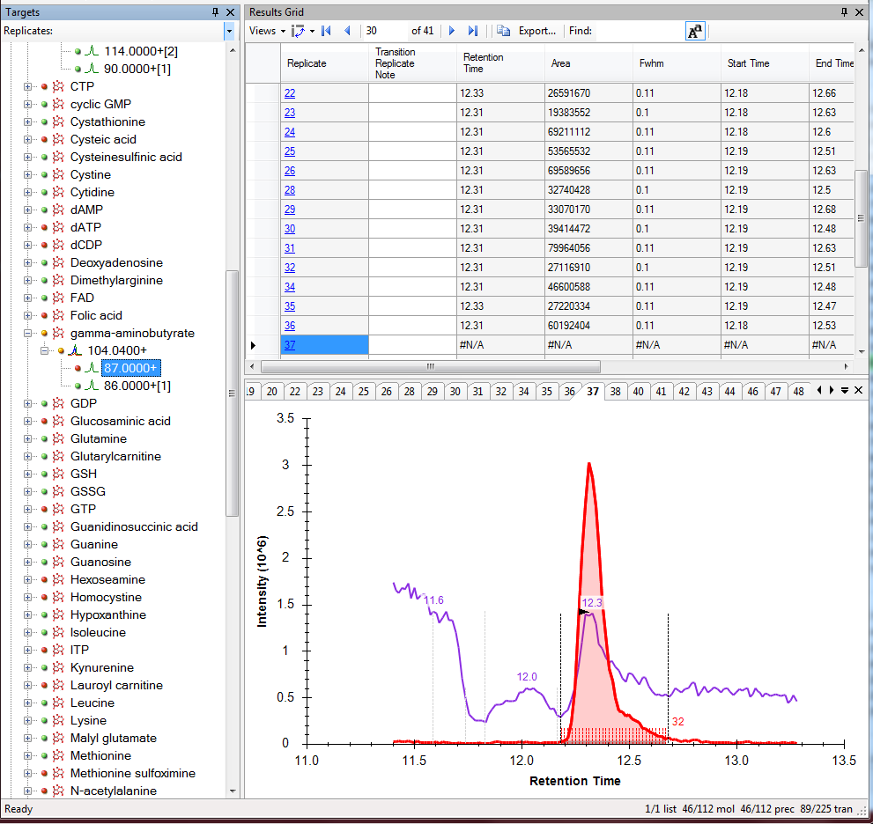
Shaded as if integrated, but no integration performed.
Red error light in the Targets pane for the 87 m/z.
#N/A for all values in Results Grid.

Slide 2
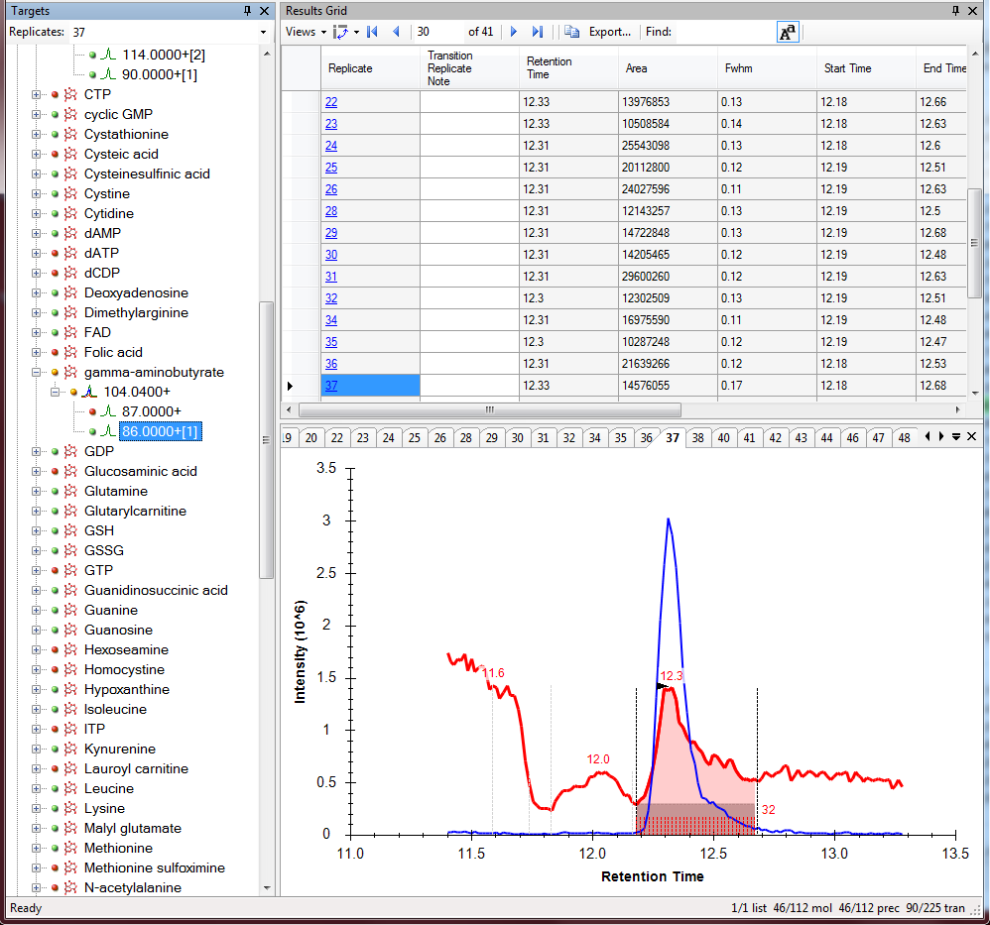
Integration performed.
Green light in Targets pane for this transition.
Values in Results Grid.

