Slide 1
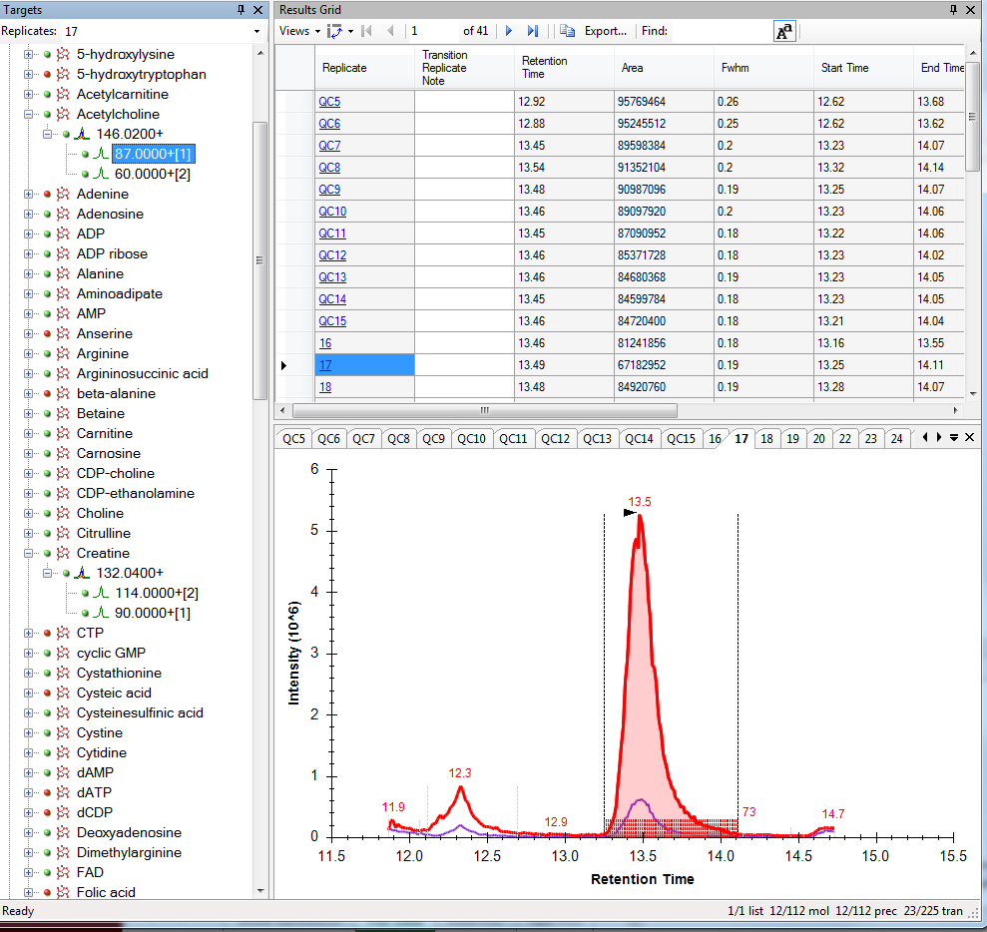
Acetylcholine, Run 17, 148->87 m/z
- Expected RT window and proper integration.

Slide 2
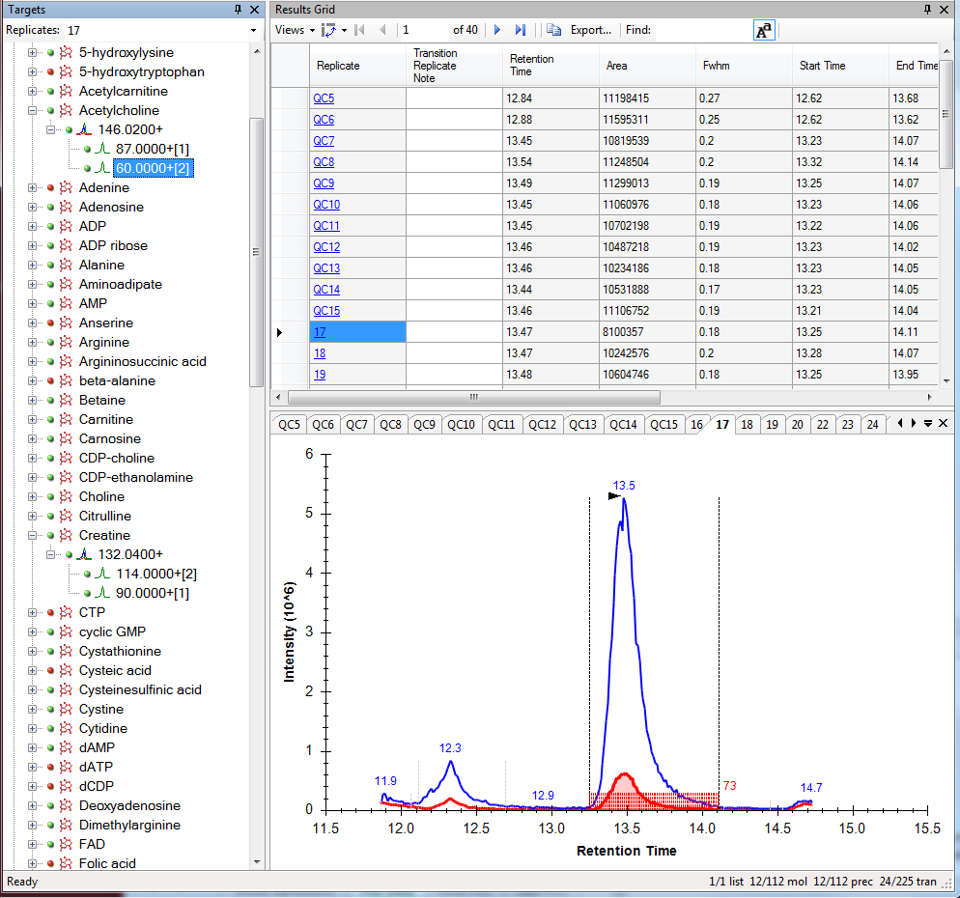
Acetylcholine, Run 17, 148->60 m/z
Expected RT window and proper integration.
Note, run 16 is not included in the Results Grid for this transition.

Slide 3
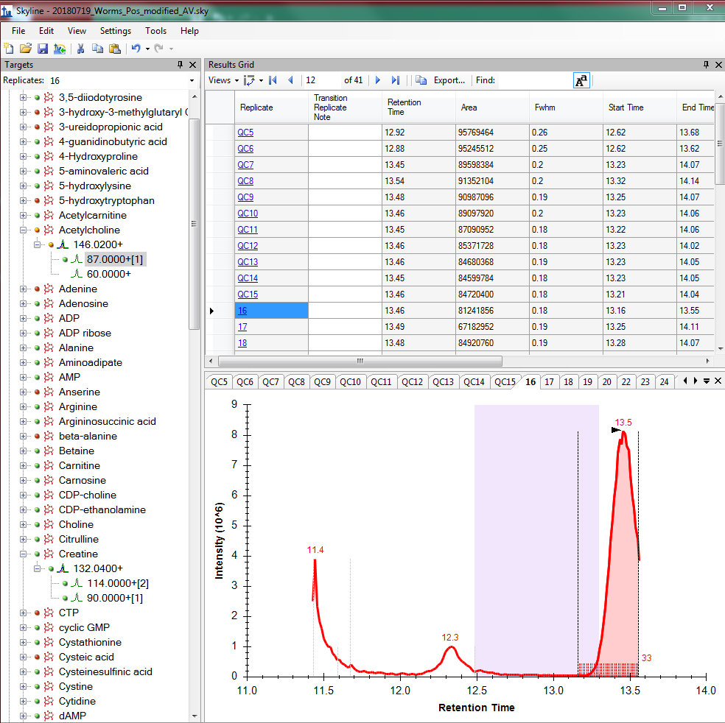
Acetylcholine, Run 16, 148->87 m/z
- Altered retention time window. Peak is cut off.

Slide 4
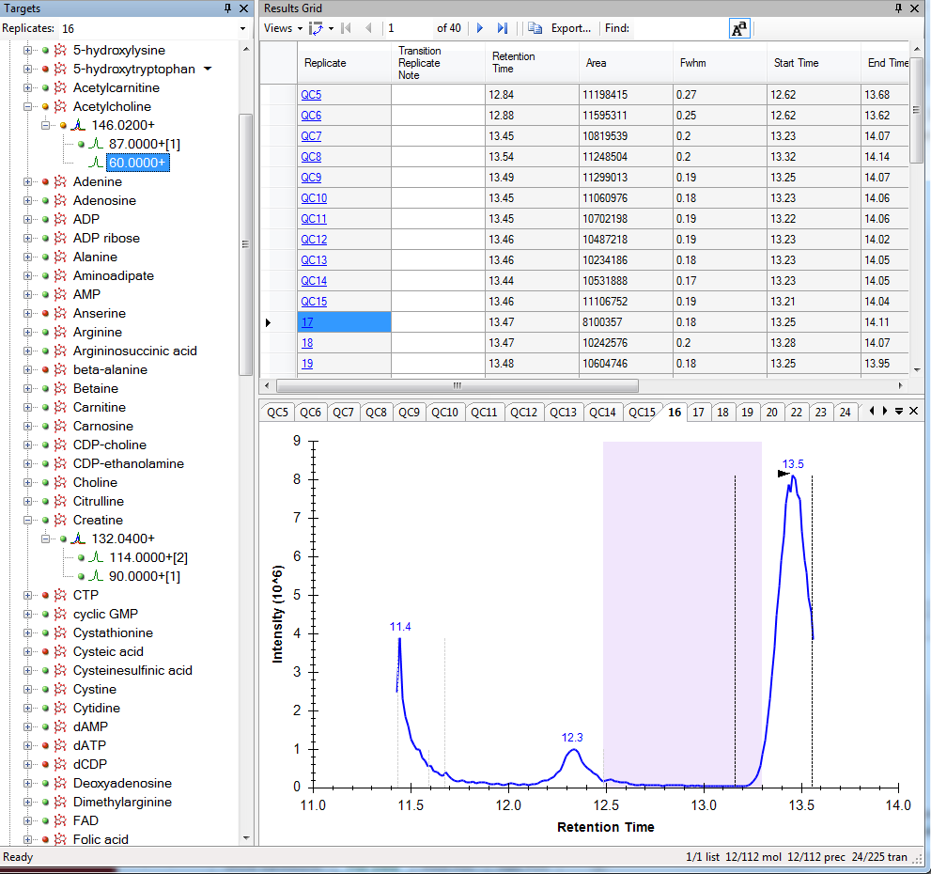
Acetylcholine, Run 16, 148->60 m/z
Altered RT window and no integration.
This transition file has not been imported.

Slide 5
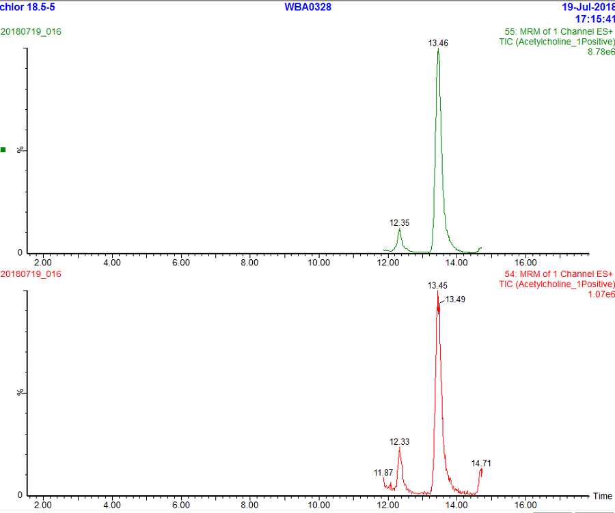
MassLynx Chromatograms
Top: Acetylcholine, Run 16, 148->87 m/z
Bottom: Run 16, 148->60 m/z

