Slide 1
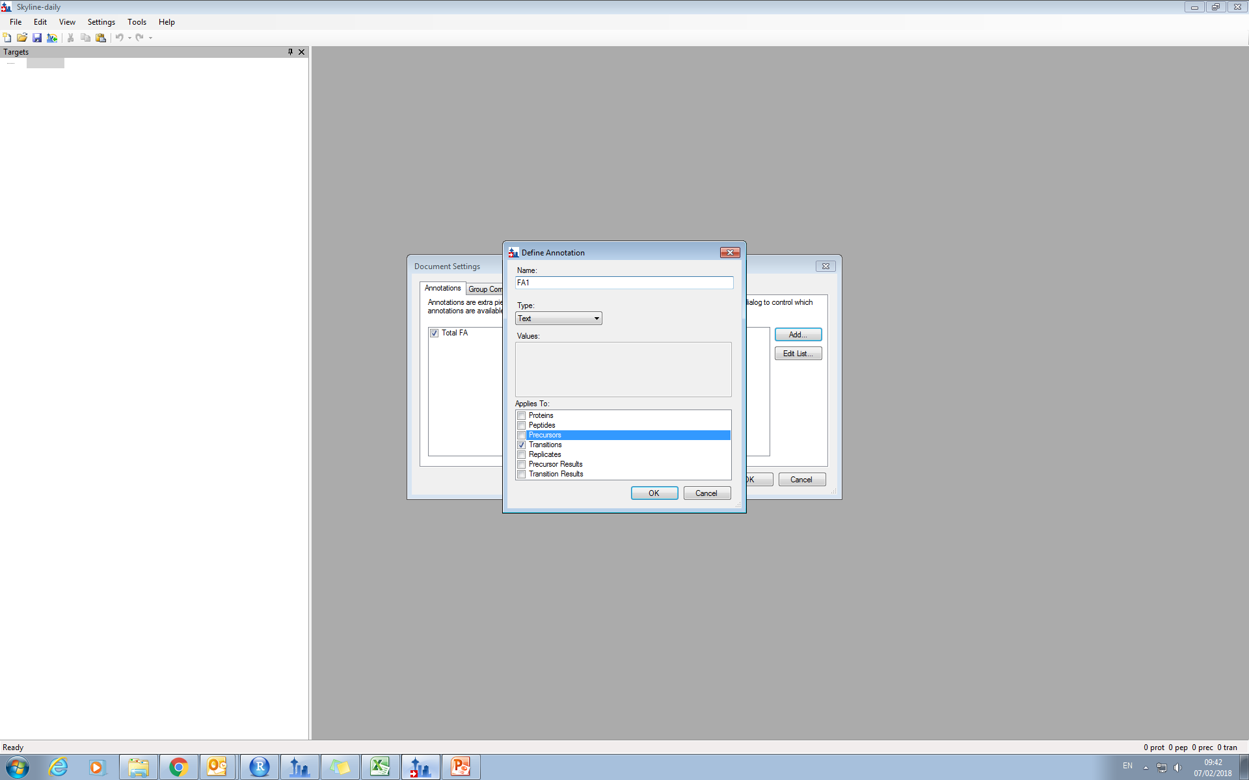
Creating the annnotitions

Slide 2
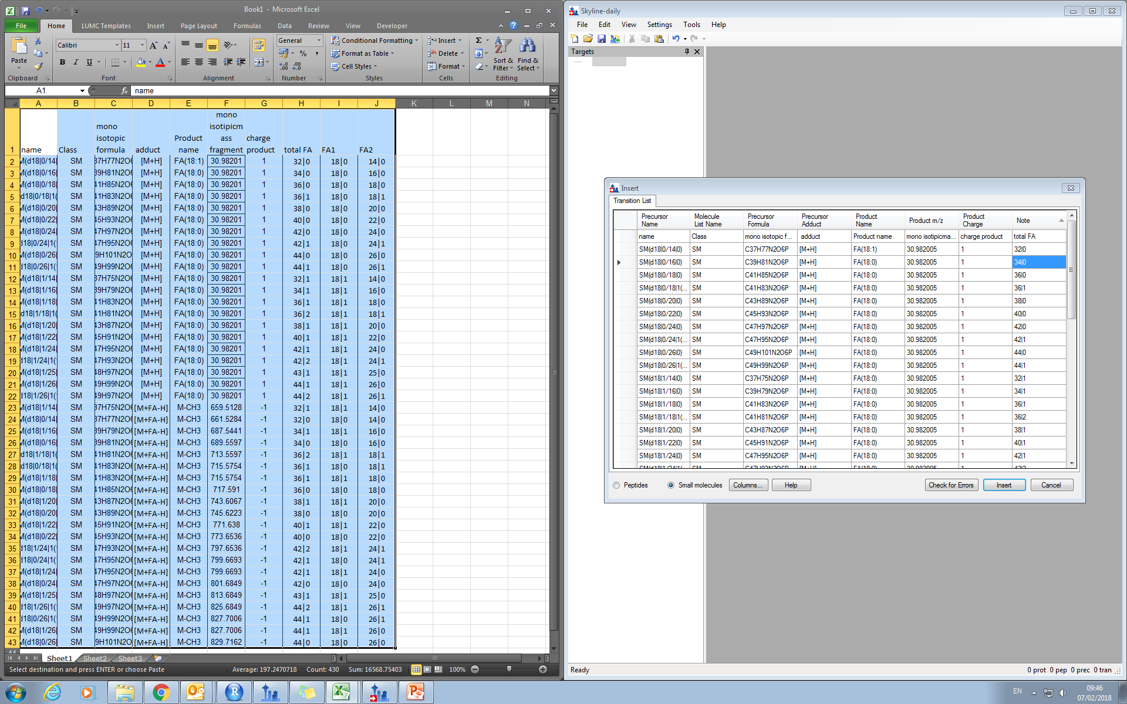
Coppying the database
Not able to add as annotation
Copying
No annotations selectable

Slide 3
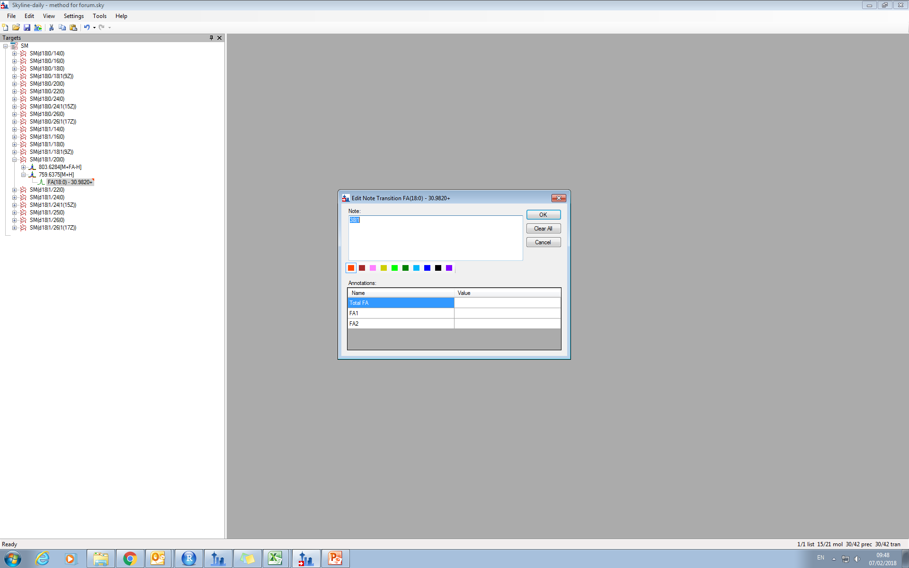
Looking at the notitions
Empty ☹

Slide 4
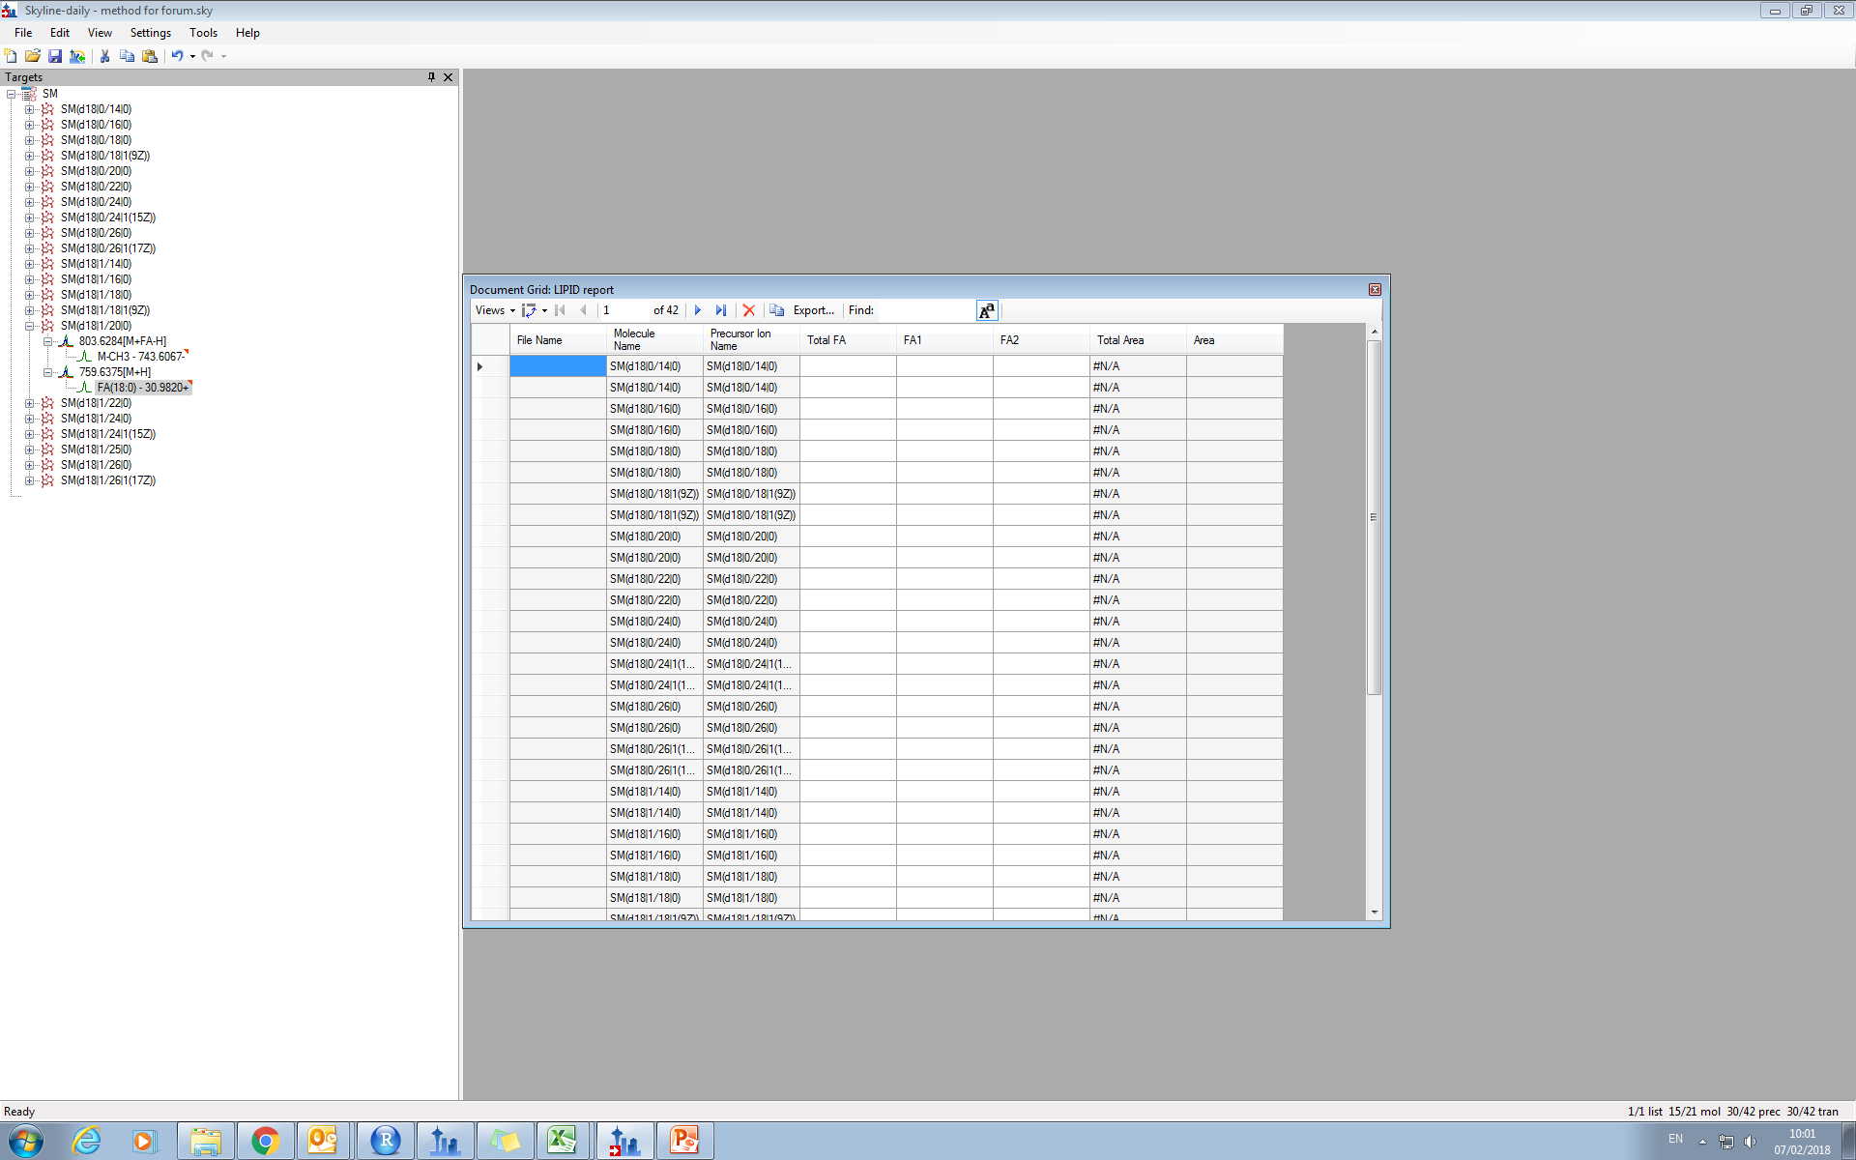
The report
Empty ☹

Slide 5

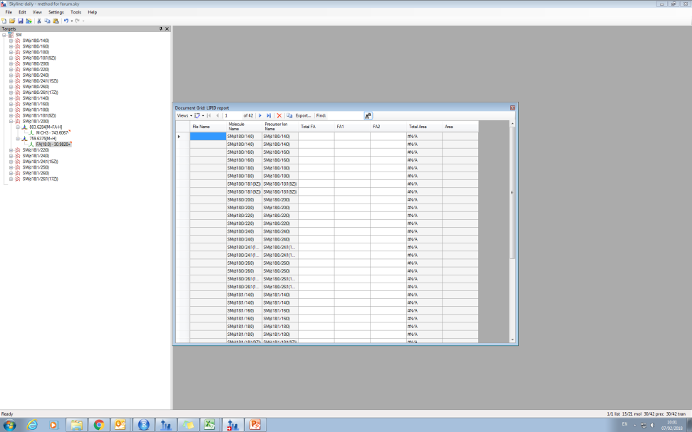
Copy multiple columns as annotation to the transition list will do the job

