Slide 1
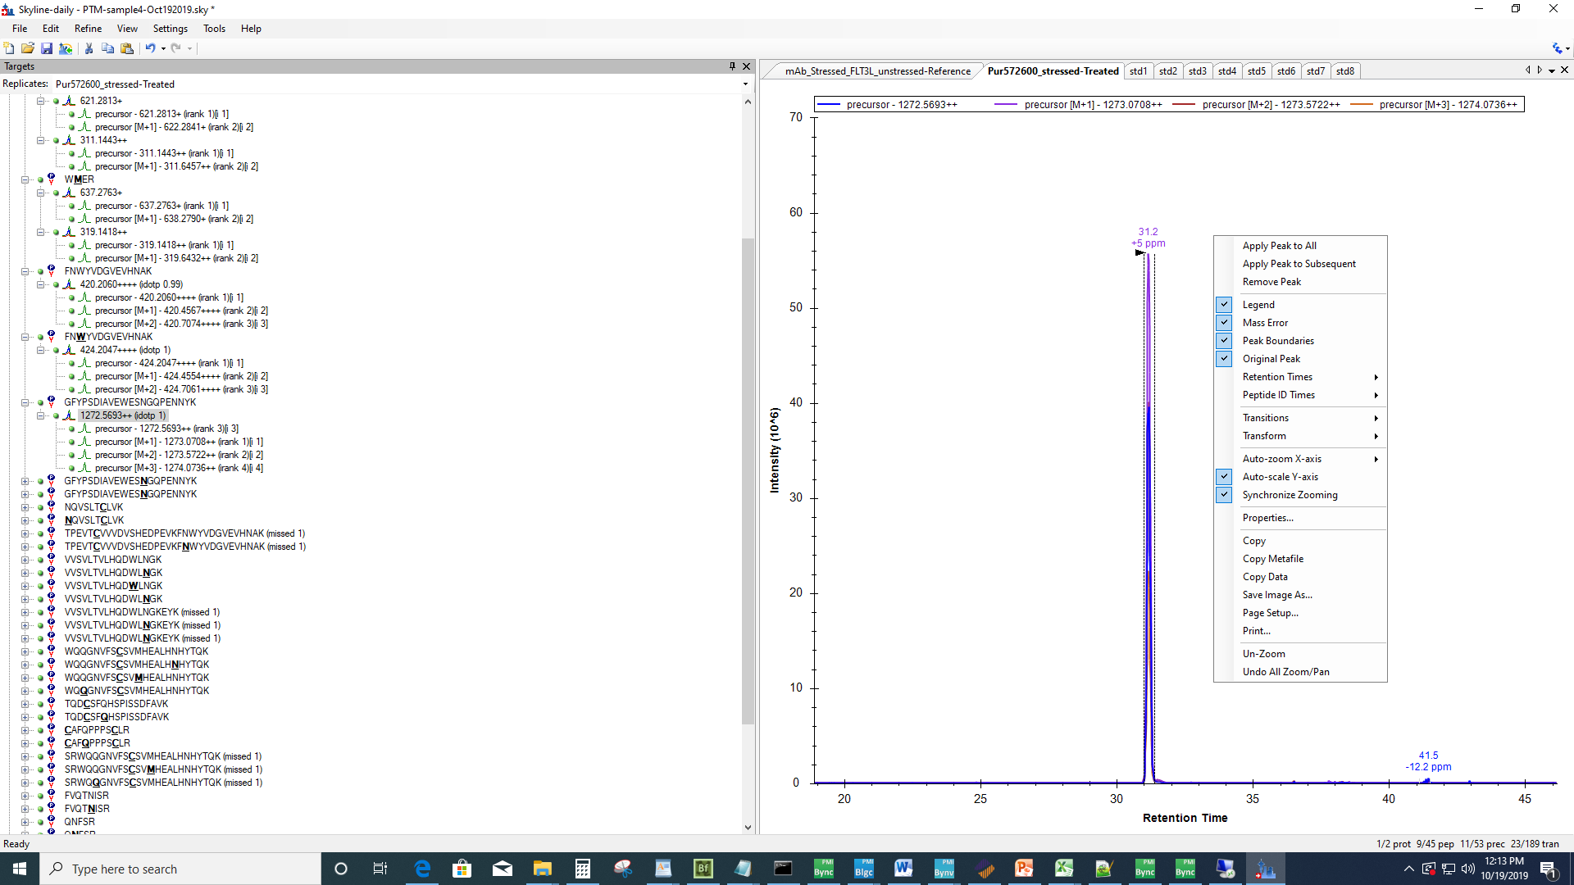
Trying to pick this 31.2 min peak in other samples by clicking ‘Apply peak to ALL’

Slide 2
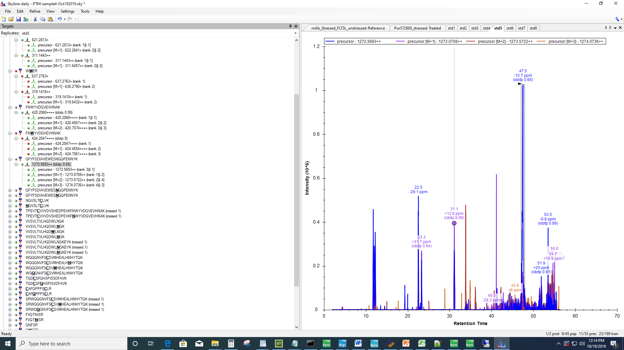
Software could not pick the 31.1 min peak but picked the 47.5 min wrong peak
This situation does not happen when the peptide is still at high abundance

Slide 3
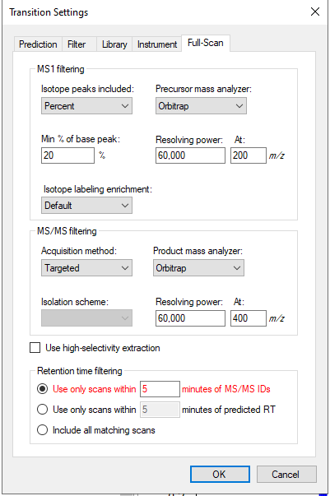
Played with those settings but did not see improvement.

