Slide 1
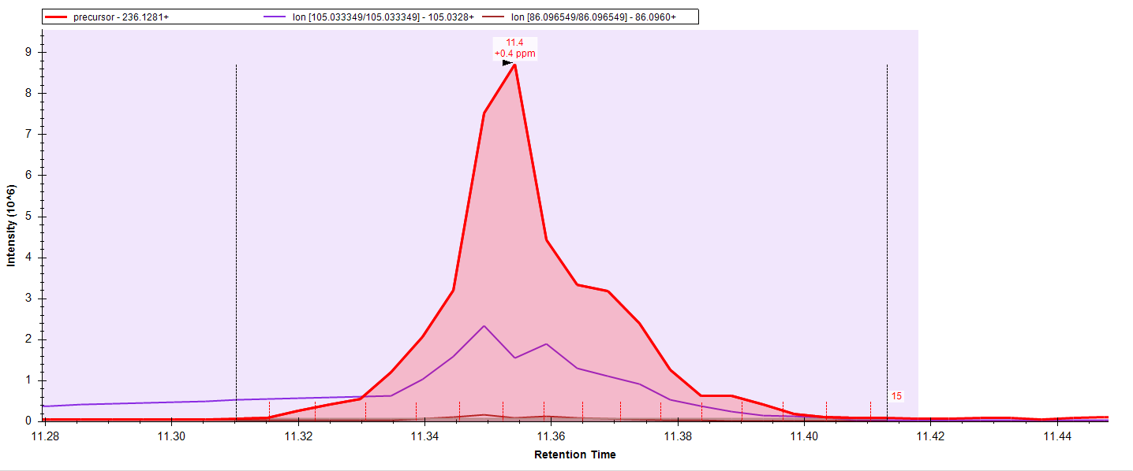
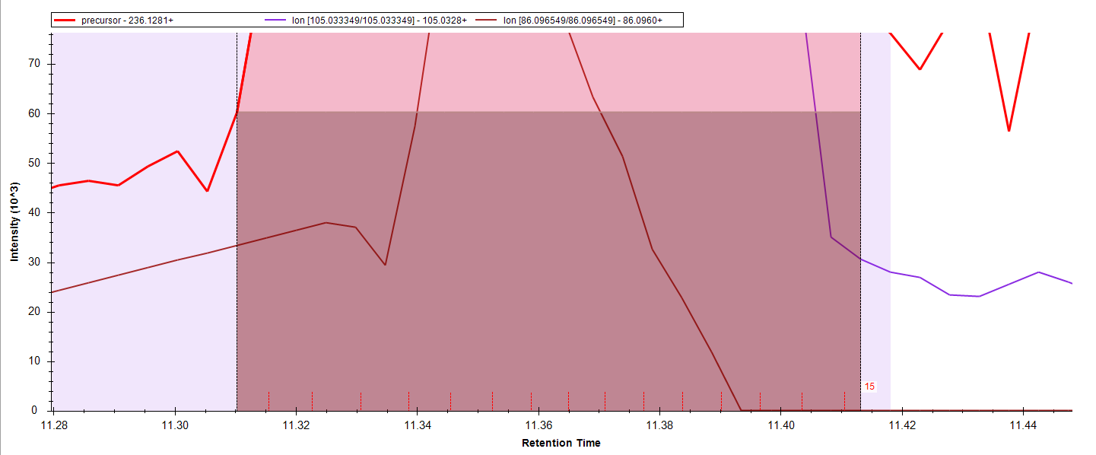
LIGHT
8,800,000 – 60,000 = 8,740,000
8.8x10⁶
60x10³
Peptide | Area | Replicate Name | Isotope Label Type | Height | RatioLightToHeavy | Fragment Ion Type | Background
isoleucine | 11587067 | 131 | light | 8652557 | 6.067 | precursor | 372245
isoleucine | 2721393 | 131 | heavy | 2286788 | 6.067 | precursor | 0

Slide 2
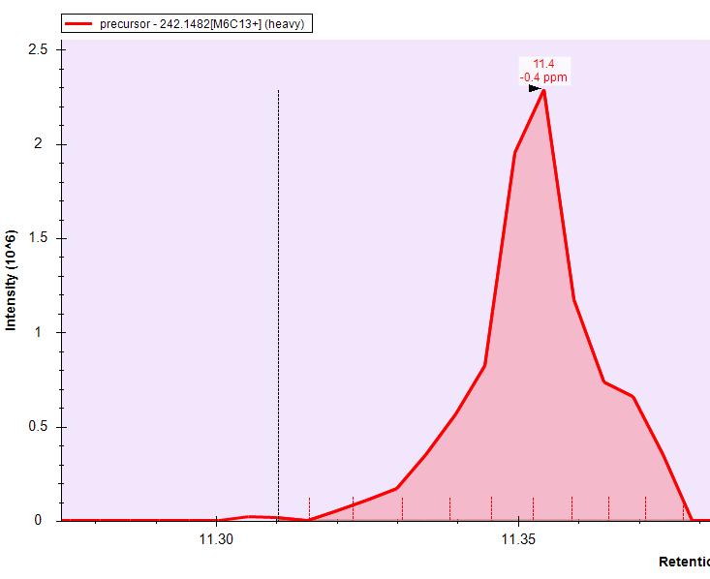
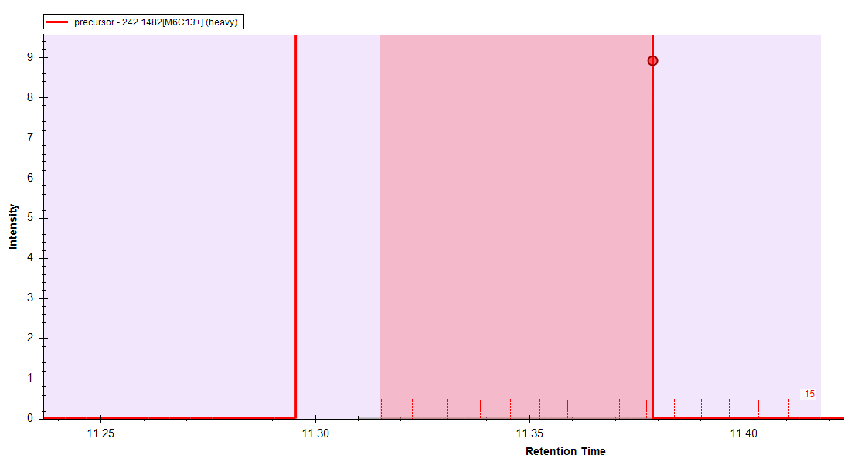
HEAVY
2,300,000 – 0 = 2,300,000
2.3x10⁶
0
Light/Heavy = 8740000/2300000 = 3.8
Peptide | Area | Replicate Name | Isotope Label Type | Height | RatioLightToHeavy | Fragment Ion Type | Background
isoleucine | 11587067 | 131 | light | 8652557 | 6.067 | precursor | 372245
isoleucine | 2721393 | 131 | heavy | 2286788 | 6.067 | precursor | 0

