Slide 1
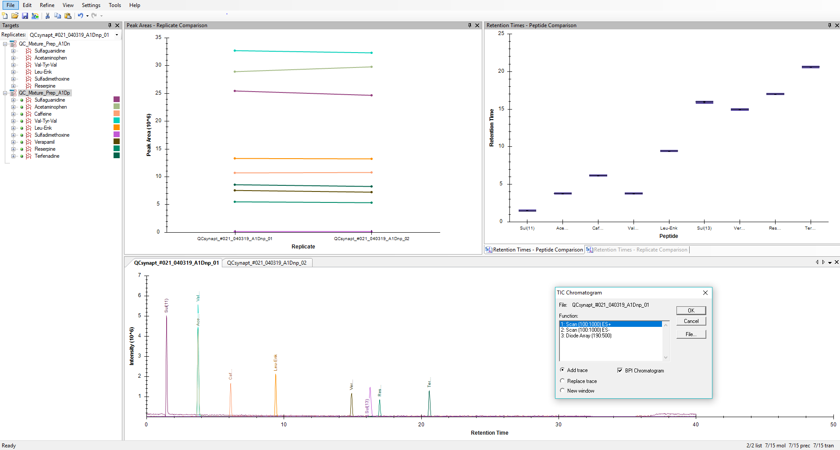
POS mode
All compounds found
Neg mode
NONE compounds found
3 traces in one run

Slide 2
