Slide 1
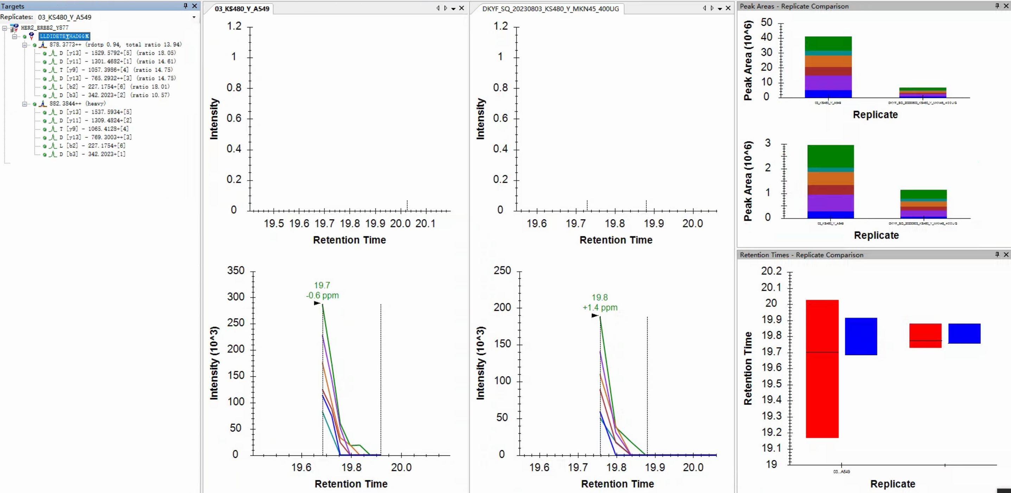
The peak areas can be seen from the skyline，but no chromatographic peak？
The chromatographic peak of the heavy peptide cannot be triggered？

Slide 2
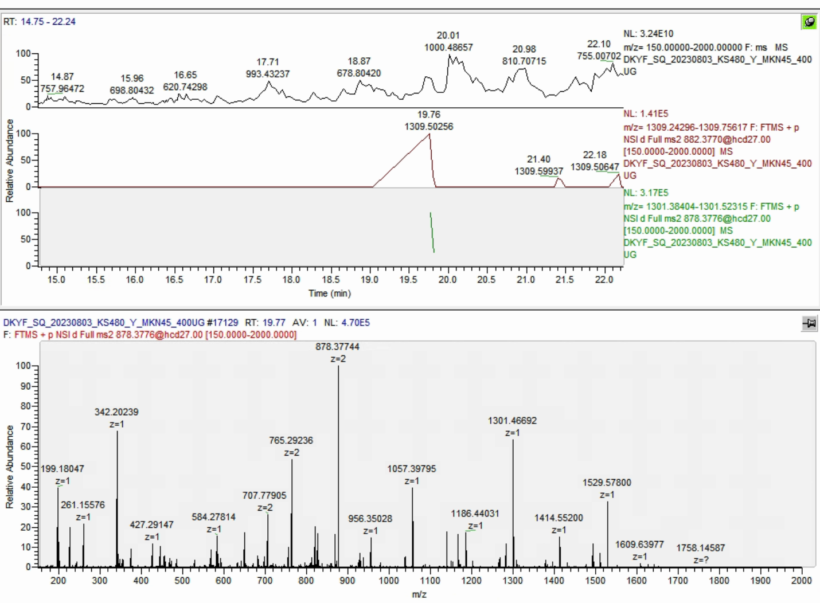
Fragment of heavy peptide
Fragment of light peptide
Fragment of light peptide

