Slide 1

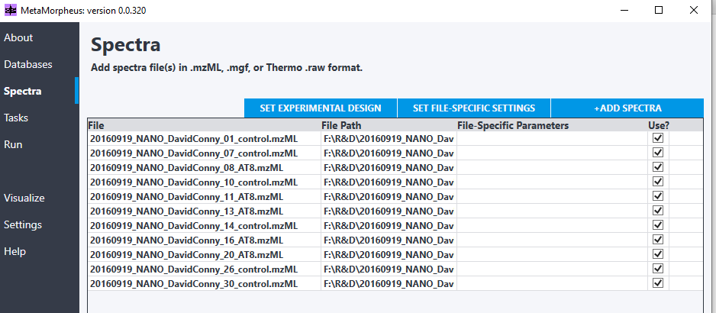
MetaMorpheus Search procedure. Used to generate search results from Hondius data (.wiff → .mzML via MS Convert)

Slide 2
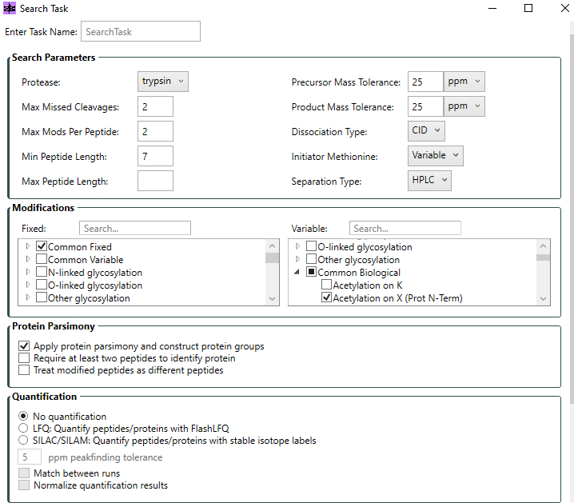
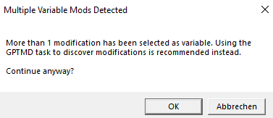



MetaMorpheus Search procedure. Used to generate search results from Hondius data (.wiff → .mzML via MS Convert)

Slide 3
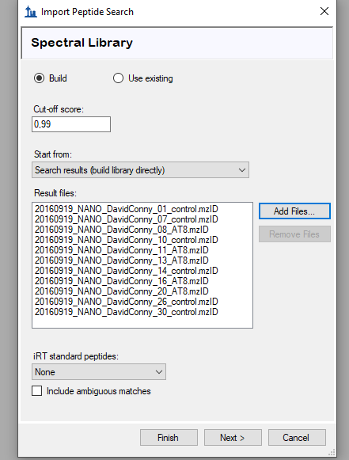
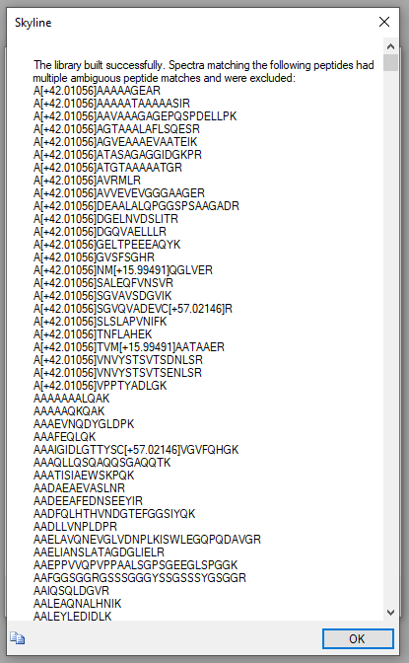
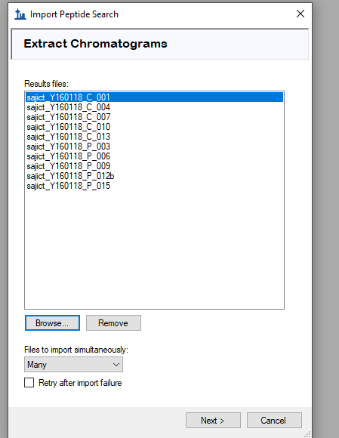

Using the Forchelet DIA data for this
Import DIA search

Slide 4
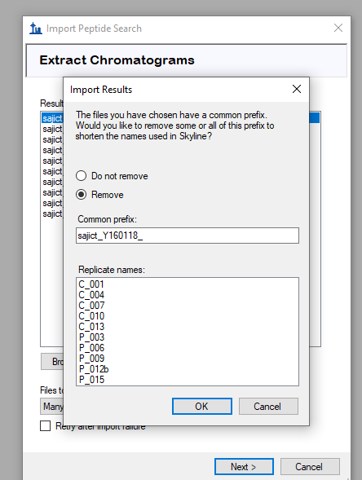
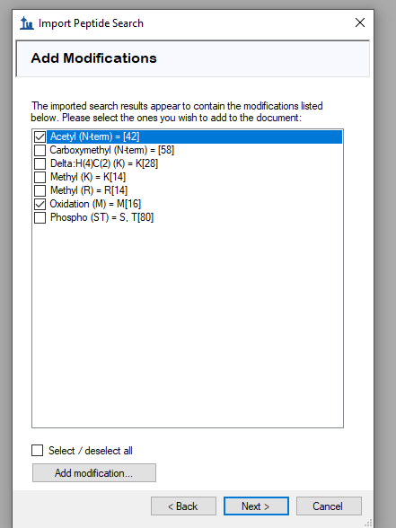
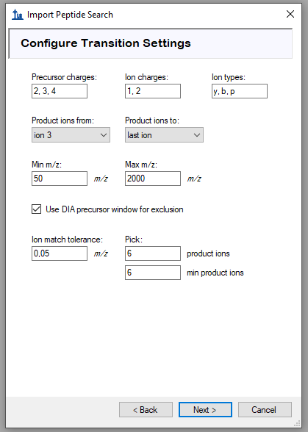

Import DIA search

Slide 5
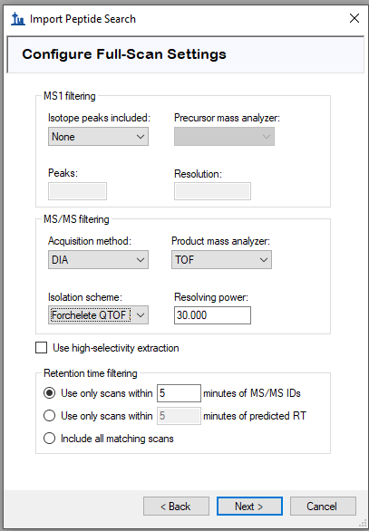
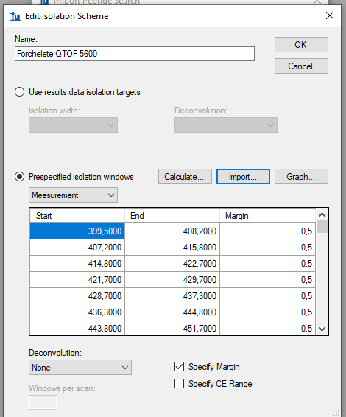
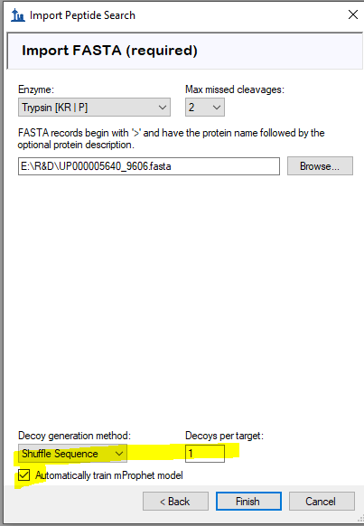





Fasta is Human proteome from Hondius study
Used a .wiff file from Forchelet data to let Skyline figure out windows
Import DIA search

Slide 6
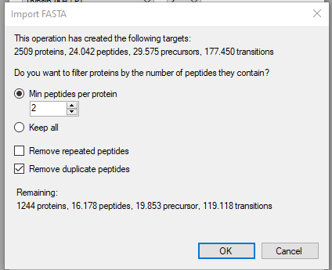
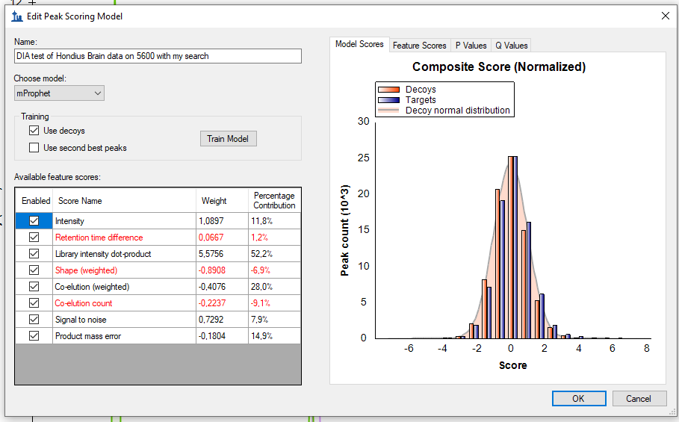



Import DIA search

