Slide 1
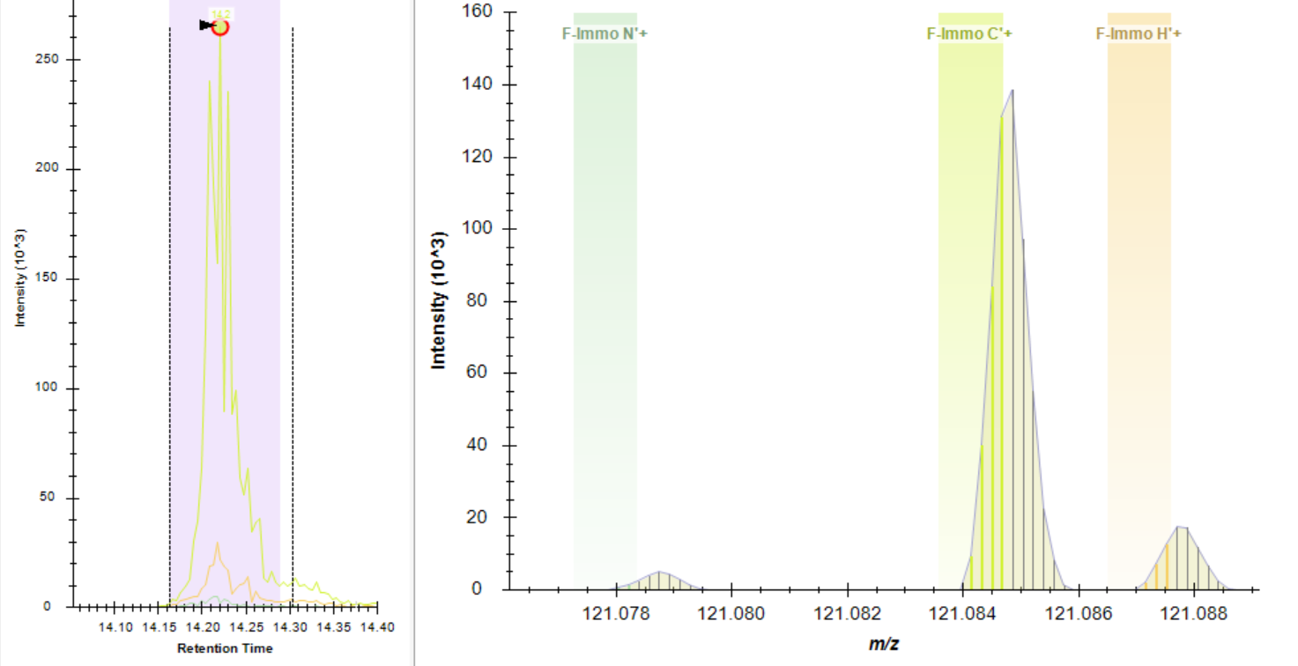
Mass error
Mass error
Mass error
MS/MS at 120K resolution
XICs

