Slide 1
ISSUES with pepXML in TPP

Slide 2
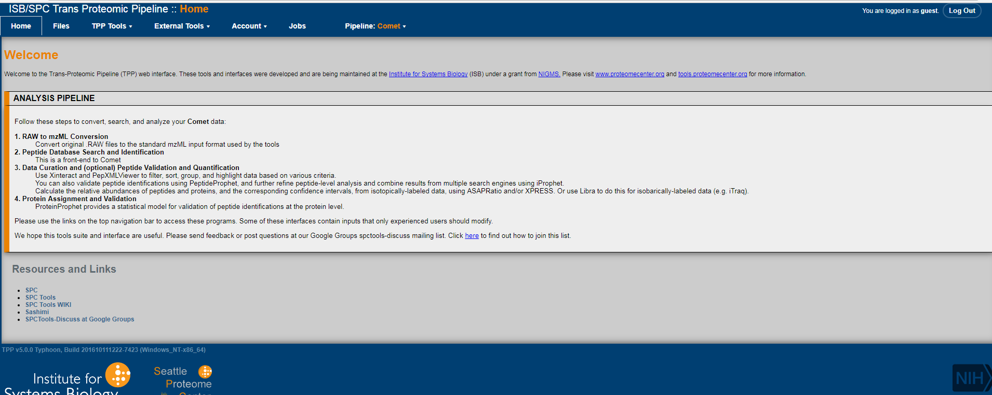
Double click TPP (installed in desktop icon as shortcut) – This tab is opened in the google chrome browser

Slide 3
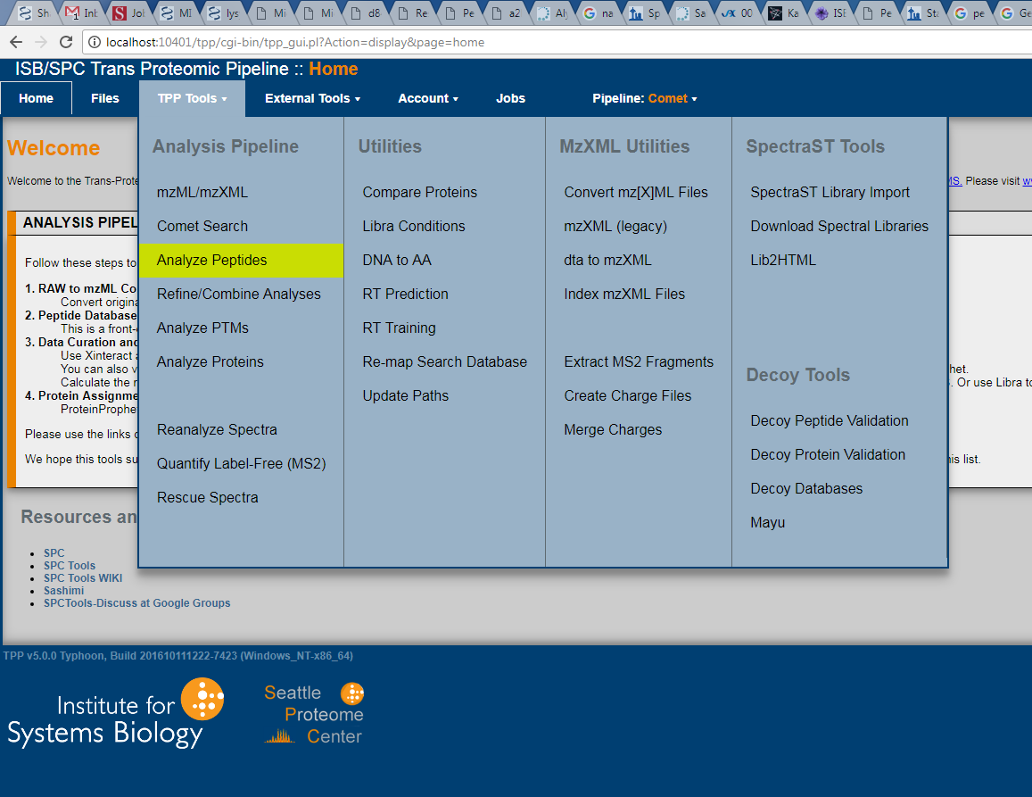
Clicked on “Analyze Peptides”

Slide 4
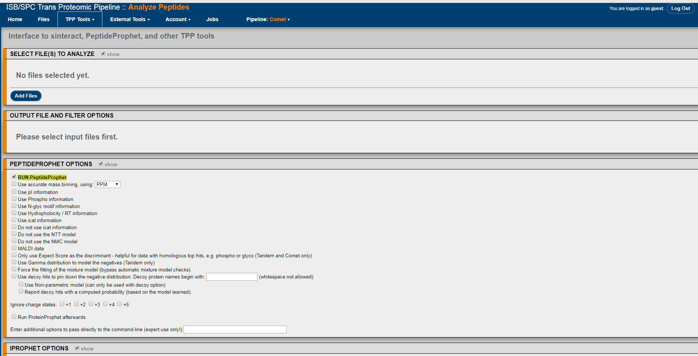
This window opens
The whole webpage is in the next screen shots- where all the parameters are available

Slide 5
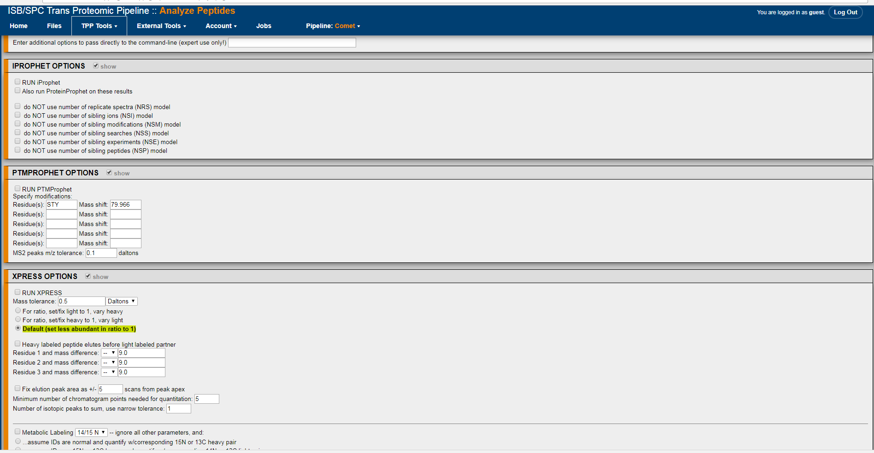

Slide 6
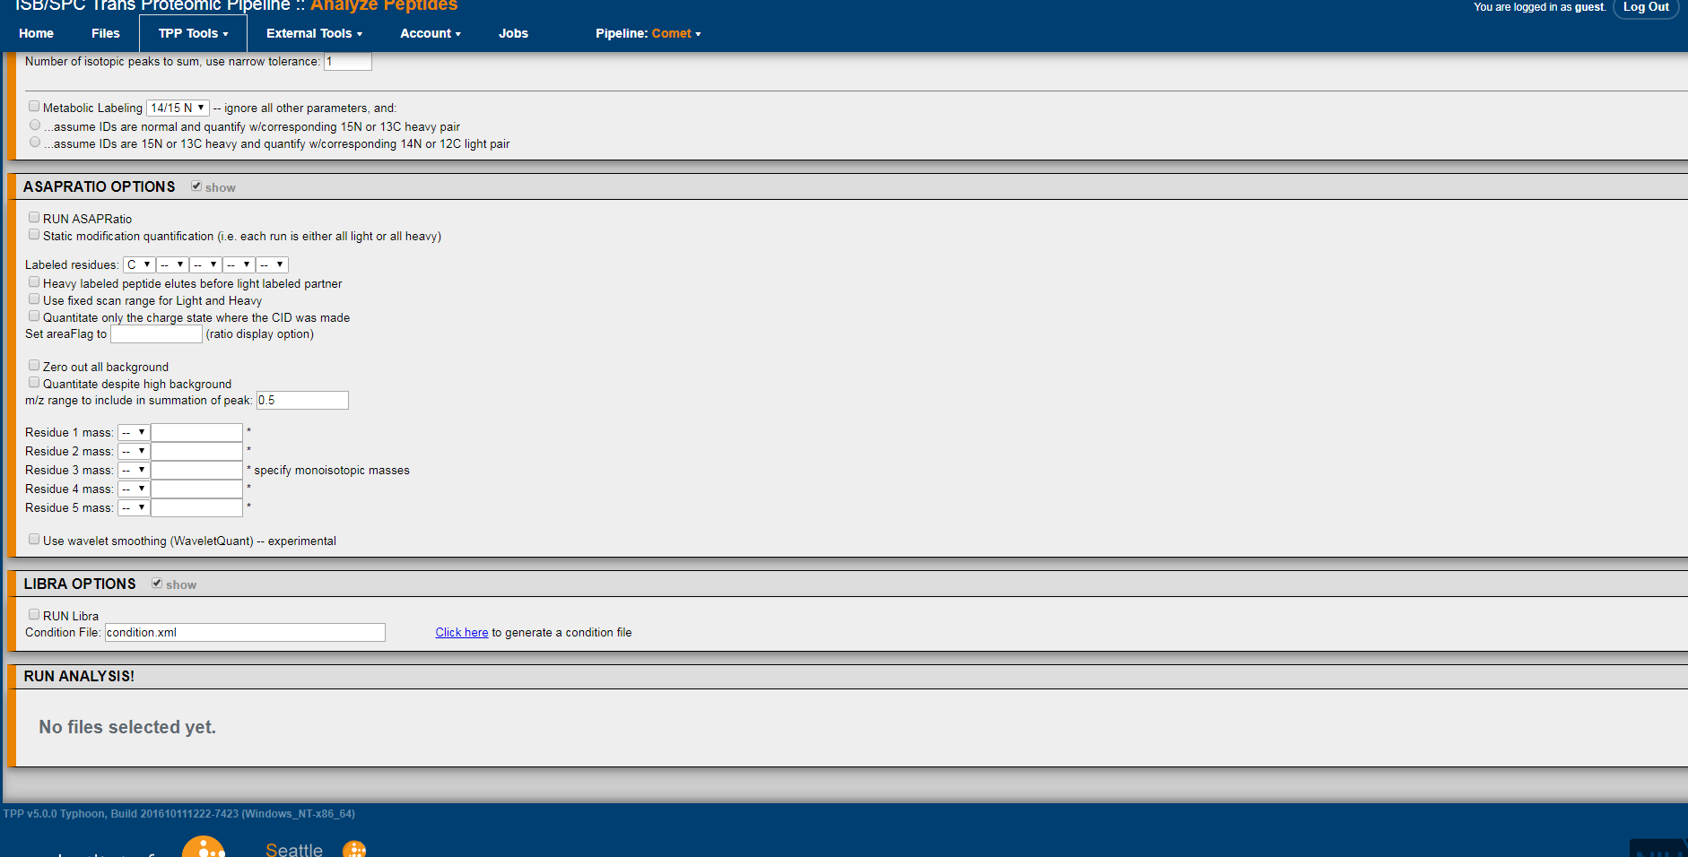

Slide 7
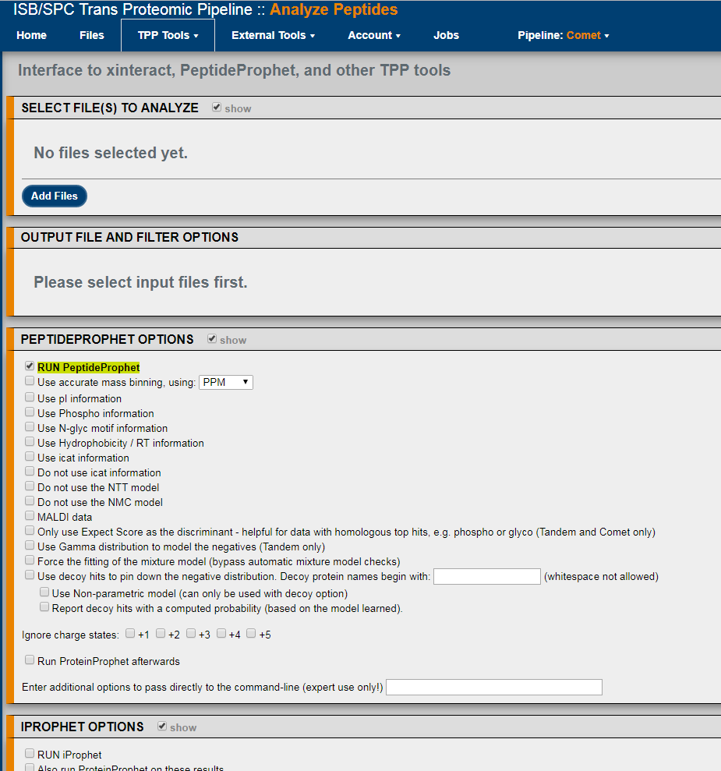
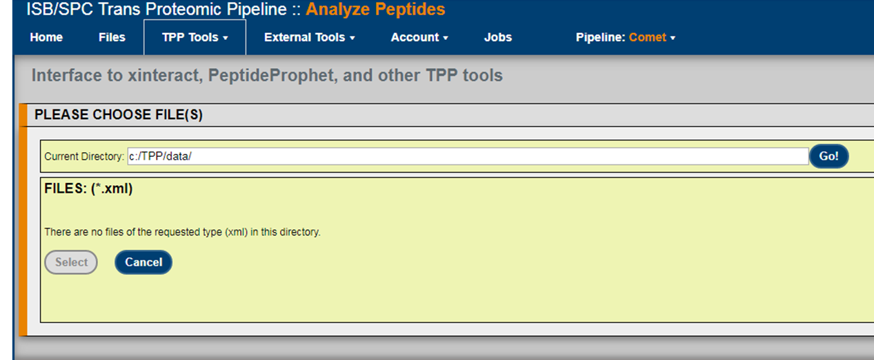
Then I click on “Add files”

Slide 8

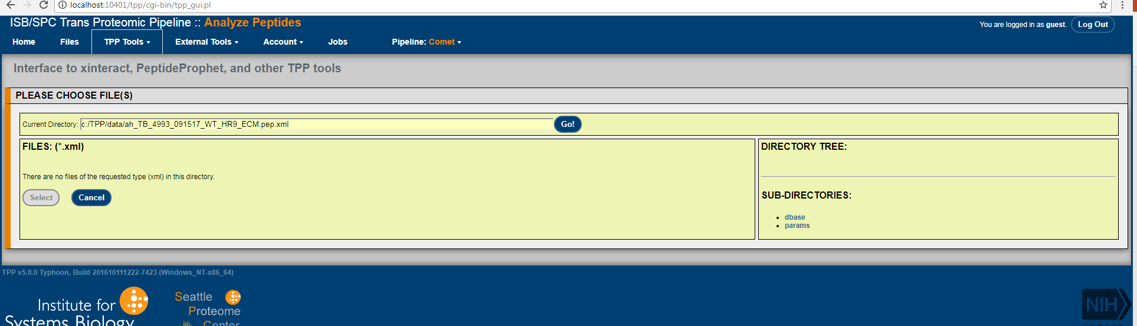
Then I keep the data with renaming it in the same directory “c:/TPP/data/”
FILE renamed “.pep.xml”
Then I write the name of the file here and hit “Go”

Slide 9
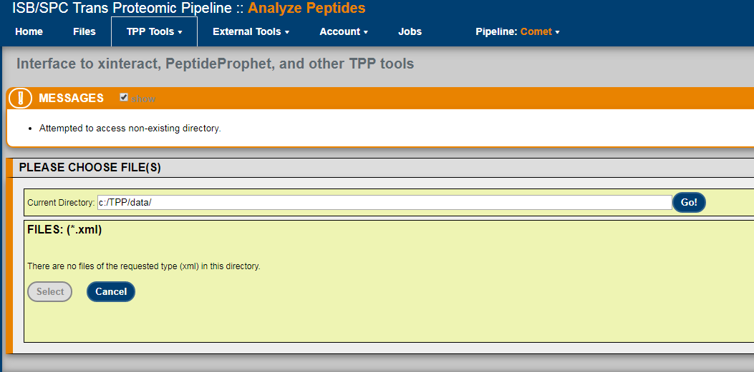
THE FILE NOT LOADING IN TPP TO RUN PEPTIDE-PROPHET
This is what I see after clicking on “Go” to load the file

Slide 10
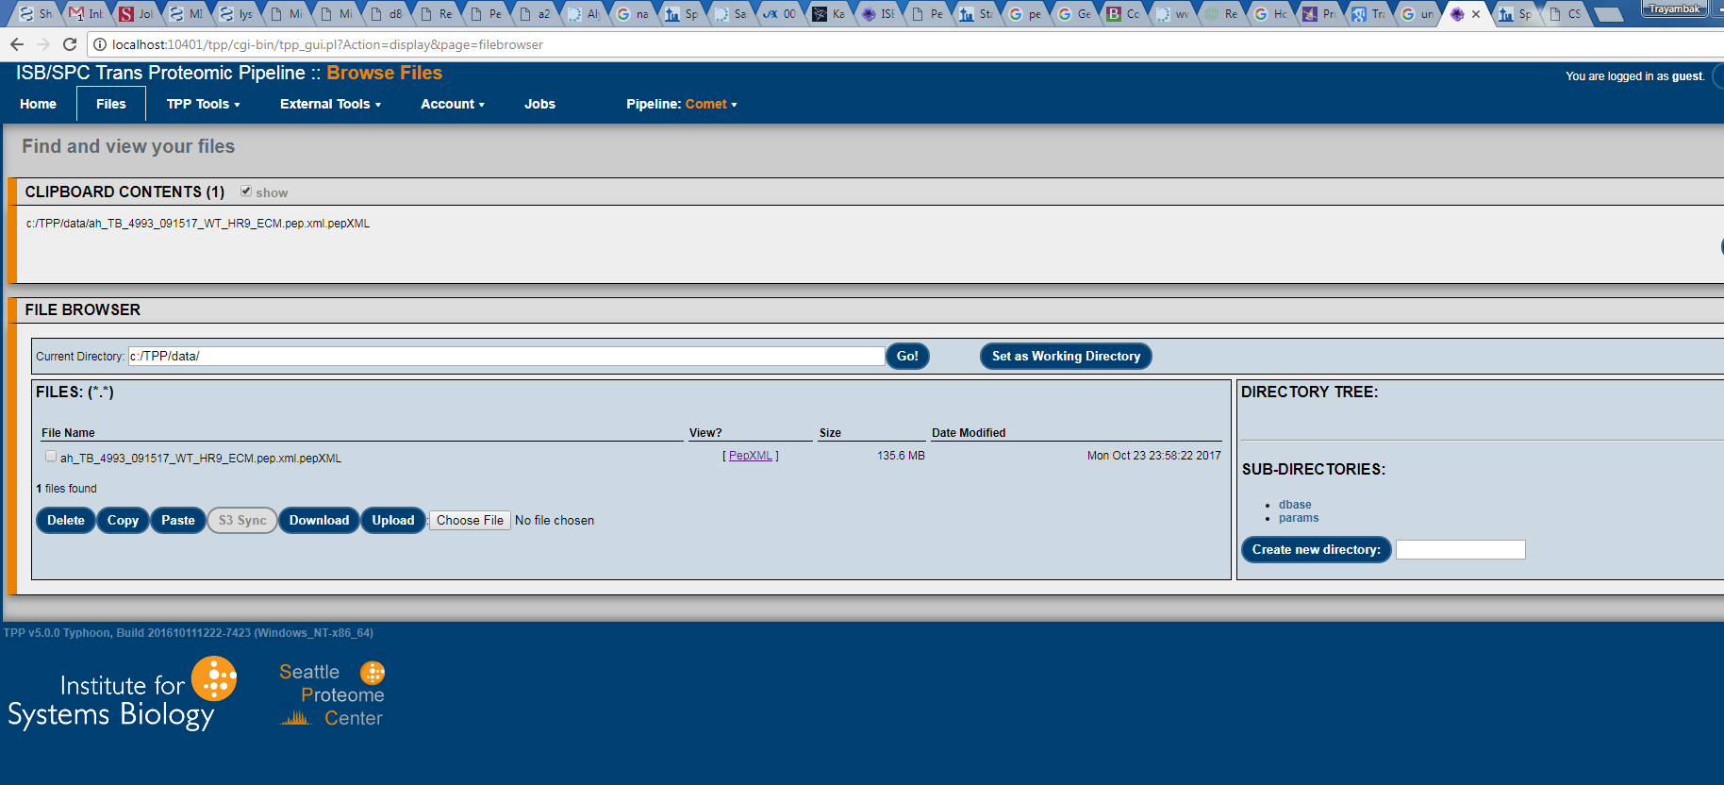
However, I can upload the data in the “File” tab

