Slide 1
2 analyzes were performed with the same sample
Before thermo software update (version 3.3):
1 ) Assay : Injection with the Sure Quant method we designed
After thermo software update (version 3.5) :
2) Assay : Injection with the Sure Quant method → some peptides were not detected
On the next slides: screenshot of the chromatogram for the same peptide with skyline or freestyle :
As you can see, skyline truncates the peak while it’s complete on freestyle.

Slide 2
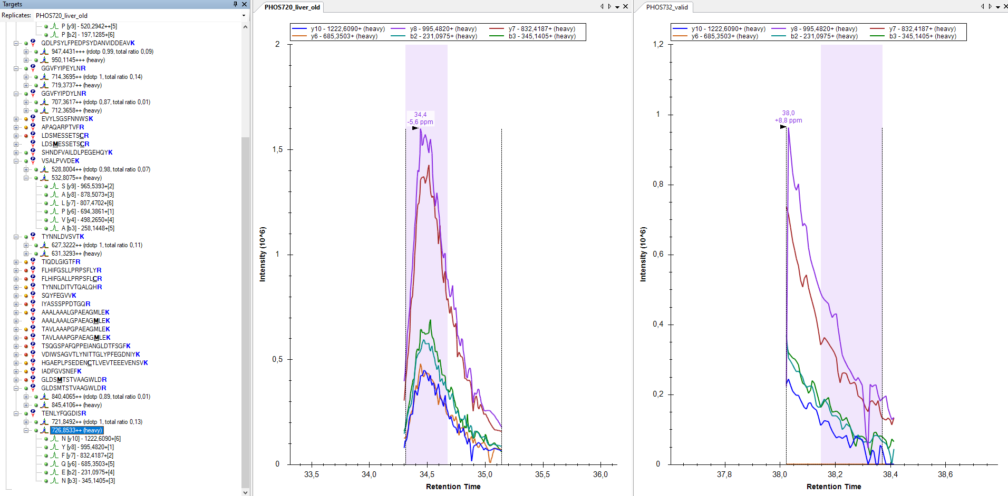
1
2

Slide 3
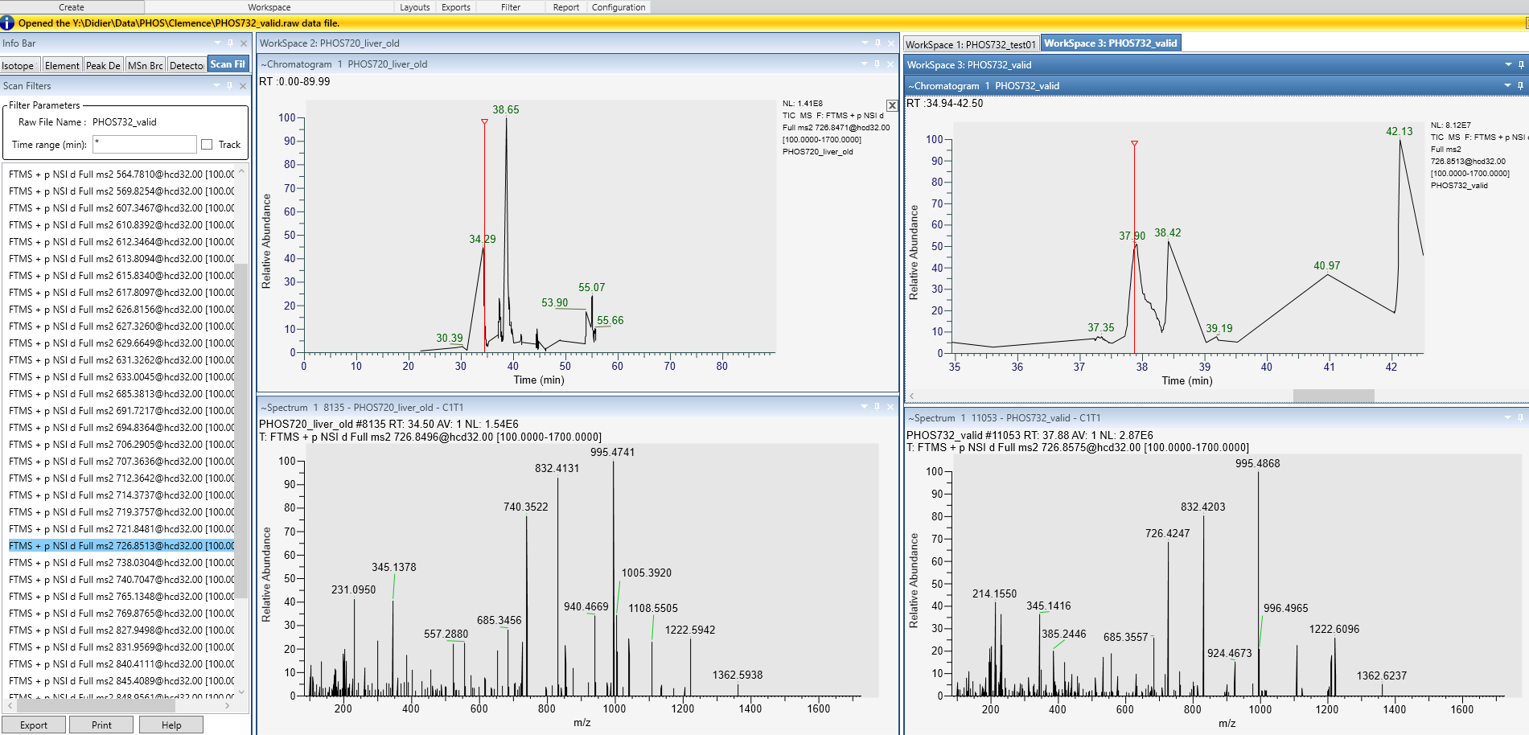
1
2

