Slide 1
Number of precursor detections with different settings in “DIA test of Hondius Brain data on 5600 with my search.sky”
Nicholas Shulman
January 31, 2022

Slide 2
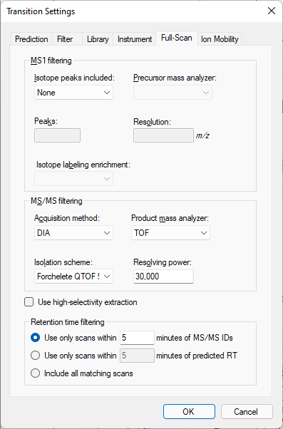
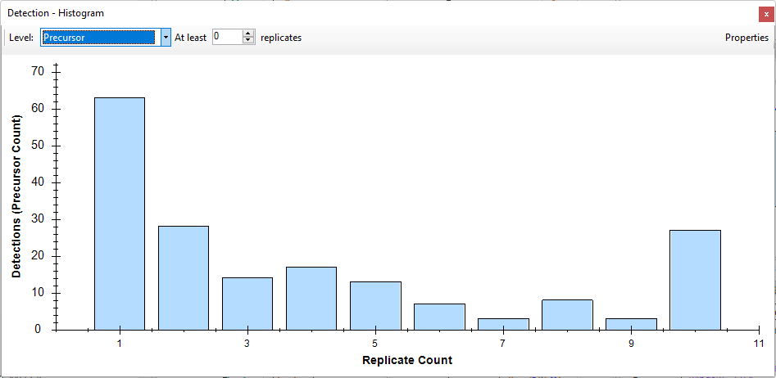
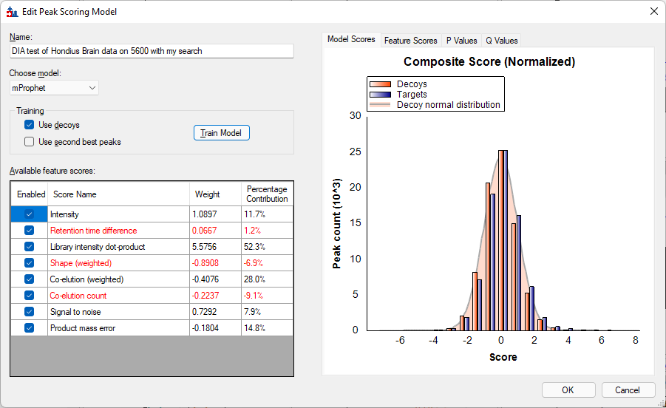
Original Skyline Document
Chromatograms are only extracted across a 5 minute interval around MS2 detections. The peak picking model is not very good, and only managed to confidently detect 27 precursors in all ten replicates.

Slide 3
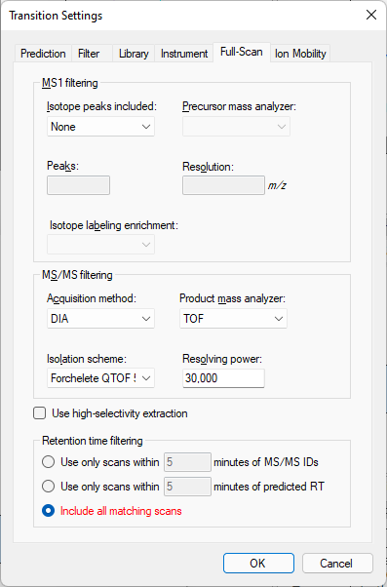
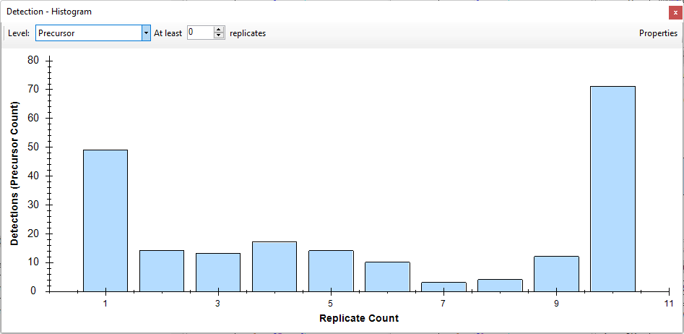
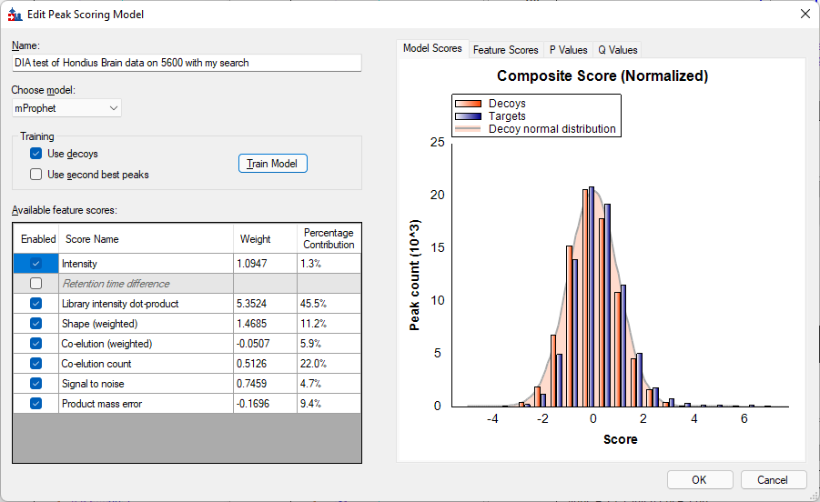
Turning of retention time filtering
When you change “Retention time filtering” to “Include all matching scans”, Skyline has more chromatogram data to work with, and the peak picking model improves.
71 precursors are confidently detected across all ten replicates.
However, when Retention Time Filtering is set that way, the “Retention Time Difference” score becomes unavailable.

Slide 4
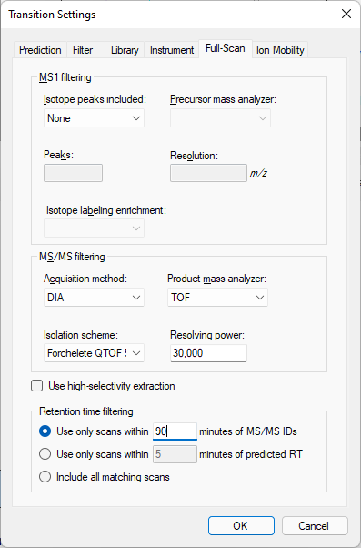
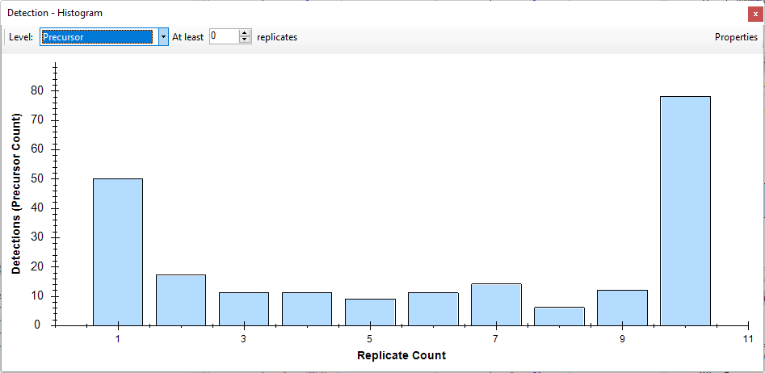
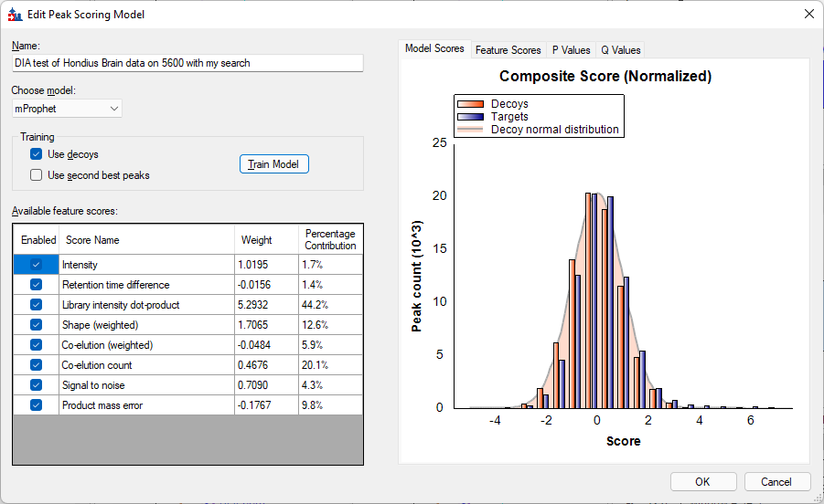
With Retention Times
If you change “Retention time filtering” to Use only scans within X minutes of MS/MS IDs, Skyline will use the MS/MS ID times for the retention time score. If you set X to a very large number, then you still end up with full gradient chromatograms. If you do all that, then 78 precursors are confidently detected across all ten replicates.

