Slide 1
CopyPasteProblemSkyline
090818

Slide 2
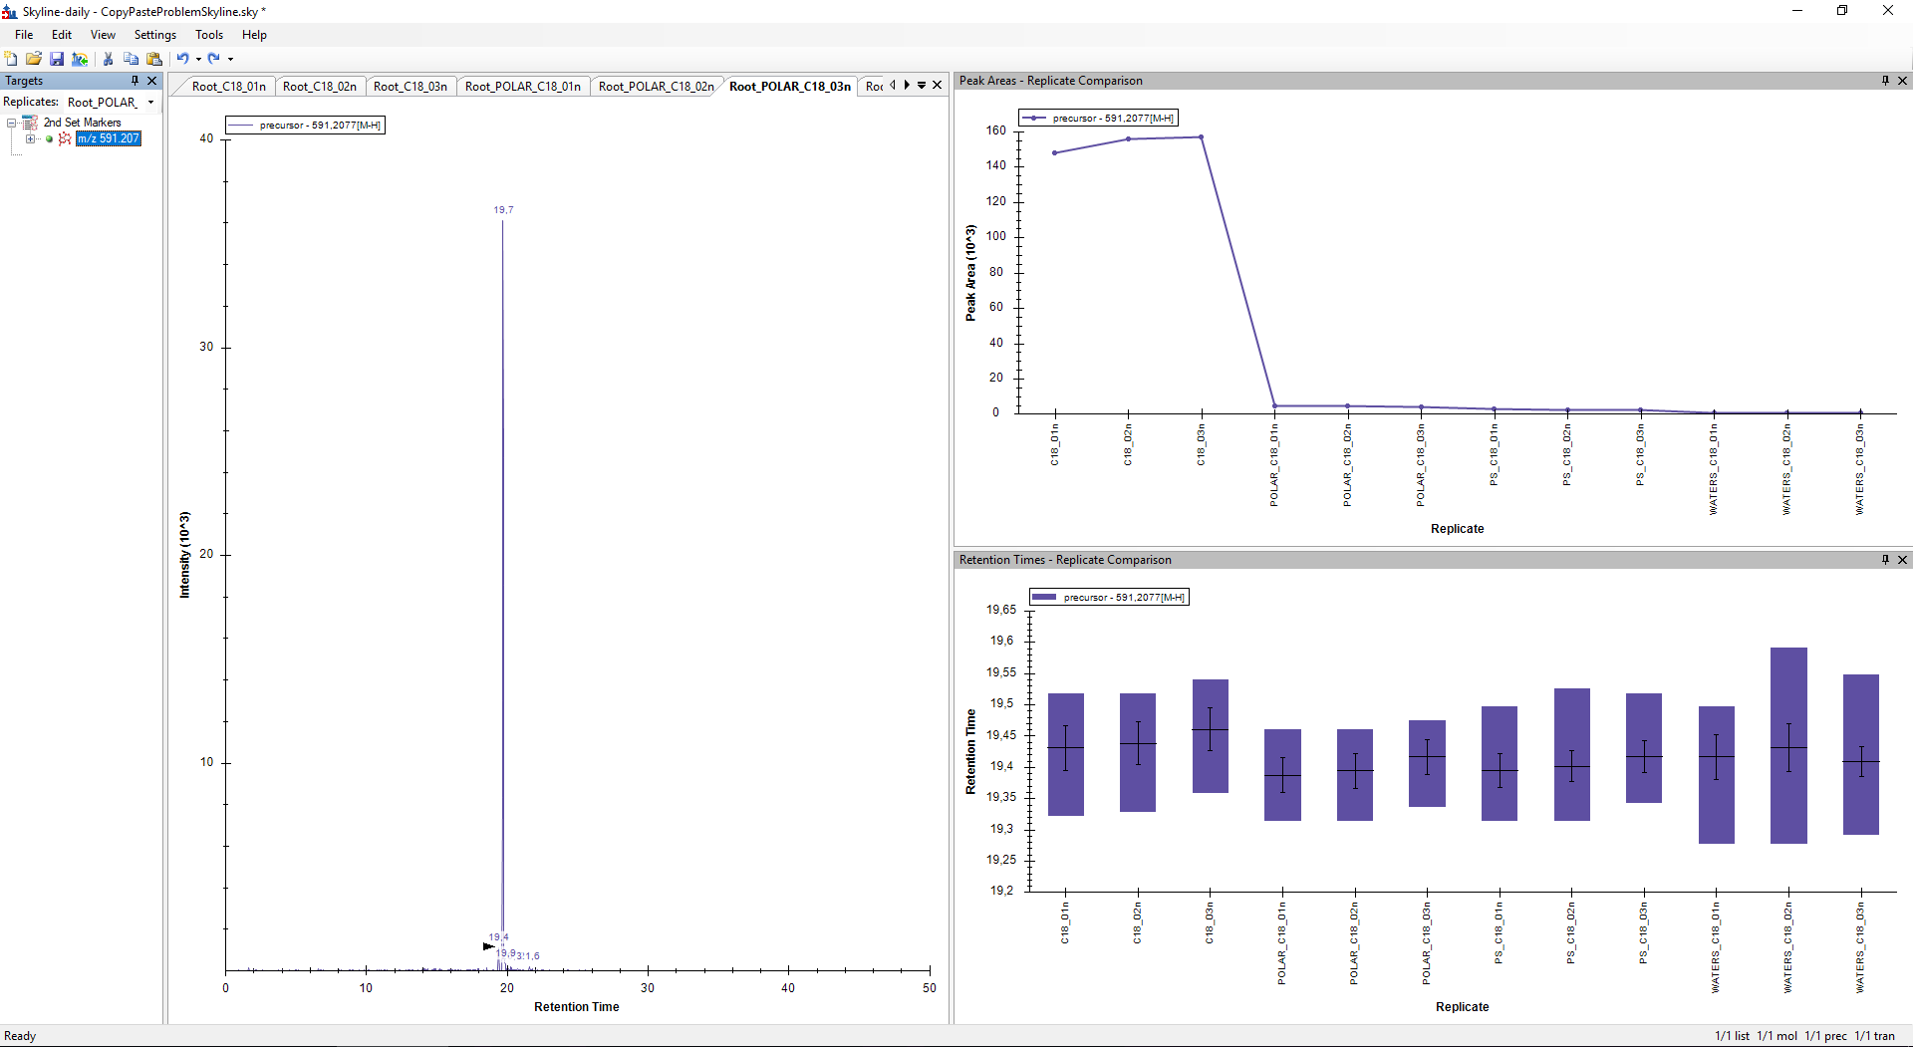
Failed to pick the highest peak
Picked peaks after importing

Slide 3
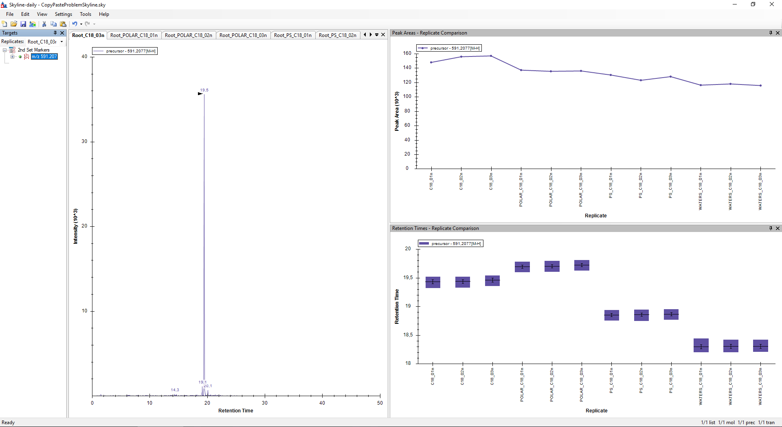
In all replicates the highest peak is selected
Adjusted picked peaks after importing (manually)

Slide 4
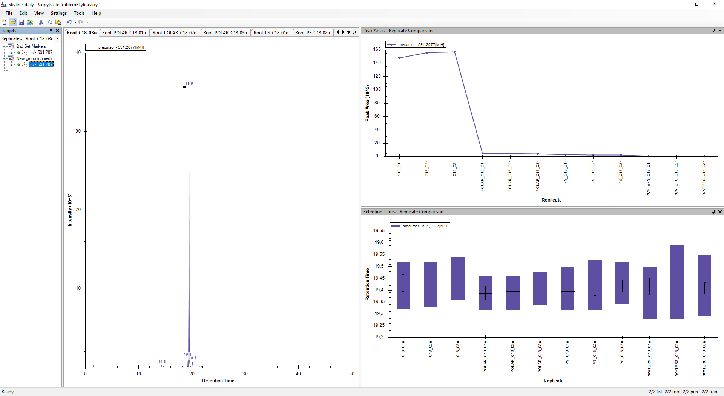
CopyPaste
Back to normal
Adjustments are lost after copying

