Slide 1
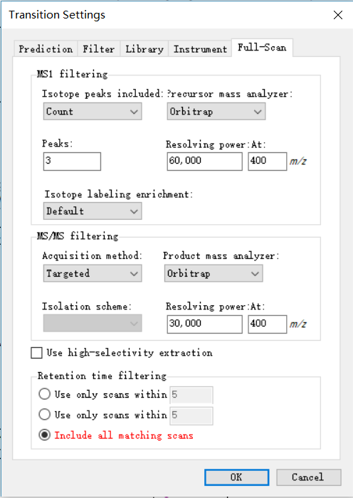
We selected the “Targeted acquisition method” and “Include all matching scans”

Slide 2
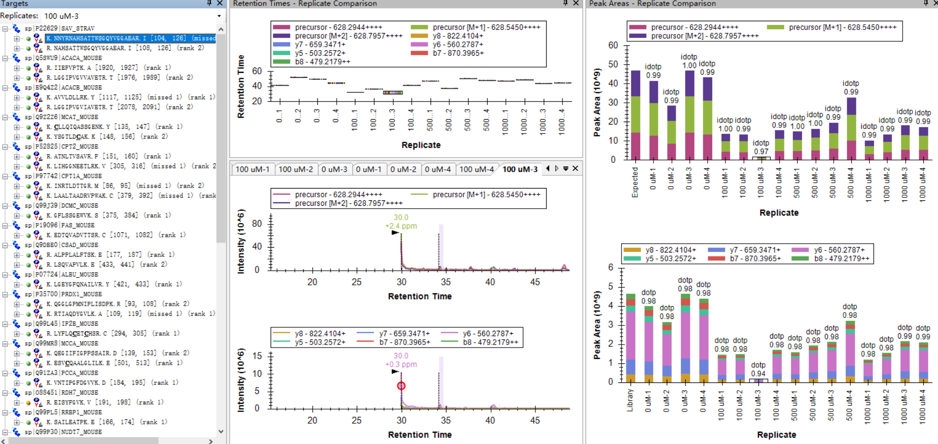
An incorrect time window for Group 100uM-3.

