Slide 1
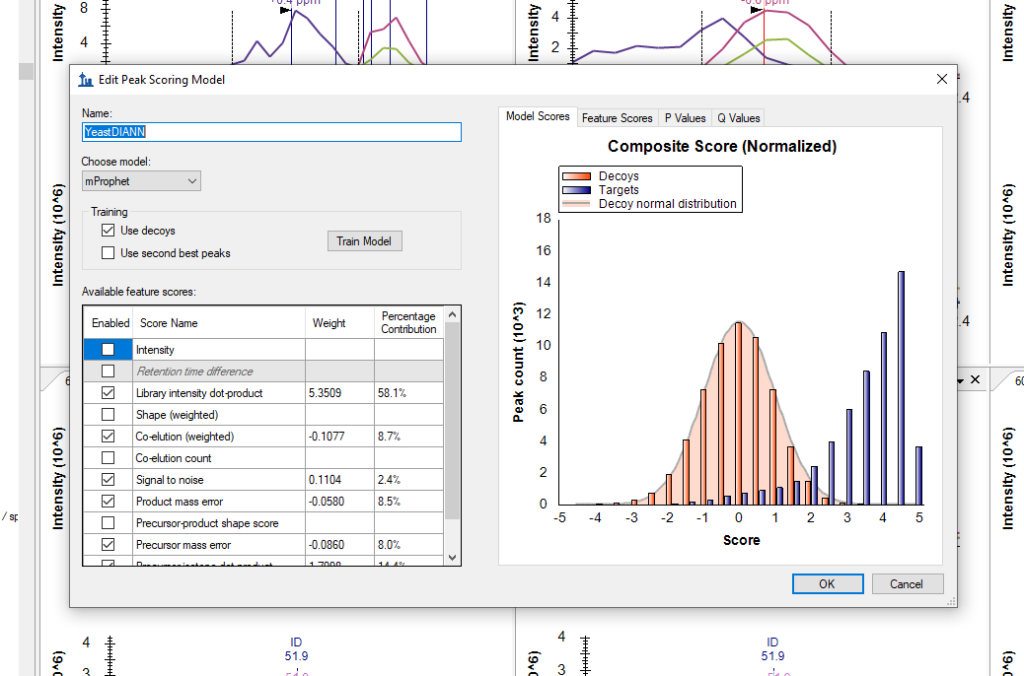

Slide 2
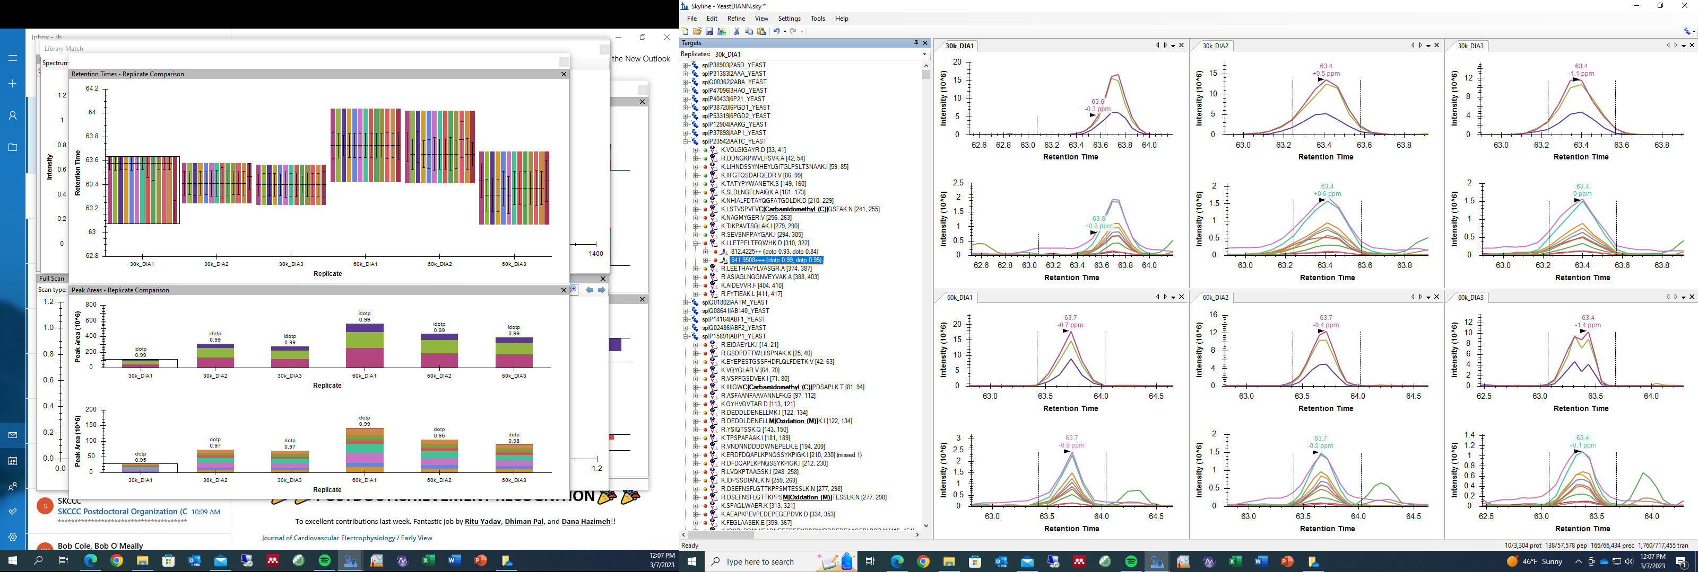
30k_DIA1 incorrect integration

Slide 3
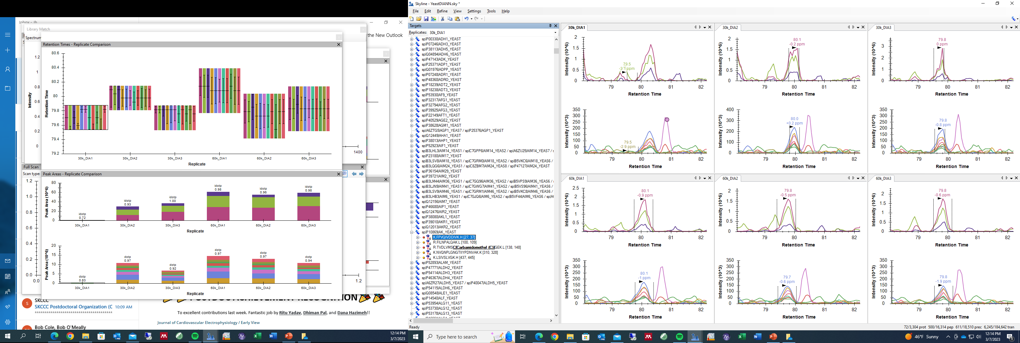
30k_DIA1 incorrect integration

Slide 4
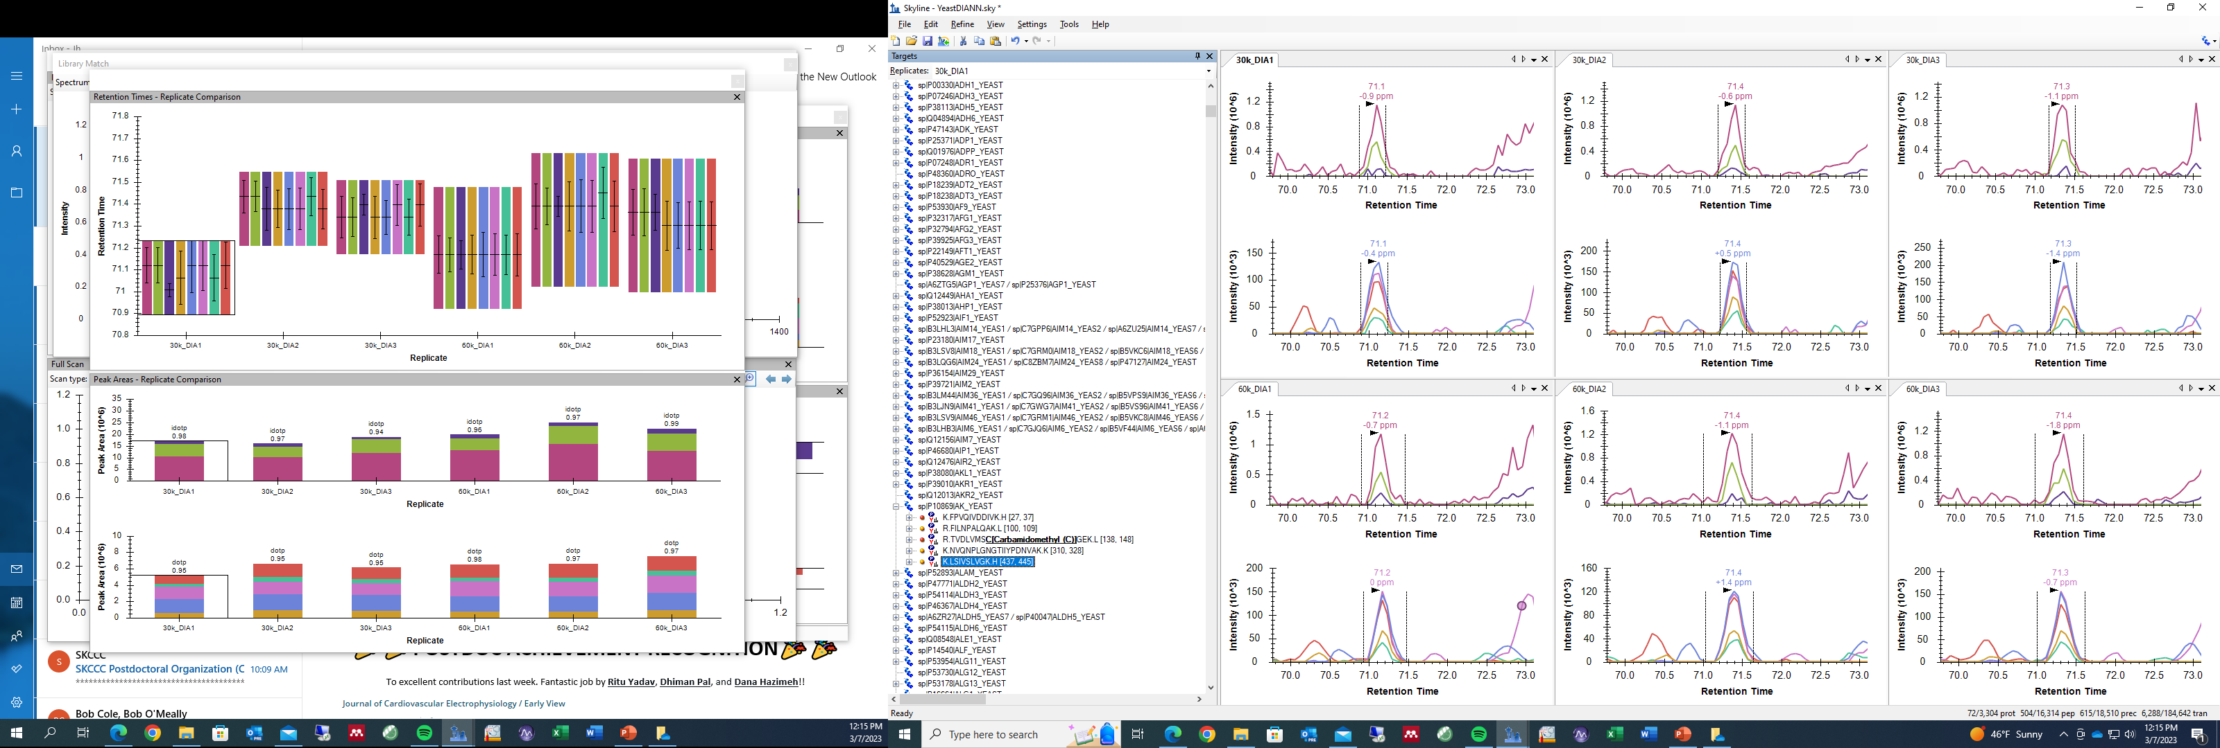
30k_DIA1 correct integration

Slide 5
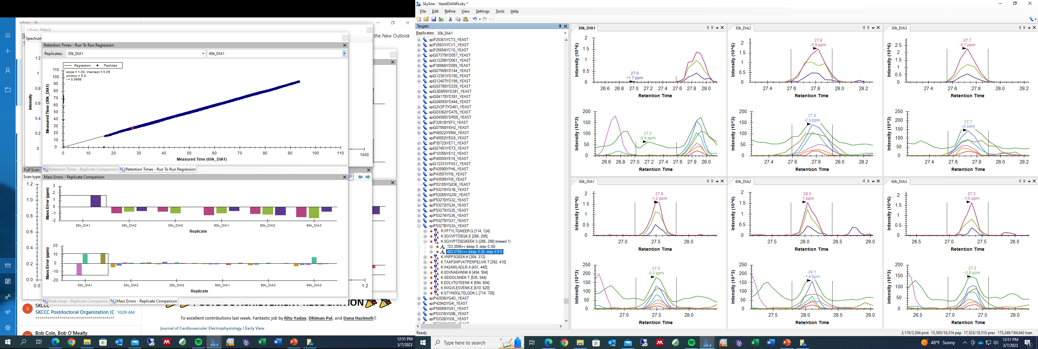
30k_DIA1 incorrect integration

Slide 6
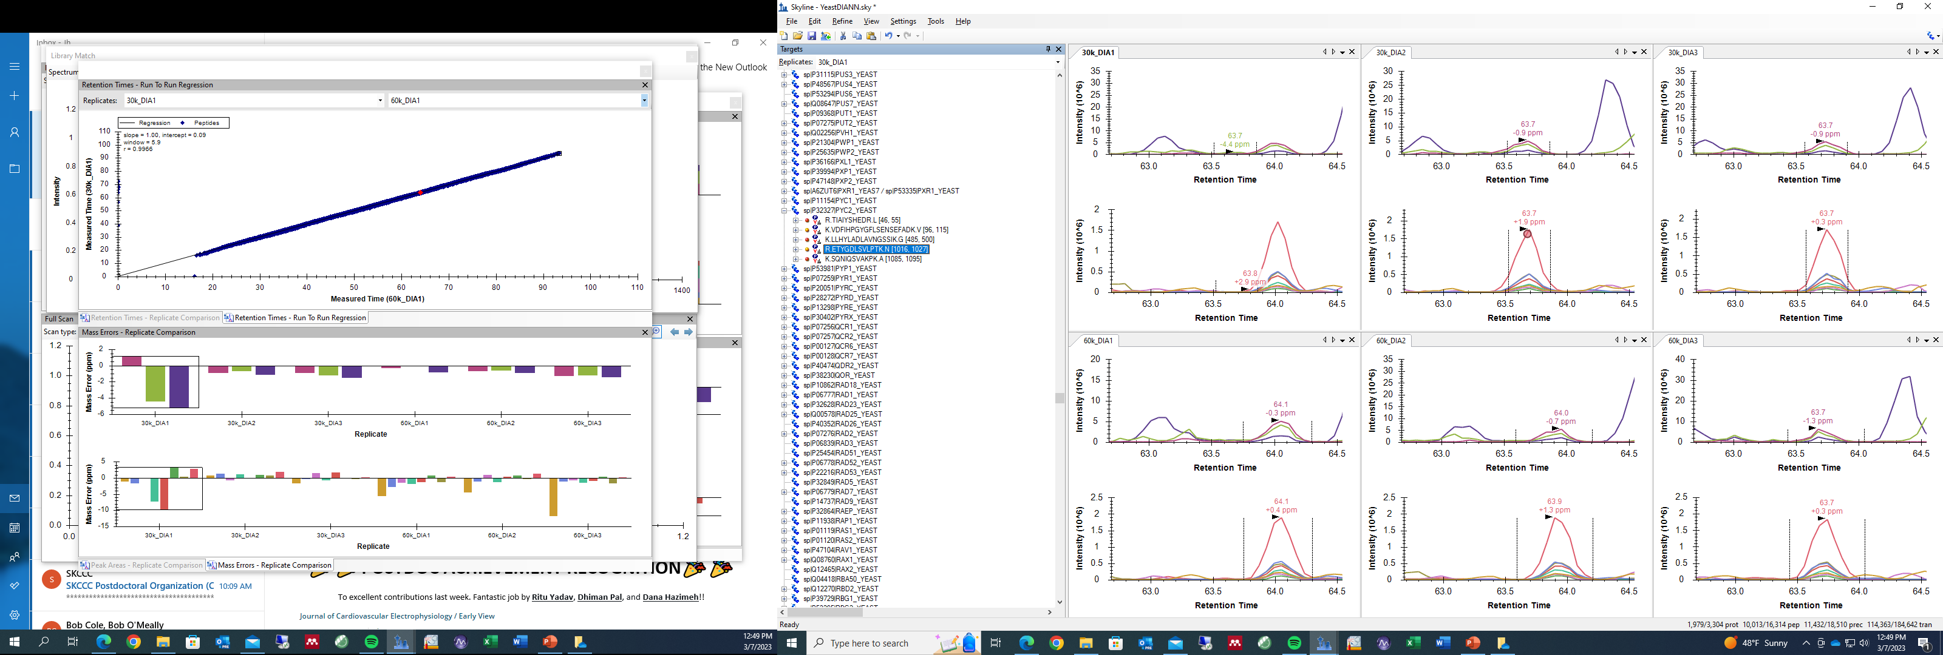
30k_DIA1 incorrect integration

Slide 7
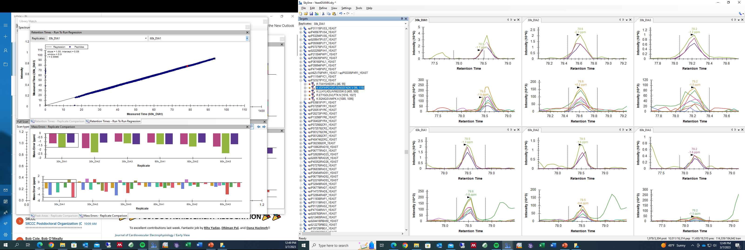
30k_DIA1 incorrect integration

Slide 8
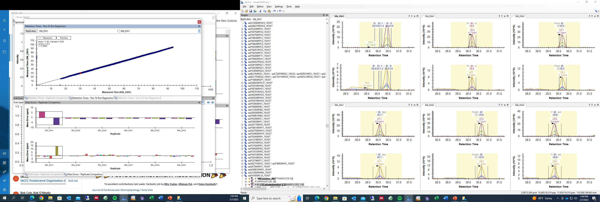
30k_DIA1 incorrect integration

Slide 9
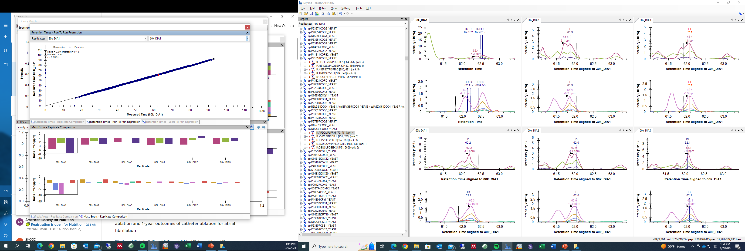
30k_DIA1 incorrect integration

Slide 10
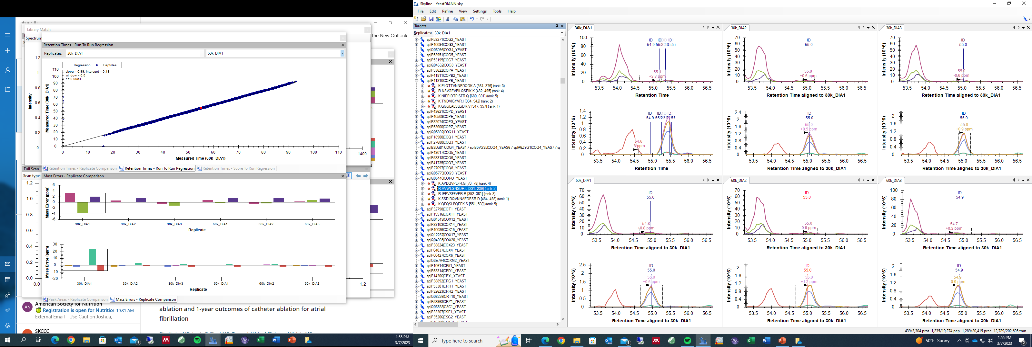
30k_DIA1 incorrect integration

