Slide 1
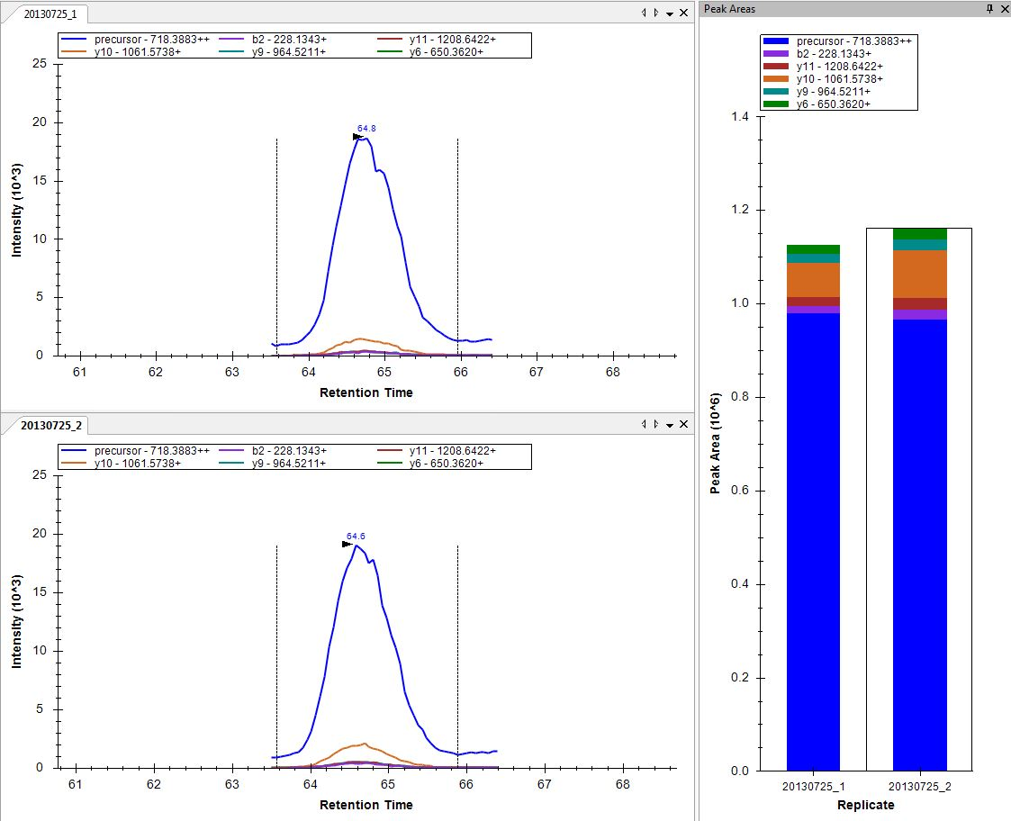
Abundant protein
Singly charged
doubly charged

Slide 2
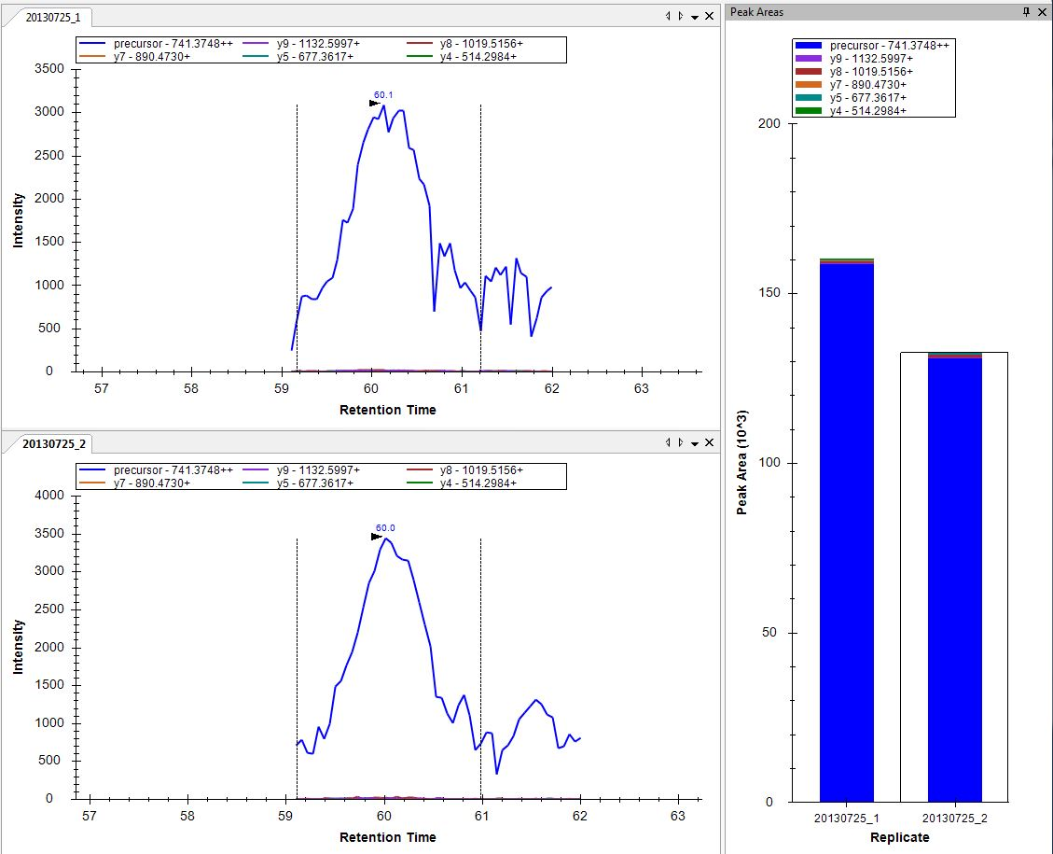
Singly charged
doubly charged

