Slide 1
Skyline
MS1 Data Import Issue
Doug Collins
7 Dec 2023
When a new project is started (transition list imported, raw data imported as Agilent .D files or Thermo .RAW files) the isotope prediction algorithm does not include the isotopologue of highest abundance (what we might think of as the “main” monoisotopic signal). Therefore the idotp does not get calculated correctly. I can fix this by simply saving, closing, and re-opening the Skyline file, which isn’t such a big deal, but this happens every time I start a new skyline file. Happens to my students also.
Occurred in version 22, continues in v23 recently downloaded, and also in the most recent Skyline Daily (7 Dec 2023)

Slide 2
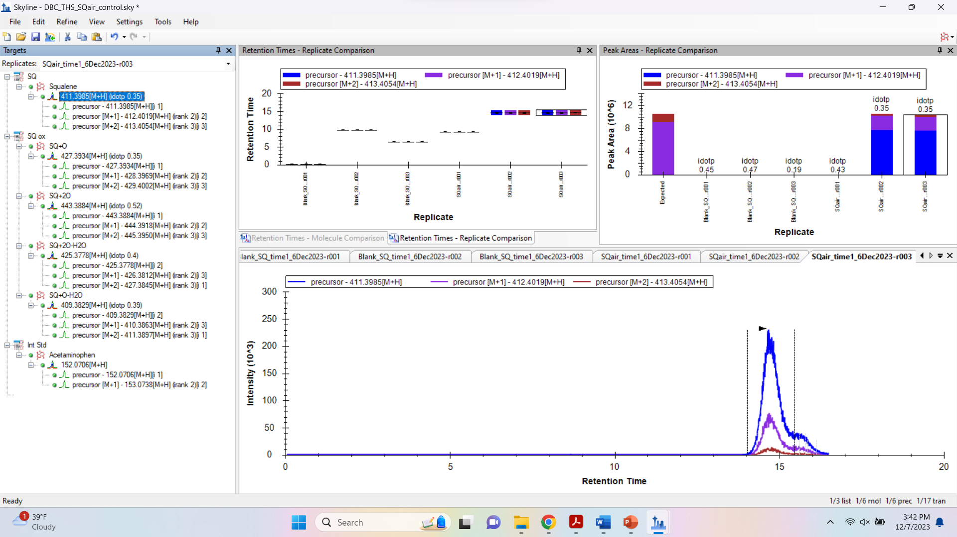

Slide 3
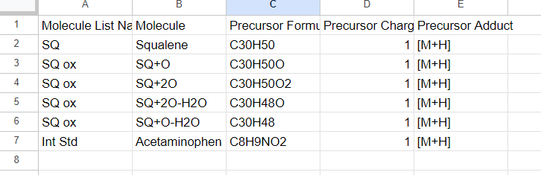
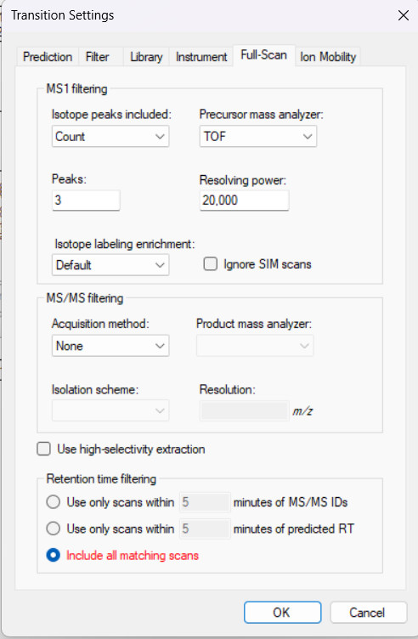
Skyline transition list that is imported via copy/paste (Ctrl+C, Ctrl+V): issue has occurred many times across different experiments/transition lists, including those copied from Google Sheets or MS Excel
Transition settings for experiments.
Issue occurs for both Agilent 6560 IM-Q-ToF data (Q ToF Only Mode, native .D files directly from instrument output)
and
Thermo Exactive Orbitrap (direct from instrument output)
The issue has been observed for MS1 data. Haven’t run as many targeted MS-MS lately, so I don’t know about that.

