Slide 1
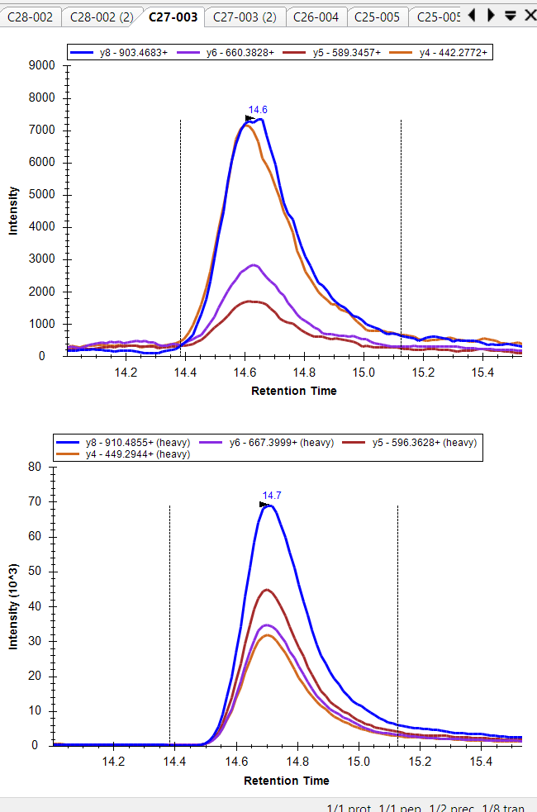
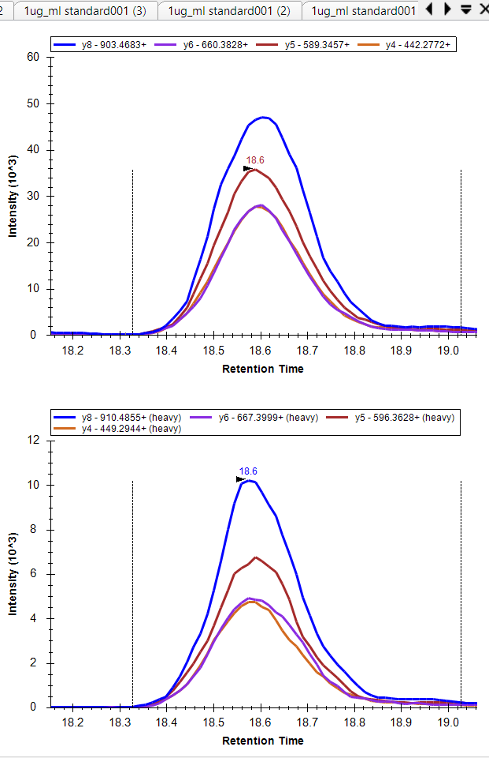
Endogenous rdotp=0.9 recombinant protein rdotp=1
Light
Spiked in
Heavy
peptide
y4 hidden under y6
* Note that slightly different HPLC gradient, hence different retention times

