Slide 1
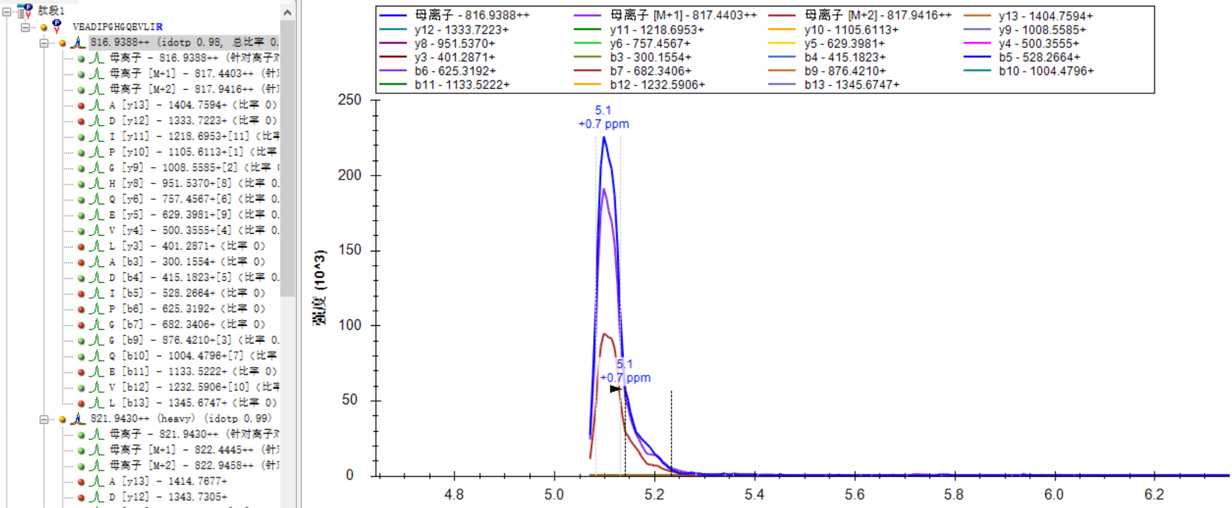
The peak isn’t intact and all of the transitions are shown in earlier version.

Slide 2
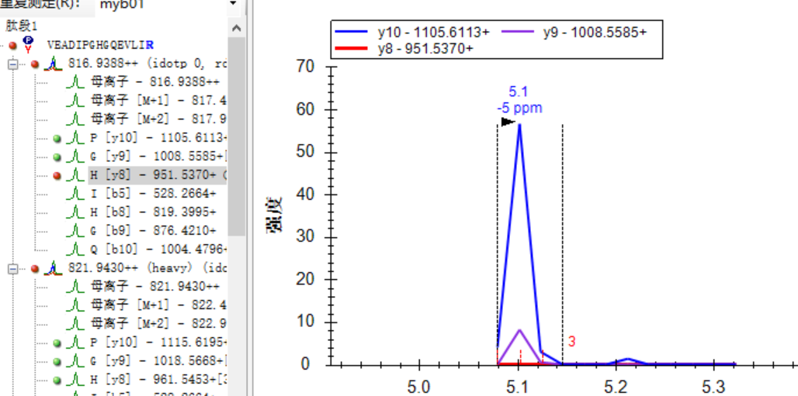
The latest released version also shows broken peak and only there transitions are shown which use the same MS data.

