Slide 1
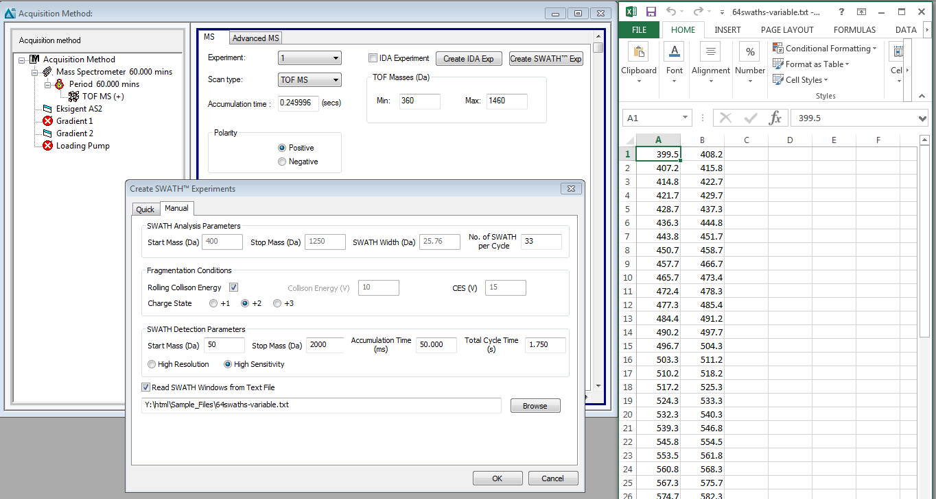
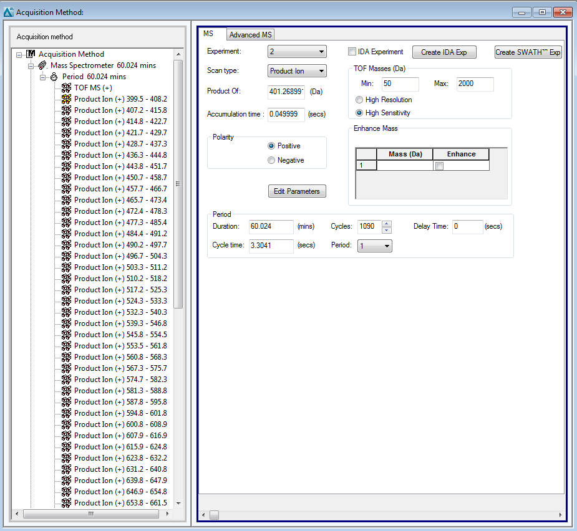
Acquisition method generation - Analyst 1.7 (Sciex TripleTOF 5600 / 6600)
1
2
3

Slide 2
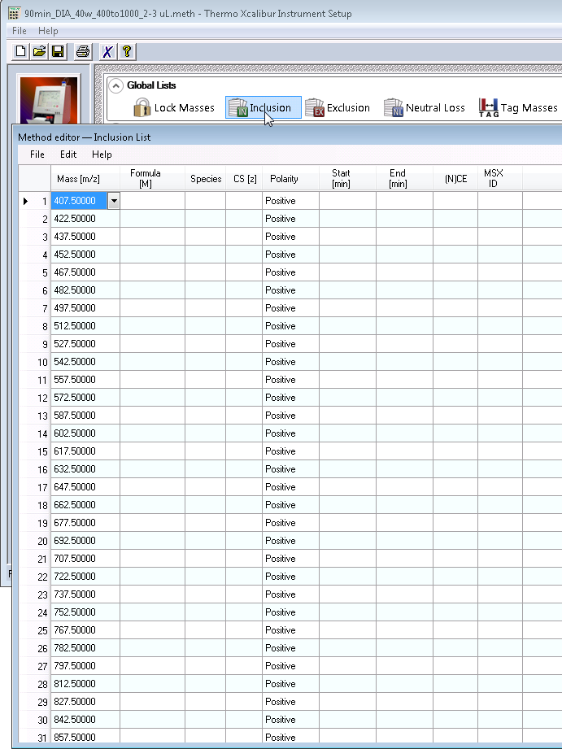
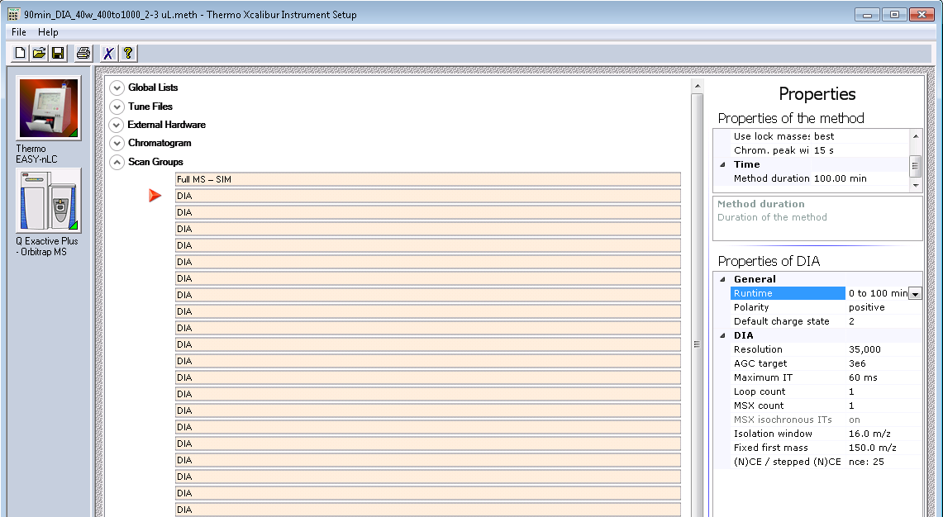
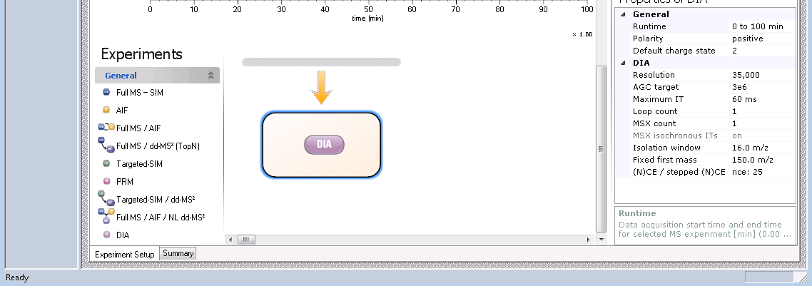
Acquisition method generation – Xcalibur 3.1 / Foundation 3.1 (Thermo Q Exactive)
Inclusion list
2
Center of the DIA window
1
Isolation window width

Slide 3
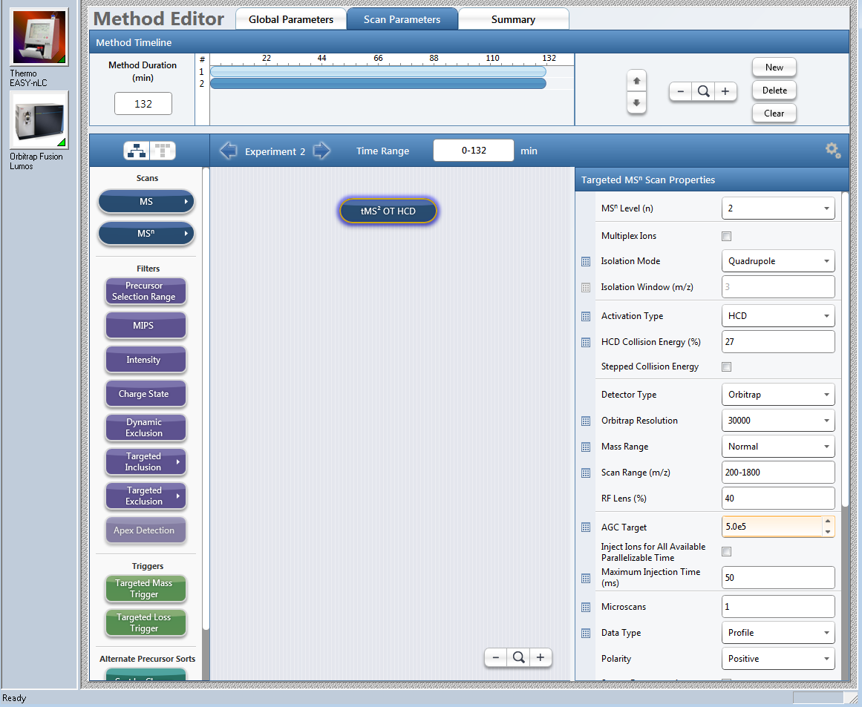
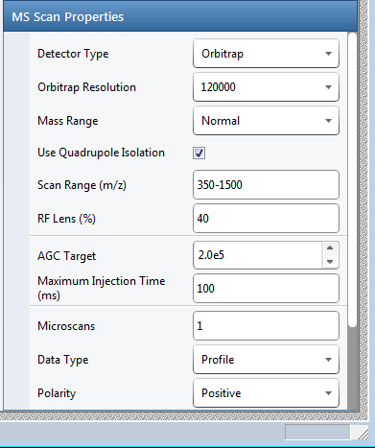
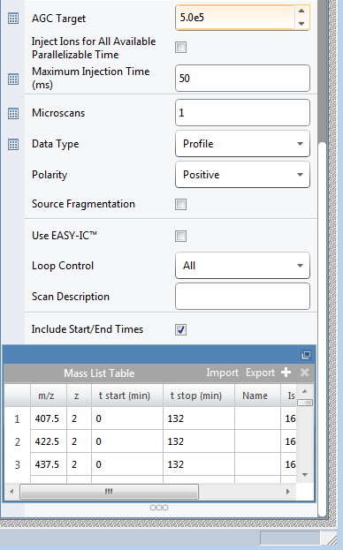
Acquisition method generation – Xcalibur 4 / Foundation 3.1 (Thermo Lumos)
MS OT scan
1
Center of the DIA window
2
Isolation window width

