Slide 1
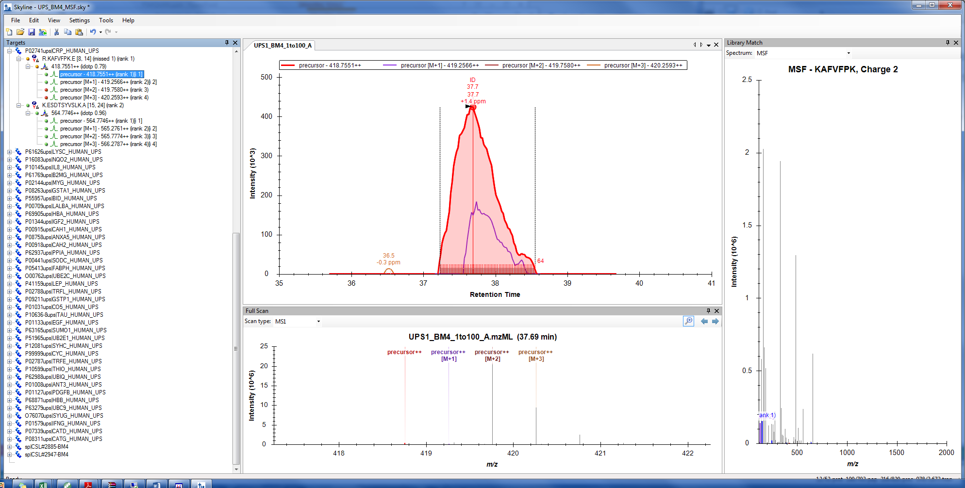
P02741ups ( 2 PEPTIDES)

Slide 2
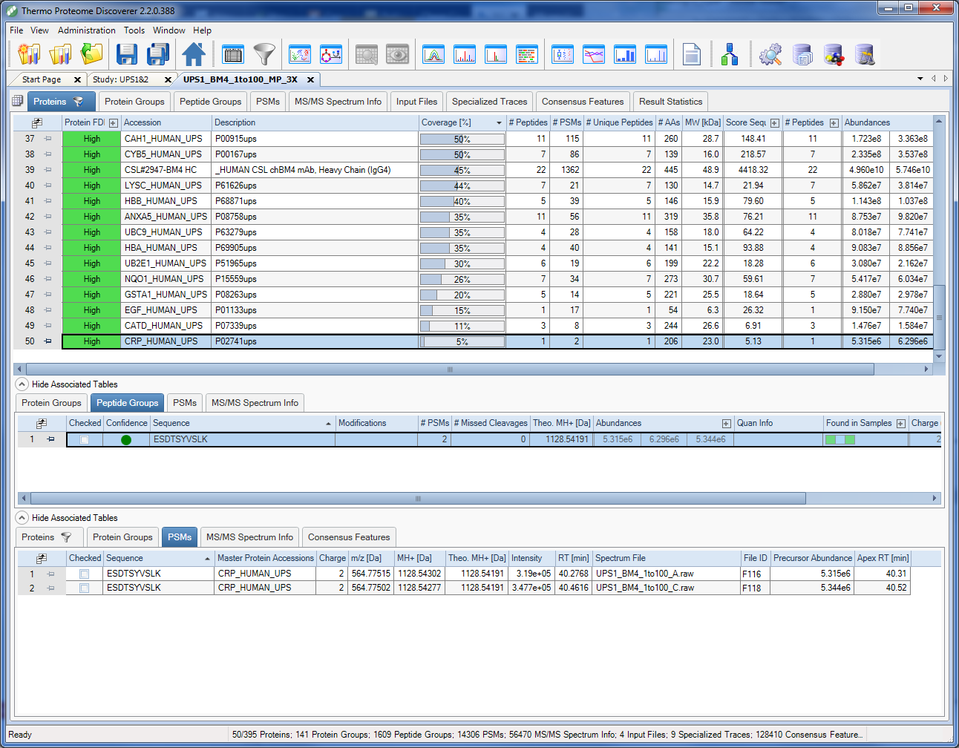
P02741ups ( 1 PEPTIDES)

Slide 3
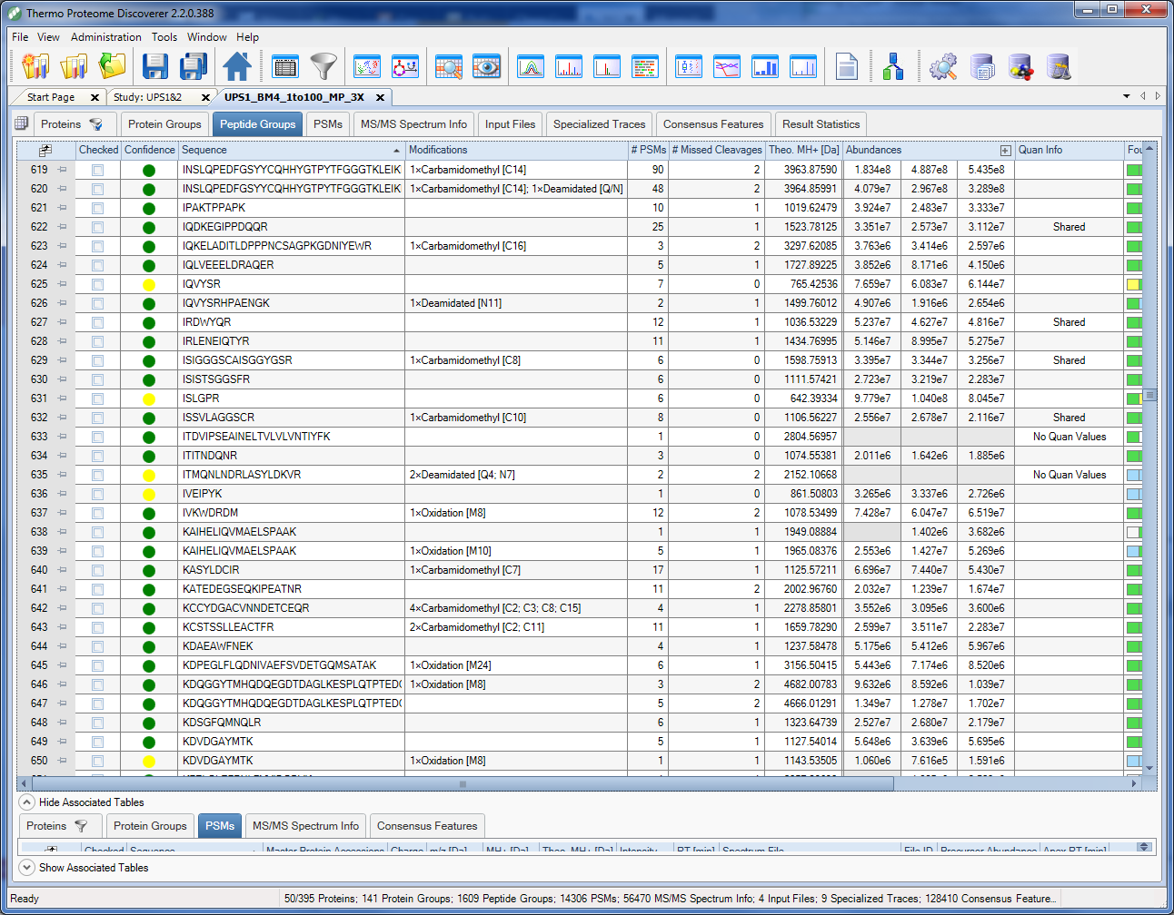
RELEVANT Peptide Groups ( Alphabetical)

Slide 4
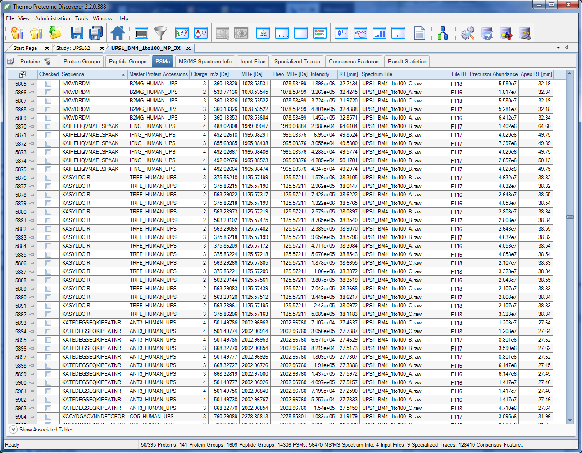
RELEVANT PSMs (Alphabetical)

